Slide 1
Spatial and Spatio-temporal
Data Uncertainty:
Modeling and Querying
Mohamed F. Mokbel
Department of Computer Science and Engineering
University of Minnesota
www.cs.umn.edu/~mokbel
mokbel@cs.umn.edu

Slide 2
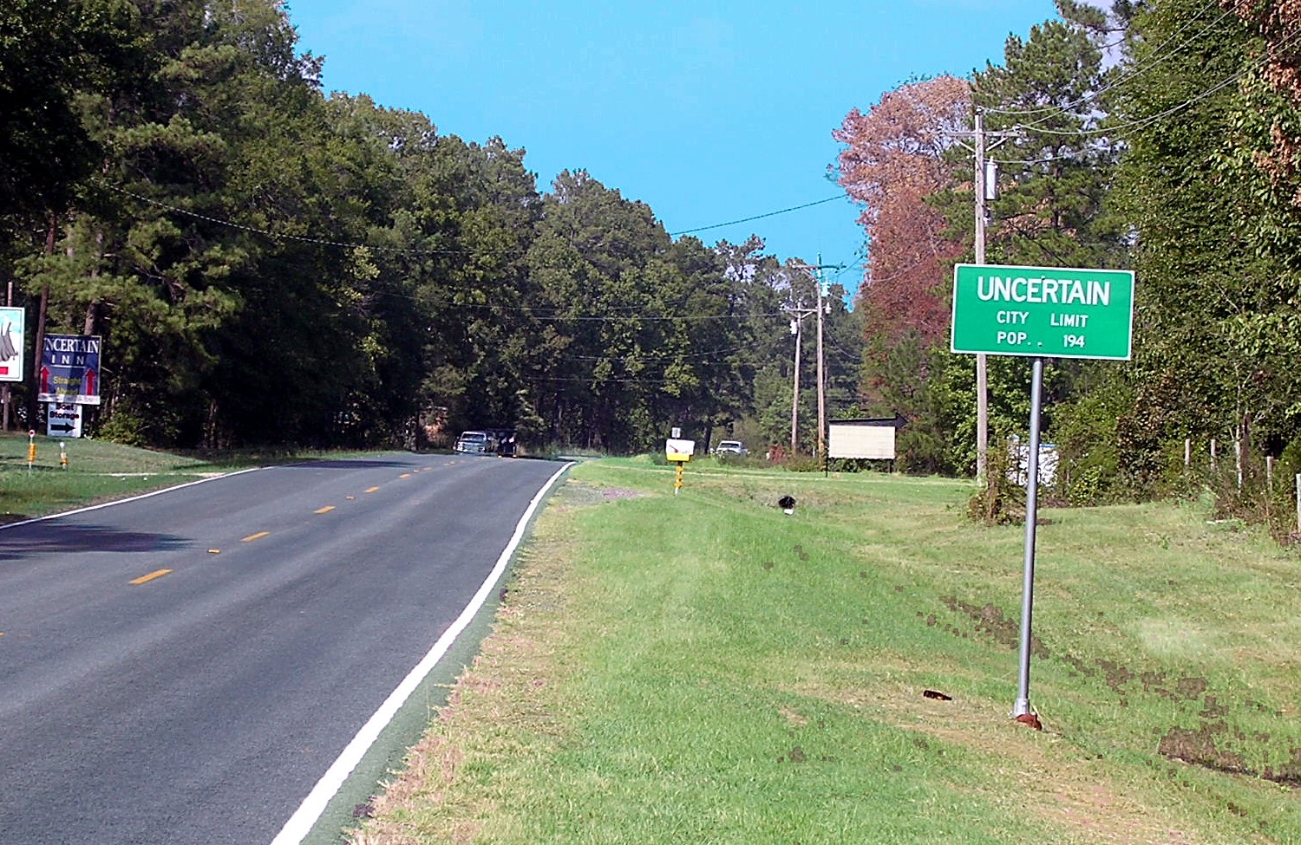
Talk Outline
Introduction to Uncertain Data
Reasons for Uncertain Data
Representation of Uncertain Data
Querying Uncertain Data
Summary

Slide 3
Certain Data: The Good Days
You trust whatever stored in a database
  Employee salary
  Banking information
  Flight reservation
Fuzzy information..!!
  Yes. It was there
  But not in a database
Data uncertainty
  The scale of uncertain data was not to the extent that needs data management techniques

Slide 4
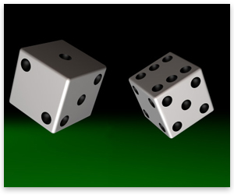
Data Uncertainty:
Different Kinds of Uncertainty
Defected data
  Completely erroneous data
Incomplete data
  Some data is missing
Probabilistic data
  A certain value is known to be true/defected with a certain probability
Range data
  The reading is in this range (uniform or normal distribution)

Slide 5
Data Uncertainty: Friend or Foe
Foe:
  Inaccuracy in device reading. Temperature reading
  Object movement & Network delay
Friend
  Privacy
  Less storage
  Expressing range of values: Menu price

Slide 6
Talk Outline
Introduction to Uncertain Data
Reasons for Uncertain Data
Representation of Uncertain Data
Querying Uncertain Data
Summary
6

Slide 7
Sources of Uncertainty: Inaccurate Reading
Sensor temperature reading
GPS reading
Cell phone locations
Affected queries
  Which sensor gives the highest temperature
  What are the sensors that give temperature between 30 and 40
  How many sensors give temperature over 40
43
45
39
35
Sensor X
Sensor Y

Slide 8
Sources of Uncertainty: Sampling
Range Queries
Current data
T₁
T₀+Є₂
T₀+Є₀
T₀
T₀+Є₁
Nearest Neighbor Queries
Historical data (Trajectories)

Slide 9

Sources of Uncertainty: Privacy
Example:: What is my nearest gas station
100%
Service
0%
100%
Privacy
0%

Slide 10
Talk Outline
Introduction to Uncertain Data
Reasons for Uncertain Data
Representation of Uncertain Data
Querying Uncertain Data
Summary
10

Slide 11
Uncertainty Representation: Ellipse
Given :
  Start point
  End point
  Maximum possible speed ➔ Maximum traveling distance S
If S is greater than the distance between the two end points, then the moving object may have deviated from the given route

Slide 12
Uncertainty Representation: Cylinders
Given:
  Start and end points
Constraint:
  An object would report its location only if it is deviated by a certain distance r from the predicted trajectory
r

Slide 13
Uncertainty Representation: Polygons
Given:
  Start and end points
Constraints :
  Deviation threshold r
  Speed threshold v

Slide 14
Talk Outline
Introduction to Uncertain Data
Reasons for Uncertain Data
Representation of Uncertain Data
Querying Uncertain Data
  Required changes in the query processor
  Range queries
  Aggregate queries
  Nearest-neighbor queries
Summary

Slide 15
Uncertainty-aware Query Processor
A new uncertainty-aware query processor is needed to deal with uncertain data rather than exact data
Traditional Query:
  What is my nearest gas station given that I am in this location
New Query:
  What is my nearest gas station given that I am somewhere in this uncertainty region

Slide 16
Data Uncertainty: Queries
Two types of data:
  Certain data. Gas stations, restaurants, police cars
  Uncertain data. Measurements, personal data records
Three types of queries:
  Uncertain queries over Certain data
    What is my nearest gas station
  Certain queries over Uncertain data
    How many cars in the downtown area
  Uncertain queries over Uncertain data
    Where is my nearest friend

Slide 17
Talk Outline
Introduction to Uncertain Data
Reasons for Uncertain Data
Representation of Uncertain Data
Querying Uncertain Data
  Required changes in the query processor
  Range queries
  Aggregate queries
  Nearest-neighbor queries
Summary
17

Slide 18

Range Queries
Uncertain Queries over Certain Data
Example: Find all gas stations within x miles from my location where my location is somewhere in the uncertain region
The basic idea is to extend the uncertain region by distance x in all directions
Every gas station in the extended region is a candidate answer
Range query

Slide 19
Range Queries
Uncertain Queries over Certain Data
Extend the uncertain area in all directions by the required distance
Three ways for answer representation:
All possible answer
Answer per area
Probabilistic Answer
0.4
0.25
0.4
0.05
0.1

Slide 20
Range Queries
Certain Queries over Uncertain Data
Example: Find all cars within a certain area
Objects of interest are represented as uncertain regions in which the objects of interest can be anywhere
Any uncertain region that overlaps with the query region is a candidate answer
Range query

Slide 21
Range Queries
Certain Queries over Uncertain Data
Range Queries: What are the objects that are within the area of Interest
  Any object that has an uncertainty region overlaps with the area of interest: C, D, E, F, H
A
B
C
Probabilistic Range Queries: With each object, report the probability of being part of the answer
  (C, 0.3), (D, 0.2), (E, 1), (F, 0.6), (H, 0.4)
  Can be computed by the ratio of the overlapping area between the cloaked region and the query region
  Easy to compute for uniform distribution
  Challenging in case of non-uniform distributions
D
E
F
G
H
I
J

Slide 22
Range Queries
Certain Queries over Uncertain Data
Threshold Probabilistic Range Queries: What are the objects within area of interest with at least 50% probability: E, F
More practical version and much easier to compute
The threshold value is used for answer pruning to avoid extensive computation for exact probabilities
A
B
C
D
E
F
G
H
I
J

Slide 23
Range Queries
Uncertain Queries over Uncertain Data
Example: Find my friends within x miles of my location where my location is somewhere within the uncertainty region
Both the querying user and objects of interest are represented as uncertainty regions
Solution approaches will be a mix of the previous two cases
Range query

Slide 24
Talk Outline
Introduction to Uncertain Data
Reasons for Uncertain Data
Representation of Uncertain Data
Querying Uncertain Data
  Required changes in the query processor
  Range queries
  Aggregate queries
  Nearest-neighbor queries
Summary
24

Slide 25
Aggregate Queries
Uncertain Queries over Certain Data
How many gas stations within x miles of my location
Answer per area
Minimum = 0, Maximum = 2
Prob (0) = 0.2, Prob(1) = 0.25 + 0.2 + 0.05 = 0.5, Prob(2) = 0.3
Average = 1.1
Alternatively, each area can be represented by an answer

Slide 26
Aggregate Queries
Certain Queries over Uncertain Data
Aggregate Queries: How many objects within area of interest
  Minimum: 1, Maximum: 5
  Average: 0.3 + 0.2 + 1 + 0.6 + 0.4 = 2.5
A
B
C
Probabilistic Aggregate Queries: How many objects (with probabilities) within area of interest
  Prob(1)=(0.7)(0.8)(0.4)(0.6)=0.1344
  ….
  [1, 0.1344], [2, 0.3824], [3,0.3464], [4, 0.1244], [5,0.0144]
  More statistics can be computed
D
E
F
G
H
I
J

Slide 27
Aggregate Queries
Uncertain Queries over Uncertain Data
To be able to compute the aggregates, we would have to go through the same procedure for range queries to either compute the probabilities of each object or divide the query region into partial regions with an answer for each region
A
B
C
D
E
F
G
H
I
J

Slide 28
Talk Outline
Introduction to Uncertain Data
Reasons for Uncertain Data
Representation of Uncertain Data
Querying Uncertain Data
  Required changes in the query processor
  Range queries
  Aggregate queries
  Nearest-neighbor queries
Summary
28

Slide 29
Nearest-Neighbor Queries
Uncertain Queries over Certain Data
Example: Find my nearest gas station given that I am somewhere in the cloaked spatial region
The basic idea is to find all candidate answers
NN query

Slide 30
Nearest-Neighbor Queries
Uncertain Queries over Certain Data: Optimal Answer
The Optimal answer can be defined as the answer with only exact candidates, i.e., each returned candidate has the potential to be part of the answer.
  Too cumbersome to compute
A heuristic to get the optimal answer is to find the minimum possible range that include all potential candidate answers
  False positives will take place

Slide 31
Nearest-Neighbor Queries
Uncertain Queries over Certain Data: Optimal Answer (1-D)
Given a one-dimensional line L = [start, end], a set of objects O= {o₁, o₂,…,o_{n}}, find an answer as tuples <o_{i} ,T> where o_{i} Є O and T ⊂ L such that o_{i} is the nearest object to any point in L
Developed for continuous nearest-neighbor queries
Optimal answer in terms of only providing all possible answers. No redundant answer are returned
Answer can be represented as all objects, probability, or by area

Slide 32
Nearest-Neighbor Queries
Uncertain Queries over Certain Data: Optimal Answer (1-D)
Scan objects by plane-sweep way
Maintain two vicinity circles centered a the start and end points
If an object lies within the two vicinity circles, remove the previous object
If an object lies within only one vicinity circle, then the previous object is part of the answer
  Draw a bisector to get part of the answer
  Update the start point
Ignore objects that are outside the vicinity circle
A
G
B
D
s
e
F
C
E

Slide 33
Nearest-Neighbor Queries
Uncertain Queries over Certain Data: Optimal Answer (2-D)
For each edge for the cloaked region, scan objects with plane-sweep
For each two consecutive points, get the intersection between their bisector and the current edge
Based on the set of bisectors, we decide the point that could be nearest neighbors to any point on that edge
All objects of interest that are within the query range are returned also in the answer
p₅
p₂
p₇
p₁
s
s₁
s₂
s₂
e
p₃
p₈
p₆
p₄

Slide 34
Nearest-Neighbor Queries
Uncertain Queries over Certain Data: Finding a Range
Step 1: Locate four filters. The NN target object for each vertex
Step 2 : Find the middle points. The furthest point on the edge to the two filters
Step 3: Extend the query range
Step 4: Candidate answer
v
m₃₄
v
3
4
T
m₂₄
m₁₃
3
T
4
T
T
1
2
v
m₁₂
v
1
2
This method is proved to be:
  Inclusive. The exact answer is included in the candidate answer
  Minimal. The range query is minimal given an initial set of filters.

Slide 35
Nearest-Neighbor Queries
Uncertain Queries over Certain Data: Answer Representation
Regardless of the underlying method to compute candidate answers, we have three alternatives:
  Return the list of the candidate answers to the user
  Employ a Voronoi diagram for all the objects in the candidate answer list to determine the probability that each object is an answer.
  Voronoi diagrams can provide the answer in terms of areas
v
v
3
4
v
v
1
2

Slide 36
Nearest-Neighbor Queries
Certain Queries over Uncertain Data
Example: Find my nearest car
Several objects may be candidate to be my nearest-neighbor
The accuracy of the query highly depends on the size of the cloaked regions
Very challenging to generalize for k-nearest-neighbor queries
NN query

Slide 37
Nearest-Neighbor Queries
Certain Queries over Uncertain Data
Nearest-Neighbor Queries: Where is my nearest friend
Filter Step:
  Compute the maximum distance for each object
  MinMax = the “minimum” “maximum distance”
  Filter out objects that are outside the circle of radius
Compute the minimum distance to each possible object for further analysis
A
B
C
D
E
F
G
H
I

Slide 38
Nearest-Neighbor Queries
Certain Queries over Uncertain Data
D
H
F
C
B
G
All possible answers: (ordered by MinDist)
  D, H, F, C, B, G
Probabilistic Answer:
  Compute the exact probability of each answer to be a nearest-neighbor
  The probability distribution of an object within a range is NOT uniform
A much easier version (and more practical) is to find those objects that can be nearest-neighbor with at leaset certain probability

Slide 39
Nearest-Neighbor Queries
Uncertain Queries over Uncertain Data
NN query

Slide 40
Nearest-Neighbor Queries
Uncertain Queries over Certain Data
Step 1: Locate four filters
  The NN target object for each vertex
Step 2: Find the middle points
  The furthest point on the edge to the two filters
Step 3: Extend the query range
Step 4: Candidate answer
v
m₃₄
4
v
m₂₄
3
m₁₃
v
m₁₂
v
1
2

Slide 41
Talk Outline
Introduction to Uncertain Data
Reasons for Uncertain Data
Representation of Uncertain Data
Querying Uncertain Data
  Required changes in the query processor
  Range queries
  Aggregate queries
  Nearest-neighbor queries
Summary
41

Slide 42
Summary
Uncertain data is ubiquitous
Data uncertainty may be desired in many cases
Various representations of uncertain data: Circle, ellipse, cylinder, polygon
New types of queries for uncertain data
Range queries, aggregate queries, and nearest-neighbor queries

Slide 43
List of References
  Reynold Cheng, Dmitri V. Kalashnikov, and Sunil Prabhakar. Evaluating Probabilistic Queries over Imprecise Data. In Proceeding of the ACM International Conference on Management of Data, SIGMOD, pages 551{562, San Diego, CA, June 2003.
  Reynold Cheng, Dmitri V. Kalashnikov, and Sunil Prabhakar. Querying Imprecise Data in Moving Object Environments. IEEE Transactions on Knowledge and Data Engineering, TKDE, 16(9):1112{1127, September 2004.
  Chi-Yin Chow, Mohamed F. Mokbel, and Walid G. Aref. "Casper*: Query Processing for Location Services without Compromising Privacy". ACM Transactions on Database Systems, TODS 2009, Accepted. To appear.
  Xiangyuan Dai, Man Lung Yiu, Nikos Mamoulis, Yufei Tao, and Michail Vaitis. Probabilistic Spatial Queries on Existentially Uncertain Data. In Proceeding of, SSTD, pages 400{417, Angra dos Reis, Brazil, August 2005.
  Haibo Hu, Dik Lun Lee: Range Nearest-Neighbor Query. IEEE Trans. Knowl. Data Eng. 18(1): 78-91 (2006)
  Mohamed F. Mokbel: Towards Privacy-Aware Location-Based Database Servers. ICDE Workshops 2006: 93
  Mohamed F. Mokbel, Chi-Yin Chow, Walid G. Aref: The New Casper: Query Processing for Location Services without Compromising Privacy. VLDB 2006: 763-774
  Jinfeng Ni, Chinya V. Ravishankar, and Bir Bhanu. Probabilistic Spatial Database Operations. In Proceeding of the International Symposium on Advances in Spatial and Temporal Databases, SSTD, pages 140{158, Santorini Island, Greece, July 2003.
  Dieter Pfoser and Christian S. Jensen. Capturing the Uncertainty of Moving-Object Representations. In SSD,, Hong Kong, July 1999.
  Dieter Pfoser, Nectaria Tryfona, and Christian S. Jensen. Indeterminacy and Spatiotemporal Data: Basic Denitions and Case Study. GeoInformatica, 9(3):211{236, September 2005.
  Yufei Tao, Dimitris Papadias, Qiongmao Shen: Continuous Nearest Neighbor Search. VLDB 2002: 287-298
  Victor Teixeira de Almeida and Ralf Hartmut Guting. Supporting Uncertainty in Moving Objects in Network Databases. In ACM GIS, pages 31{40, Bremen, Germany, November 2005.
  Goce Trajcevski, Ouri Wolfson, Fengli Zhang, and Sam Chamberlain. The Geometry of Uncertainty in Moving Objects Databases. In Proceeding of the International Conference on Extending Database Technology, EDBT, pages 233{250,, March 2002.
  Goce Trajcevski, OuriWolfson, Klaus Hinrichs, and Sam Chamberlain. Managing Uncertainty in Moving Objects Databases. ACM Transactions on Database Systems, TODS, 29(3):463{507, September 2004.
  Ouri Wolfson and Huabei Yin. Accuracy and Resource Concumption in Tracking and Location Prediction. In Proceeding of the International Symposium on Advances in Spatial and Temporal Databases, SSTD, pages 325{343, Santorini Island, Greece, July 2003.

Slide 44
Thank You …

