Slide 1
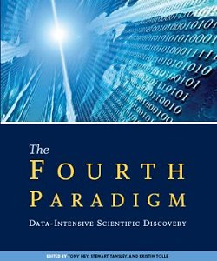
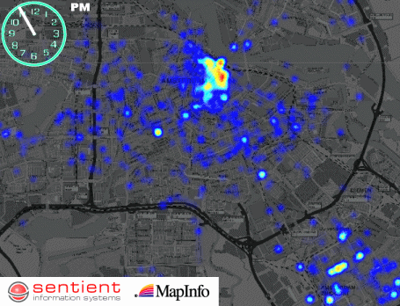
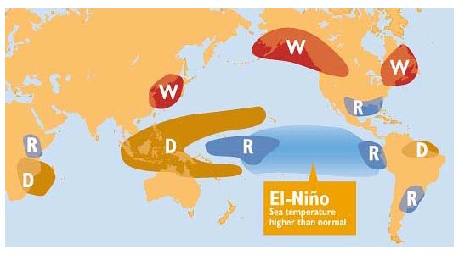
Tools: Data Mining
Why is it important ?
Fourth paradigm of science
Data intensive scientific discovery
Why is Data Mining needed?
Growth_rate(Data) >> Growth_rate(# Human Analysts)
To amplify human capability to analyze large datasets
Possibly automate repeating tasks
What is Data Mining (DM)?
Identify interesting, useful, non-trivial patterns
Ex. Anomalies, associations, trends, hotspots…
What are new challenges in this project?
Auto-correlation (violates sample independence assumption)
Non-stationarity
What new capabilities are offered?
Spatial DM, e.g. tele-connections, co-location, …
Spatio-temporal DM, e.g. predict hotspots and impacts
In context, e.g. land-cover, agriculture, climate, …

