Slide 1

BD Hubs: Midwest: “SEEDCorn: Sustainable Enabling Environment for Data
Collaboration”
One of four Big Data Regional Innovation Hubs (BD Hubs) funded by the
National Science Foundation through award #1550320
Spoke Overview: Water, Food, Energy Nexus
Shashi Shekhar
McKnight Distinguished University Professor
University of Minnesota
www.cs.umn.edu/~shekhar

Slide 2
Core Team: FEW Spoke
Klara Nahrstedt (UIUC) – MBDH leadership council
Shashi Shekhar, Jessica Hellman, David Haynes (UMN)
Shaowen Wang, Anand Padmanabhan, Luis Rodriguez (UIUC)
Carol Song (Purdue U)
Aaron Packman (NWU)
Adam Ward (Indiana U)

Slide 3
Collaborators (Almost 40)
Multi-sectoral
  Industry: IBM, Climate Corp, …
  Govt: Chicago Water District, USDOE:ANL, USGS, NCAR, …
  NGO: Nature Conservancy, …
  Academia: mid-west - Indiana U, NWU, Purdue, UIUC, UMN, NWU
  Academia outside midwest: Texas A&M U, U of Glasgow
Multi-Disciplinary
  Big Data: TerraPop (Datanet), GABBS (DIBBS), CyberGIS
  Water: NWU, Indiana, UIUC (Civil / Env. Eng.)
  Food: AgMIP/GABBS (Purdue), UMN Food Protection & Defense Inst., …
  Energy: NWU Inst. For Sustainability and Renewable Energy, …
  Environment: Climate Corporation, NCAR, Minnesota Population Center, …
  Education: UMN MS in Data Science, NWU STEM Education Partnership, …

Slide 4
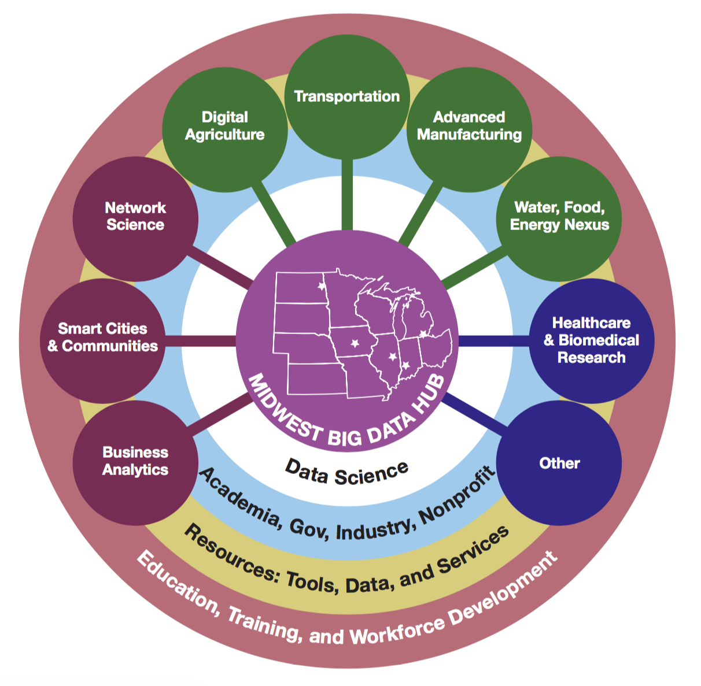
Context: FEW Spoke
Midwest
  Water: Largest freshwater reserves, e.g., Great Lakes.
  Food: Leader in agricultural production, processing, transportation, distribution
  Energy: Dominant Biofuel Supplier
NSF Cross-Directorate Initiative
  Research: Innovations for Food, Energy, Water Nexus (INFEWS)
  Education: NRT solicitation listed INFEWS as a priority
  Infrastructure & Community Building: Our Spoke

Slide 5
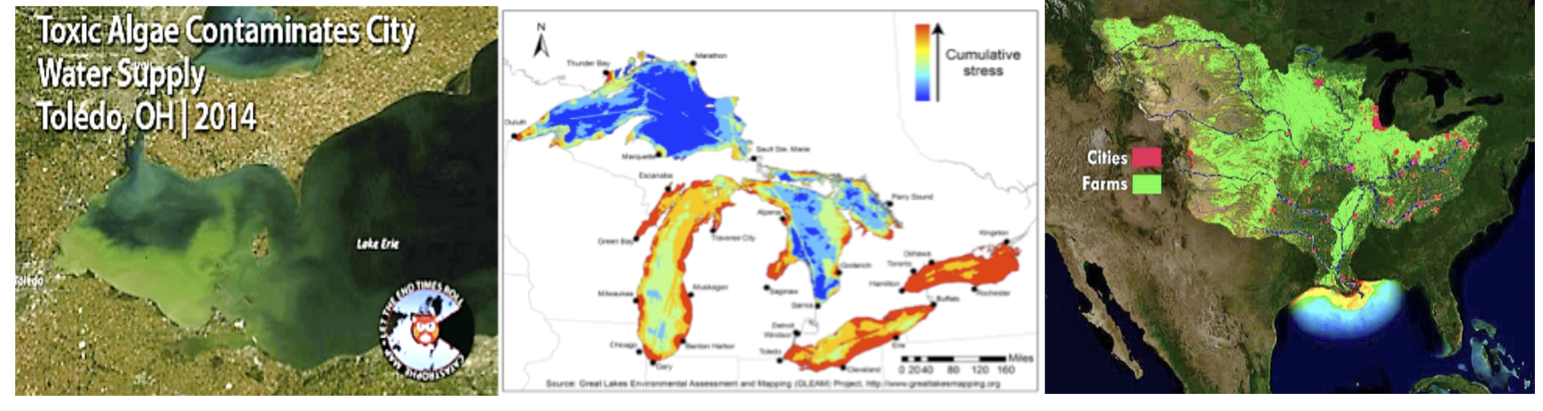
Motivation: FEW Spoke
Piece-meal policies => unanticipated problems
  Ex. Fertilizers affect Water quality (e.g., Great Lakes, Mississippi River)
  Ex. Bio-fuel subsidy => Rise in food prices
Crucial to understand interactions across Water, Food, Energy Systems
  Not just for mid-west
  National priority with initiatives from NSF, USDA USDOE, USGS, …
  Global priority with initiatives from U.N., …

Slide 6


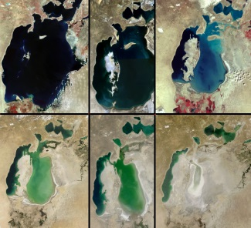
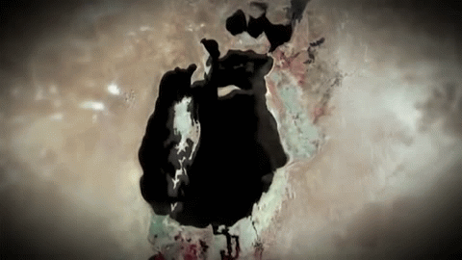
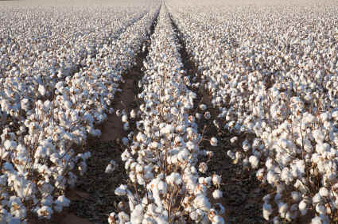
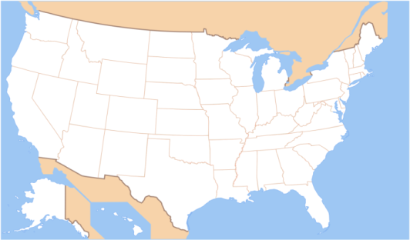



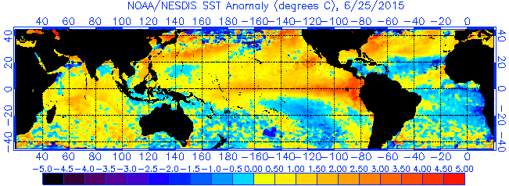
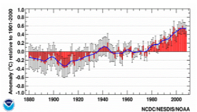
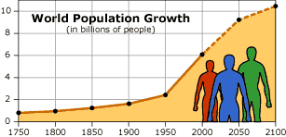
NSF INFEWS Data Science Workshop
(@ USDA NIFA, Oct. 5th-6th, 2015; Shekhar, Mulla, & Schmoldt; www.spatial.cs.umn.edu/few)
Goals:
Design compelling visions, Identify gaps
Develop a research agenda
55 Participants (Data-driven FEW & Data Sciences)
Aral Sea Shrinkage (1978-2014)
Due to Cotton Farms
Alerts
Food | Energy | Water | DataSc.
14 | 10 | 11 | 20
Nexus Dashboard
Gov. | Aca. | Industry
26 | 24 | 5
State
Trends
Locations
Finding 1: Data & Data Science are crucial!
Understand problems, connections, impacts
Monitor FEW resources, and trends to detect risks
Support decision and policy making
Communicate with public and stakeholders
Finding 2: However, there are show-stopper gaps.
Data Gaps: No global water & energy census, Heterogeneous data formats & collection protocols
Data Science (DS) Gaps: Current DS methods are inadequate for spatio-temporal-network FEW data.
Sea-Surface Temperature Anomaly
Global Temperature
Global Population
Potentially Transformative Research Agenda:
National FEW Nexus Observatory & Dashboard for chokepoint monitoring, alerts, warnings
Novel Physics-aware Data Science for mining nexus patterns in multi-scale spatio-temporal-network data despite non-stationarity, auto-correlation, uncertainty, etc.
Scalable tools for consensus Geo-design via participative planning with nexus observations and policy projections
An INFEWS data science community to address crucial gaps, and shape next-generation Data Science
Global Population

Slide 7
Related Work
Challenge:
  Spatial nature of FEW datasets.
  Popular BD tools (e.g. MapReduce, Spark) inadequate for Spatial Data
State of Spatial BD Tools
  Siloed with small user communities
  Ex.: GABBS for Agriculture Model Inter-comparison(AgMIP)
  Ex. CyberGIS, SpatialHadoop
  Ex. Minnesota Population Center TerraPop
Note:
  Lightning talk on GABBS and CyberGIS
  We welcome interest in spatial tools from all spokes

Slide 8
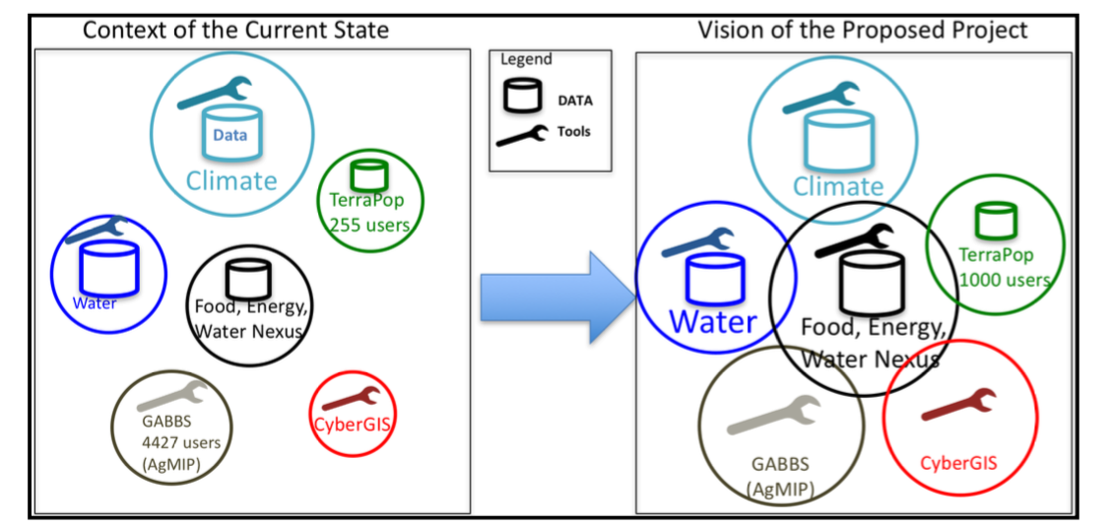
Spoke Mission & Vision
Grow and Connect Communities
  Producers and Consumers of FEW Nexus Data, Tool, Services

Slide 9
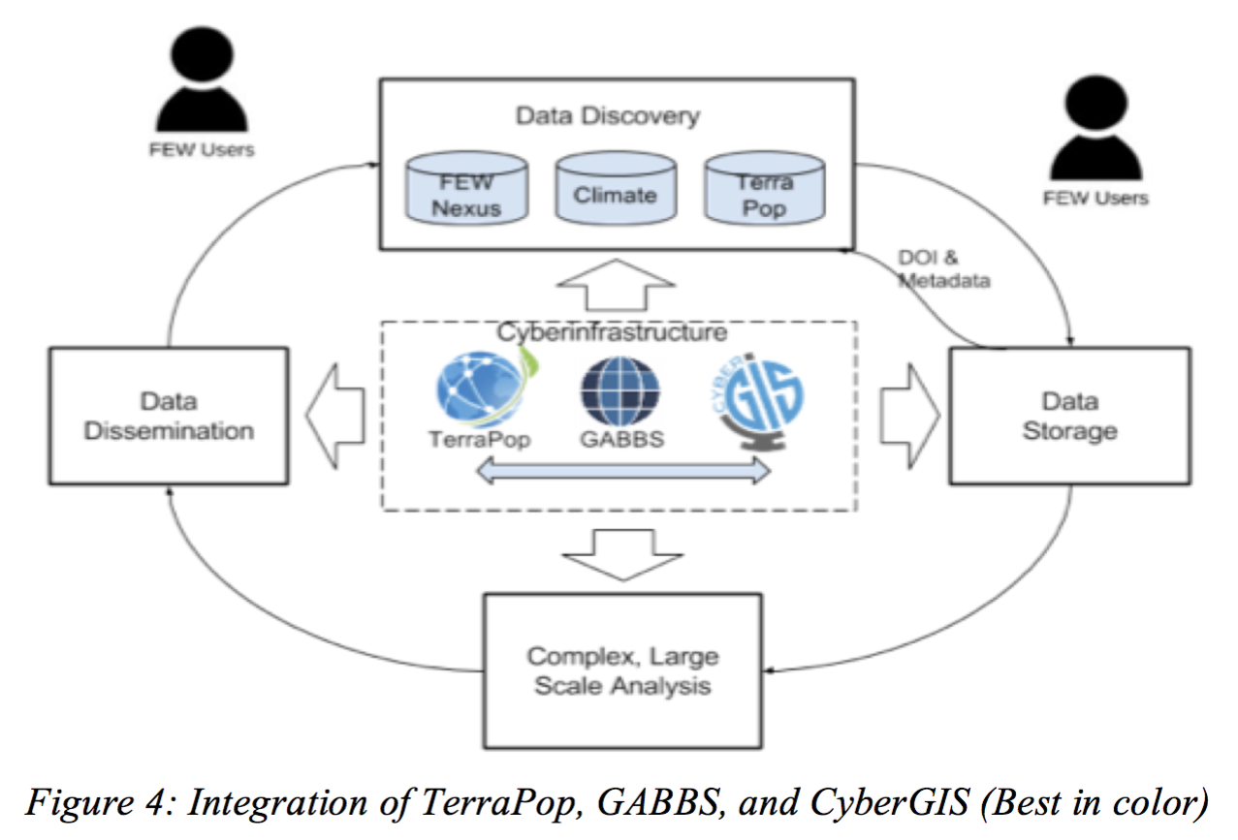
Data, Tools, Services

Slide 10
Activities: FEW Spoke
Past and Ongoing
  Capitol Hill Presentation, House Ag Committee Reception on “Deconstructing Precision Agriculture” (Shekhar, 3/15)
  NSF Workshop to Identify Interdisciplinary Data Science Approaches and Challenges to Enhance Understanding of Interactions of Food Systems with Energy and Water Systems (Shekhar, 10/15)
  Symposium S-E2 (Towards a Food-Energy-Water Nexus Data and Data Science Community”, NCSE 2016 Conference (Shekhar, Rodriguez, …, 1/16)
  BDSpokes proposal Big Data Community for the Nexus of Food, Energy, and Water Systems (Core Team, 2/16)
  MBDH/CCC Call for Proposal to engage Young Researchers (Nahrstedt, 3/16)
  TerraPop, CyberGIS, GABBS education and outreach activities (Lightning Talks)
Upcoming
  CyberGIS Curriculum Workshop (Wang, 4/16)
  Michigan State U Symposium on Climate-Food-Energy-Water Nexus (Shekhar, 4/16)
  CCC/CRA Symposium on Computing Research: Addressing National Priorities and Societal Needs (Nahrstedt, Shekhar, 5/16)

Slide 11
 | Expertise | Name | Affiliation
30 | BD: Big Data Computation | Claudia Neuhauser | Minnesota Supercomputing Institute, University of Minnesota
31 | FEWS: Educational Program – STEM Study and Outreach | Amy D. Pratt | Office of STEM Education Partnerships, Northwestern University
32 | FEWS: Educational Program | Stephen W. Searcy | Department of Biological and Agricultural Engineering, Texas A & M University
33 | FEWS: Environmental Sustainability Industrial Affiliate Program | Timothy Smith | NorthStar Initiative for Sustainable Enterprise, Institute on Environment, UMN
34 | FEWS: National Laboratory | Seth W. Snyder | Argonne National Laboratory
35 | FEWS: Energy, Water Science | Ashlynn S. Stillwell | Department of Civil and Environmental Engineering, University of Illinois
36 | BD: Educational Program | Goce Trajcevski | Department of Electrical Engineering and Computer Science, Northwestern University
37 | BD: Geospatial Big data Analytics | Raju Vatsavai | Center for Geospatial Analytics, North Caroline State University
38 | FEWS: Water Science, Sustainability | Peter W. Voorhees | Northwestern‐Argonne Institute for Science and Engineering
39 | FEWS: Social and Behavioral Science | Moira Zellner | College of Urban Planning and Public Affairs, University of Illinois
No | Expertise | Name | Affiliation
1 | BD: Industry | Chid Apte | IBM
2 | FEWS: Industry | Brian Smoliak | The Climate Corporation
3 | FEWS: Government | Richard Alexander | U.S. Geological Survey
4 | FEWS: Government | E. Lynn Usery | U.S. Geological Survey
5 | FEWS: Local Government | Cather A. O’Connor | Metropolitan Water Reclamation District of Greater Chicago
6 | FEWS: NGO | Bob Moseley | The Nature Conservancy
7 | FEWS: International | Marian Scott | University of Glasgow
8 | BD: Big Data Community Building | Luis A. Nunes Amaral | Northwestern Institute on Complex Systems, Northwestern University
9 | FEWS: Industrial Affiliate Program | Brent W.Auvermann | Texas A & M AgriLife Research and Extension Center at Amarillo
10 | BD: Educational Program | Ravi Bapna | Carlson School of Management University of Minnesota
11 | BD: Educational Program | Daniel Boley | College of Science and Engineering University of Minnesota
12 | FEWS: Climate Science | Lawrence Buja | National Center for Atmospheric Research
13 | FEWS: Environmental Science | Ximing Cai | Civil and Environmental Engineering, University of Illinois
14 | FEWS and Big Data Science | Melba M. Crawford | Environmental & Ecological Engineering Purdue University
15 | FEWS: Water Science | Ibrahim Demir | Iowa Flood Center, University of Iowa
16 | FEWS: Sustainability | Evan H. DeLucia | Institute for Sustainability, Energy, and Environment, University of Illinois
17 | FEWS: Water Science, Hydrology | Mostafa M. Elag | Civil and Environmental Engineering, University of Illinois
18 | FEWS: Sustainability and Energy | Demetria Giannisis | Institute for Sustainability and Energy, Northwestern University
 | Expertise | Name | Affiliation
19 | FEWS: Food, Water Science | Kaiyu Guan | Department of Natural Resources and Environmental Sciences, University of Illinois
20 | FEWS: Industrial Affiliate Program | Brian Herman | Vice President of Research, University of Minnesota
21 | FEWS: Industrial Affiliate Program | Thomas Hertel | Department of Agricultural Economics, Purdue University
22 | FEWS: Food, Environment Science | Matthew Hudson | Department of Crop Sciences, University of Illinois
23 | FEWS: International, Industrial Affiliate Program | James W. Jones | AgMIP Project, University of Florida
24 | FEWS: Educational Program, Economics | Madhu Khanna | Environmental Economics, University of Illinois
25 | FEWS: Food, Agricultural Science | Amy Kircher | Food Protection and Defense Institute
26 | FEWS: Water Science, Hydrology | Praveen Kumar | Civil and Environmental Engineering, University of Illinois
27 | BD: Climate Science | Vipin Kumar | College of Science and Engineering University of Minnesota
28 | FEWS: Food, Agricultural Science | Stephen P. Long | Departments of Crop Sciences and of Plant Biology, University of Illinois
29 | FEWS: Food, Water Science | Venkatesh Merwade | Lyes School of Civil Engineering, Purdue University

