Slide 1
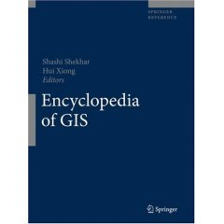
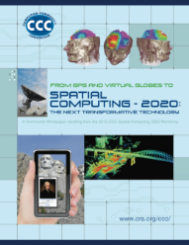
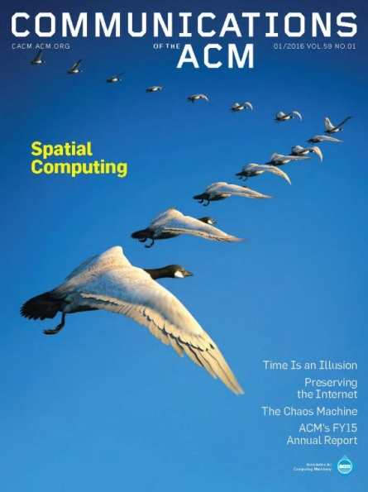
Computing Challenges in Food-Energy-Water Nexus : A Perspective Oct. 30th, 2017 AIChE Annual Meeting “Topical Conference on Food, Energy, Water Nexus”
Shashi Shekhar
McKnight Distinguished University Professor
Computer Sc. & Eng., University of Minnesota
www.cs.umn.edu/~shekhar
Notes:
1
1

Slide 2
Outline
FEW Nexus
Context
History
Role of Computing
Computing Challenges in FEW Nexus
Next

Slide 3
U.N. Sustainable Development Goals 2030
includes Food (2), Energy (7), Water (6), Climate Action (13), …

Slide 4
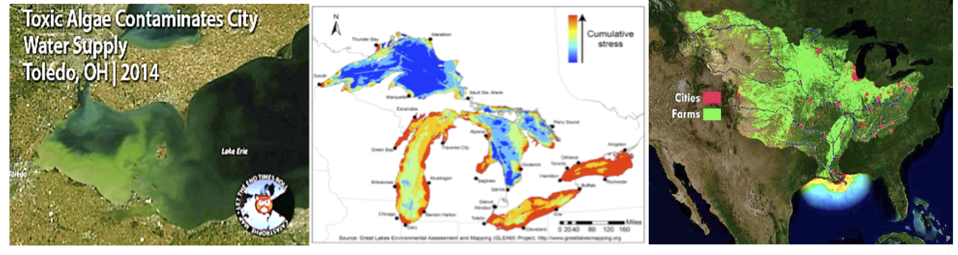
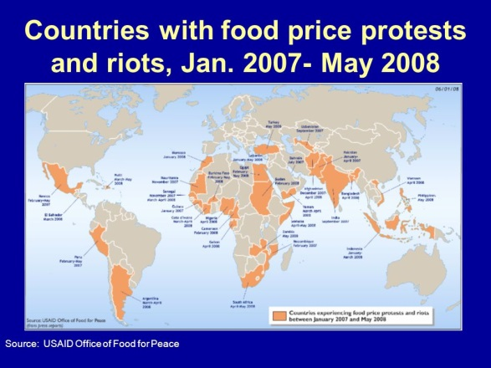
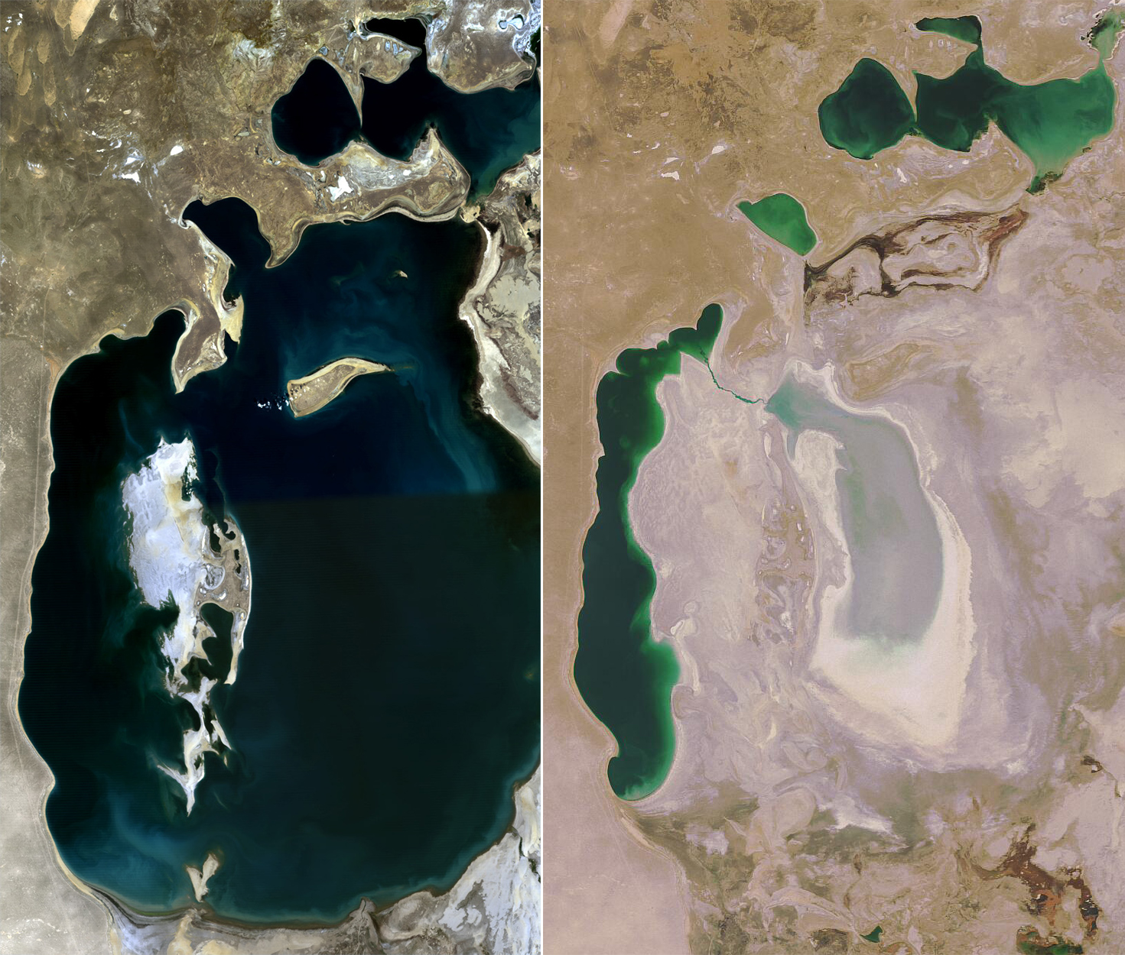
Downside of Piece-meal Approach
Piece-meal policies => unanticipated problems
Ex. Fertilizers affect Water quality (e.g., Great Lakes, Mississippi River)
Ex. Bio-fuel subsidy => Rise in food prices (2008)
Crucial to understand interactions across Water, Food, Energy Systems
National priority
Reports: USDOD/NIC, NSF, USDA USDOE, USGS, …
Research Initiatives: NSF/USDA, USDOE
Global priority with initiatives from U.N. University and many countries
Courtesy: Wikipedia

Slide 5
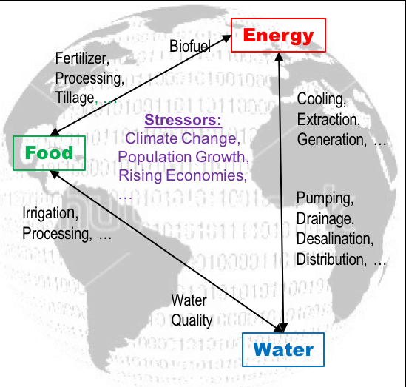
Interactions among Food, Energy, Water Systems
Piecemeal decisions in one affect the other
Efficiency or abundance in one reduces scarcity in others!
Chokepoint: Scarcity in one constraints growth in others!
Stressors:
Population Growth
Climate Climate
Rising Economy

Slide 6
Outline
FEW Nexus
Role of Computing
Precision Agriculture
Crop Monitoring
Computing Challenges in FEW Nexus
Next

Slide 8
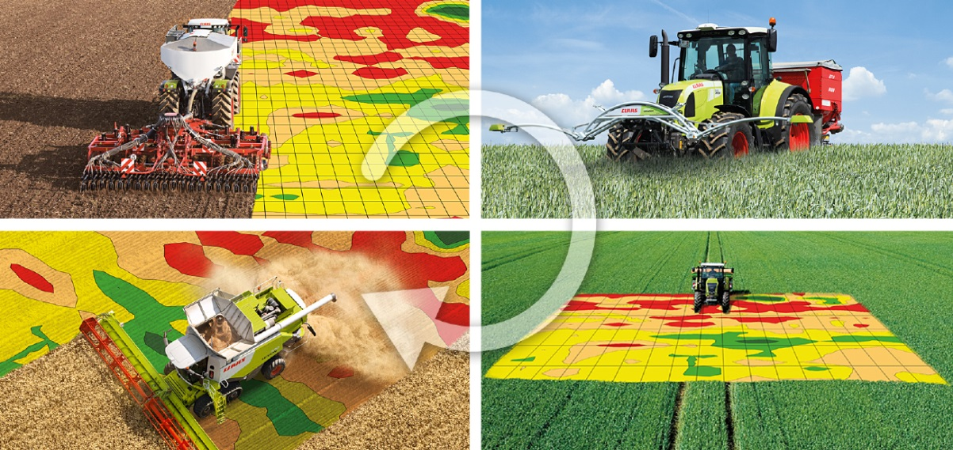
Precision Agriculture
Reduce fertilizer run-offs, water use
Improves yield
Computing is critical
Cyber-Physical Systems
Data & Data Science Elements

Slide 9
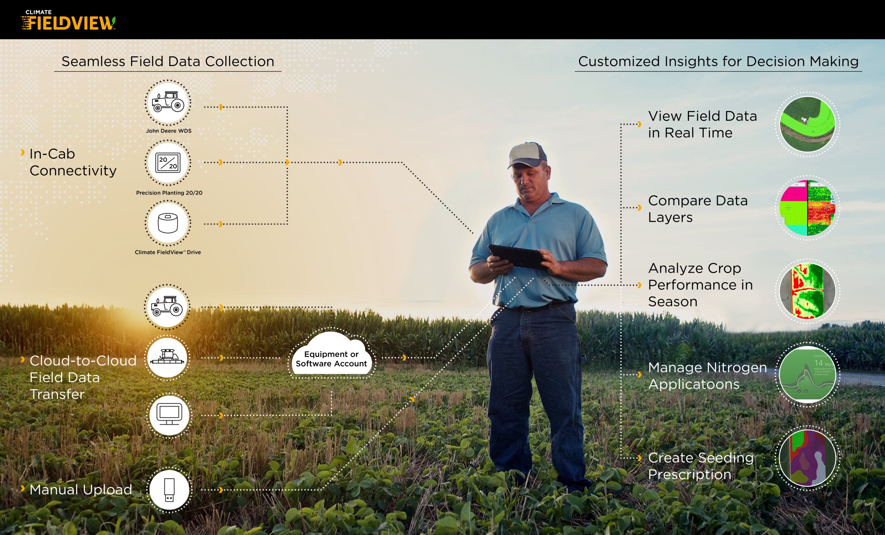
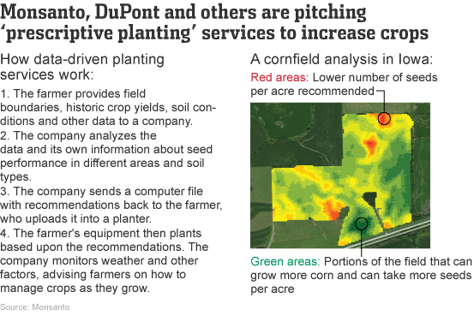
Support (Farm-level) Decisions and (Insurance) Policy

Slide 10
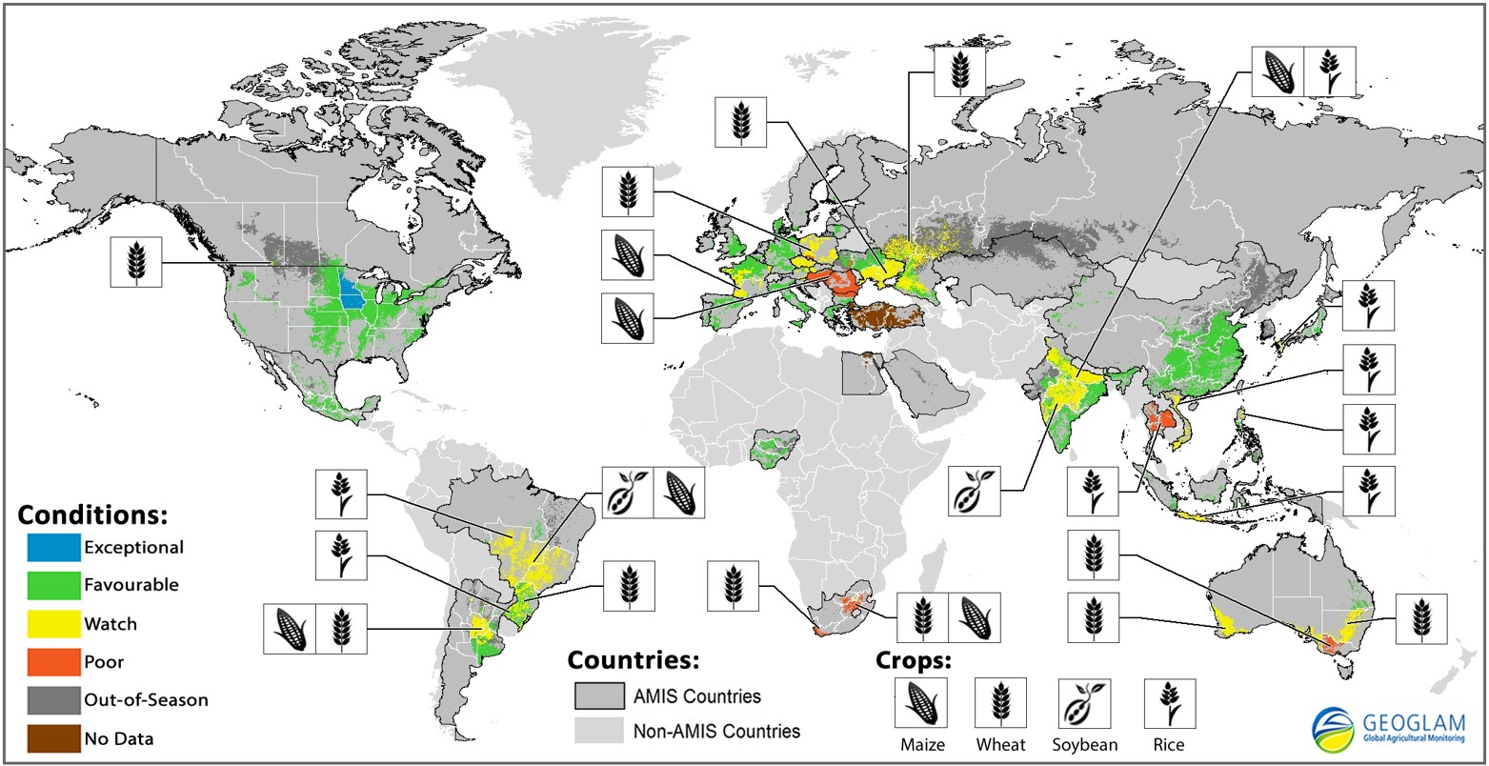
Support (Global) Decisions and Policy Making

Slide 11
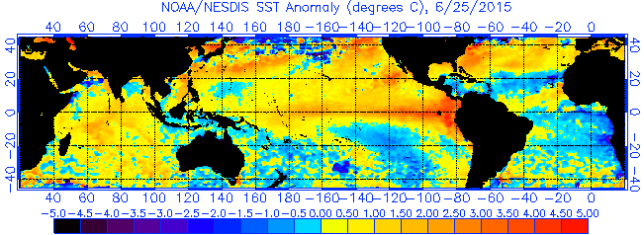
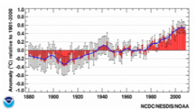
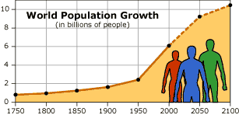
Communicate with public and stakeholders
Monitor resources & trends to detect risks
Aral Sea Shrinkage (1978-2014)
Due to Cotton Farms
Alerts
Nexus Dashboard
State
Trends
Sea-Surface Temperature Anomaly
Global Temperature
Global Population
Global Population

Slide 12
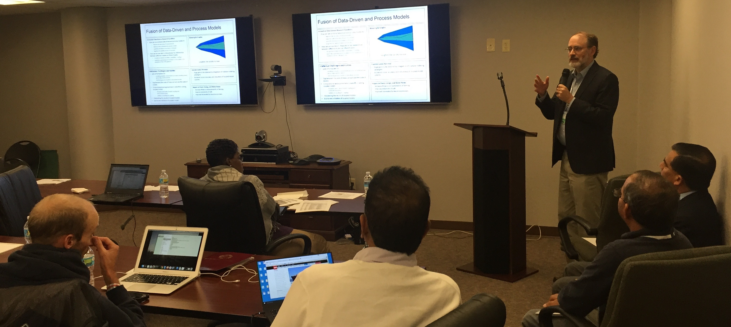
Outline
FEW Nexus
Role of Computing
Computing Challenges in FEW Nexus
NSF INFEWS Data Science Workshop (Oct. 2015)
Data and Data Science Gaps
Next

Slide 13
17+ NSF Workshop grants
Planned across the country
Facilitate partnerships across disciplines, sectors
Define fundamental sc. & eng. research needs & questions
Two workshop with CISE PIs
Technology & Information Fusion
Data Science

Slide 14
2015 Workshops
Proposal | Title | PI | PI institution | Amount | Confirmed Dates | Workshop Location
1542770 | FEW NSF Workshop: Closing the Human Phosphorus Cycle | Platz | U Hawaii Hilo | $ 87,873 | Jun 8 - 9, 2015 | Arlington
1541880 | FEW: Developing Intelligent Food, Energy,and Water Systems (DIFEWS) | Potts, Matthew D. | University of California- Berkeley | $ 49,863 | Sept 28-29, 2015 | UC Berkeley
1541838 | FEW Workshop: "Scaling Up" Urban Agriculture to Mitigate Food-Energy- Water Impacts | Newell, Joshua | University of Michigan Ann Arbor | $ 69,242 | Oct 5-7, 2015 | Univeristy of Michigan, Michigan League
1541876 | FEW: A Workshop to Identify Interdisciplinary Data Science Approaches and Challenges to Enhance Understanding of Interactions of Food Systems and Water Systems | Shekhar, Shashi | UMN | $ 50,000 | Oct. 5-6, 2015 | USDA/NIFA, Washington DC
1541883 | FEW: Food-Energy-Water Nexus Workshop to Develop System Approaches and Sustainability Metrics for Evaluation | Schuster, Darlene S | American Institute of Chemical Engineers | $ 94,929 | Oct. 7-9, 2015 | Washington, DC
1541790 | FEW: Coupling Economic Models with Agronomic, Hydrologic, and Bioenergy Models for Sustainable Food, Energy, and Water Systems | Catherine Kling | Iowa State University | $ 45,922 | Oct 11-12, 2015 | Iowa State University; Ames, Iowa
1541771 | FEW: Food-Energy-Water infrastructure systems, engineering solutions and institutions | John L Sabo | Arizona State University | $ 94,905 | Oct 13 - 15, 2015 | ASU Campus
1541807 | FEW: Workshop to Identify Opportunities and Challenges for Nanotechnology to Optimize and Unify Food, Energy and Water Systems | Lowry, Gregory V. | Carnegie-Mellon University | $ 58,358 | Oct 19-20, 2015 | Pittsburgh, PA
1541736 | FEW: A sustainable rural framework workshop for the upper Great Plains. | Stone, James J | South Dakota School of Mines and Technology | $ 50,000 | Oct 19 - 20, 2015 | SDSM&T in Rapid City, SD
1541799 | FEW Workshop - Planned Migration as a Strategy to Sustain Agricultural Production | McNider, Richard (1049050 NIFA) | University of Alabama in Huntsville | $ 56,335 | Oct 21-23, 2015 | NCAR, Boulder
1541866 | Few Workshop: Food, Energy, and Water Nexus in Sustainable Cities | Assaf-Anid, Nada M | New York Institute of Technology | $ 98,877 | Oct 20-21, 2015 | Beijing, China
1541844 | FEW: Conference on Environmental Change, Migration, and the Resilience of Regional Food, Water, and Energy Systems | Elena Irwin | Ohio State U | $ 97,496 | Nov 4-5, 2015 | Ohio State Univ.
1541868 | FEW Workshop: Water- and Energy-efficient Food Production: Solutions for America’s Bread Basket | Rezac, Mary E. | Kansas State University (EPSCoR) | $ 50,000 | Nov 19-20, 2015 | Manhattan, Kansas; Governor’s Conference Nov. 18 - 19
1541642 | FEW: Development and Application of Analytical Tools in Support of Food-Energy-Water Nexus Planning | Miralles-Wilhelm, Fernando R | University of Maryland College Park | $ 99,980 | Oct. 27-28, 2015 | Washington DC
1541890 | FEW: Towards Food, Energy and Water Security in California under Changing Conditions: the Nexus Perspective | Gebremichael, Mekonnen | University of California- Los Angeles | $ 49,680 | Dec 2-4, 2015 | UCLA, Los Angeles, California
1541863 | FEW: Technology and Information Fusion Needs to Address the Food, Energy, Water Systems (FEWS) Nexus Challenges | Ebert, David | Purdue | $ 60,105 | Nov. 5-6 | Napa Valley Marriott Hotel and Spa
1541694 | FEW: River FEWs: Workshop to explore the nexus between food, energy and water in a large international river system | Holtgrieve, G.W. | University of Washington | $ 98,367 | Dec. 10-12, 2015 | U. Washington, Seattle

Slide 15
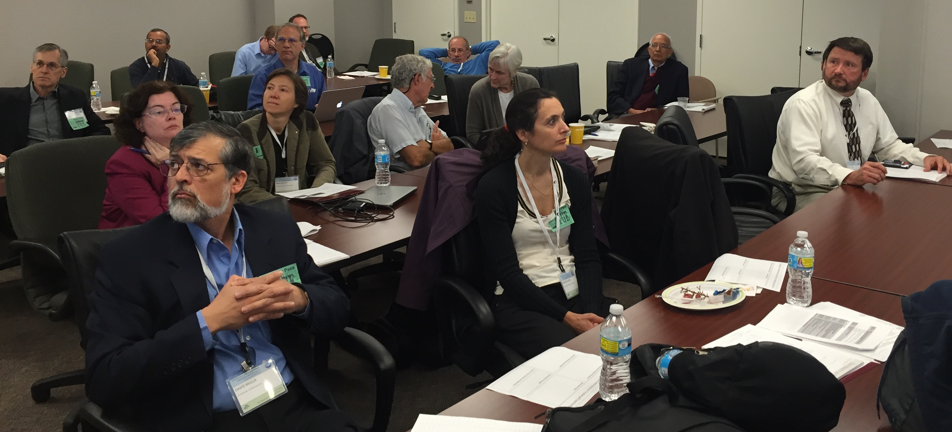
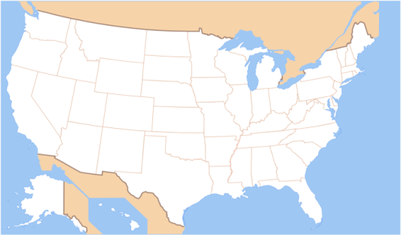
NSF INFEWS Data Science Workshop
Goals
Develop visions, Identify gaps
Develop a research agenda
At USDA NIFA, Oct. 5th-6th, 2015
Co-organizers: Shekhar, Mulla, Schmoldt
URL: www.spatial.cs.umn.edu/few
Draft report available for comments:
http://www.spatial.cs.umn.edu/few/few_report_draft.pdf
55 Participants (Data-driven FEW & Data Sciences)
Gov. | Aca. | Industry
26 | 24 | 5
Food | Energy | Water | DataSc.
14 | 10 | 11 | 20

Slide 16
Multi-disciplinary Multi-sectoral Participation
Data Science | Names
Data Collection, Remote Sensing | Peggy Agouris David Corman (NSF) Thomas G. Dietterich Paul Gader Raju Vatsavai
Data Exploration, Management, Dissemination | Chandra Krintz Dieter Pfoser Hanan Samet Tom Shapland (Farmlink) Goce Trajcevski
Data Extrapolation … | Chid Apte (IBM) Vasant Honavar (CCC) Zico Kolter Vipin Kumar Sanjay Ranka …
FEW | Names
Food | Parag Chitnis (USDA) Jason Hill Rattan Lal L. K. Matukumalli (USDA) Rachel Melnick Rabi Mohtar Sonny Ramaswamy (USDA) Susan Jean Riha Paul Tanger Luis Tupas (USDA)
Energy | Noel M.Bakhtian (USDOE) Robie Lewis (USDOE) Bob Vallario (USDOE) Tamara Zelikova
Water | Richard Alexander (USGS) Brad Doorn (NASA) Alan Hecht (EPA)
Cross-cutting, Social Sc., … | Inna Kouper Zachary Hayden Moira Zellner Ariela Zycherman (NSF)

Slide 17
Panels, Presentations & Breakouts
Panel: Data-Driven FEW Nexus Science and Application Innovations
FEW Nexus Overview (with life-cycle analysis): Rabi Mohtar (TAMU)
Energy - Water Nexus: Bob Vallario (USDoE)
FEW : A NIFA Perspective: Sonny Ramaswamy (NIFA)
Water - Food Nexus: Rich Alexander (USGS)
Energy - Food Nexus: Louis Tupas (NIFA)
Drivers of FEW Nexus: Rattan Lal (OSU)
Panel: Data Sci. Research Needs to Understand & Innovate for FEW Nexus
Data Science Challenges in Sustainable Energy: Zico Kolter (CMU)
Open-Source Precision Agriculture and Analytics Driven Decision Support: Chandra Krintz (UCSB)
Machine Learning Challenges: Thomas Dietterich (Oregon U)
Trustworthiness and Sustainability: Data Science for FEW Nexus in the Developing Regions: Inna Kouper (Indiana U)
Informatics Challenges: Vasant Honavar (Penn State)
Remote Sensing and Water: Brad Doorn (NASA)

Slide 18
Outcomes: F-E-W Nexus Data Gaps
Water: Need US water census
Equivalent of Ag. Census and US-EIA
Other Data Needs:
Energy, Food– consumption & FEW Interaction data
A FEW nexus data community (BD FEW Spoke)
Data Integration Challenges
Varied data collection (e.g., aquifer withdrawal meter in TX & CA)
Heterogeneous data format (e.g., raster climate data, vector population)

Slide 19
Outcomes: Data Science Gaps
Methods to help stakeholders reach consensus on FEW issues
Social science methods: scenario-based discussion, design exercises, etc.
Computational tools: visualization, explainable/interpretable models, interactive simulation and optimization
Spatio-temporal modeling
Dealing with data collected multiple spatial, temporal scales,
missing values
Fusion of multiple model types
Data-driven, process-driven, economic, etc.
Lifecycle thinking for the FEW Nexus
modeling human behavior, understanding indirect effects of perturbations, supply chains, opportunity costs, agent-based modeling
Data uncertainty, incompleteness, bias
provenance, conflict of interest, capturing and visualizing uncertainty

Slide 20
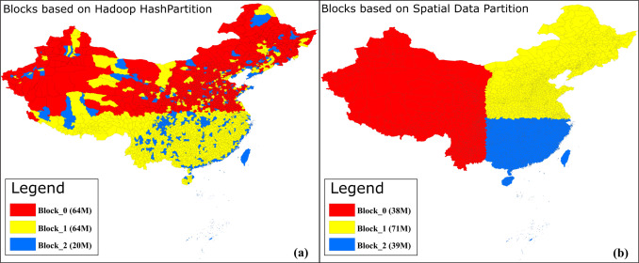
Limitations of Hadoop
Hadoop uses Hash (i.e. Random) partitioning
related objects scattered, not grouped
Alternative is Spatial partitioning
Source: Spatial coding-based approach for partitioning big spatial data in Hadoop, X. Yao et al.,
Computers & GeoScience, 106:60-67, September 2017, Elsevier.

Slide 21
Food Big Data Analysis
Simulation, Statistics, Data Mining, Machine Learning
Challenge: One size does not fit all
Prediction error vs. model bias, Cost of false positives, …
Ex. Interaction patterns
(a) a map of 3 features
(b) Spatial Partitions
(c) Neighbor graph
 | Pearson’s Correlation | Ripley’s cross-K | Participation Index
 | -0.90 | 0.33 | 0.5
 | 1 | 0.5 | 1

Slide 22
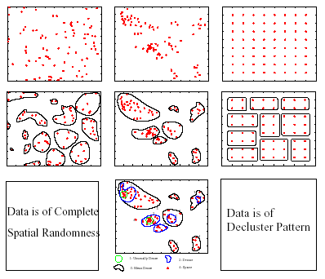
Limitation of Traditional Clustering
Simulation, Statistics, Data Mining, Machine Learning
Challenge: One size does not fit all
Prediction error vs. model bias, Cost of false positives, …
Ex. Clustering: Find groups of tuples
Traditional Clustering
(K-means always finds clusters)
Spatial Clustering begs to differ!

Slide 23
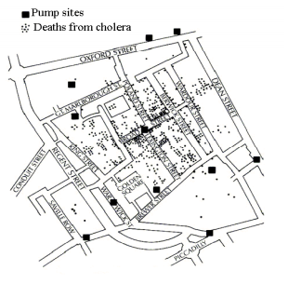
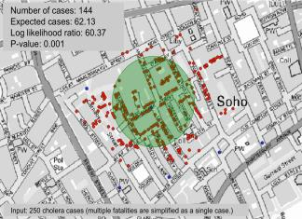
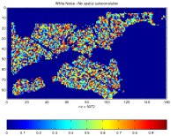
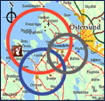
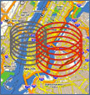
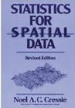
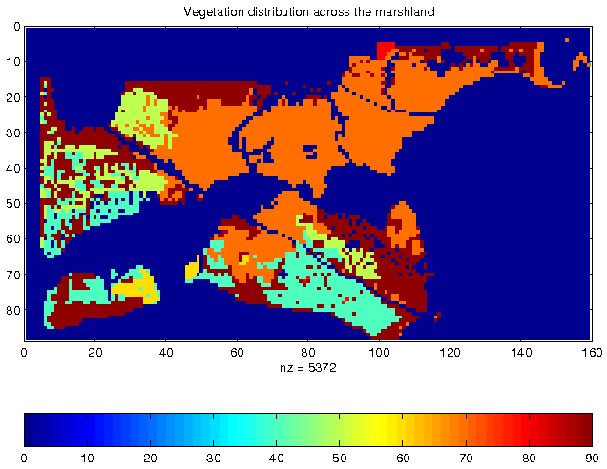
Sensor Big Data Analysis: Spatial Methods
Spatial Statistics, Spatial Data Mining
Quantify uncertainty, confidence, …
Is it (statistically) significant?
Is it different from a chance event or rest of dataset?
e.g., SaTScan finds circular hot-spots
Auto-correlation, Heterogeneity, Edge-effect, …

Slide 24
Food Big Data Analysis
Challenge: One size does not fit all
Prediction error vs. model bias, Cost of false positives, …
Ex. Interaction patterns
(a) a map of 3 features
(b) Spatial Partitions (two different splits)
(c) Neighbor graph
 | Pearson’s Correlation |  | Ripley’s cross-K | Participation Index
 | Split Left | Split Right
 | -0.90 | -0.52 | 0.33 | 0.5
 | 1 | 0.58 | 0.5 | 1

Slide 25
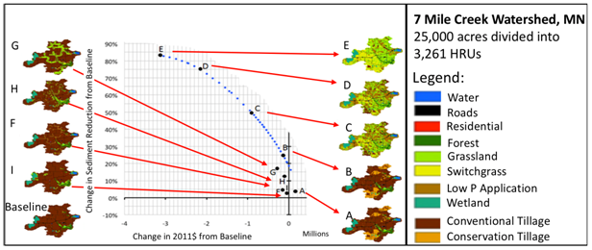
Gap Example: Spatial Fragmentation in Optimization
Landscape geodesign
stakeholder collaboration (designs F, G, H, I)
linear programming (designs A, B, C, D, and E)
Stakeholder Collaboration
Linear Programming

Slide 26
Outline
F-E-W Nexus
Role of Computing
Computing Challenges
Related Events
Dec. 2015: NSF INFEWS Solicitation
Jan. 2016 : NCSE
Mar. 2016: Midwest Big Data Hub – FEW Spoke
Mar. 2016: Whitehouse Water Summit
Aug. 2016: ACM SIGKDD Workshop on FEW
Dec. 2016: AGU session proposal

Slide 27
Anticipated Funding Amount: $50,000,000
With $9,000,000 to $15,000,000 for Track 2, Visualization and Decision Support
for Cyber-Human-Physical Systems at the FEW Nexus;

Slide 28
INFEWS Goals
Four Tracks
Significantly advance our understanding of the food-energy-water system through quantitative and computational modeling, including support for relevant cyberinfrastructure;
Develop real-time, cyber-enabled interfaces that improve understanding of the behavior of FEW systems and increase decision support capability;
Enable research that will lead to innovative system and technological solutions to critical FEW problems; and
Grow the scientific workforce capable of studying and managing the FEW system, through education and other professional development opportunities.

Slide 29
Highlights:
Participation from NSF, USDA, USDOE, NOAA, USGS, NASA, USFS, etc.
Many sessions related to NSF INFEWS
Ex. S-E2: Towards a F-E-W nexus data science community
NSF Director Córdova (right) with former NSF Director Rita Colwell, who received a lifetime achievement award from National Council for Science & Environment (NCSE).

Slide 30
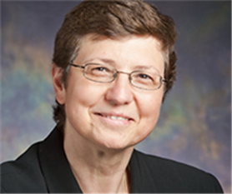
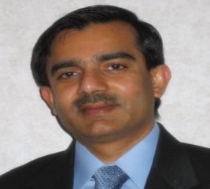
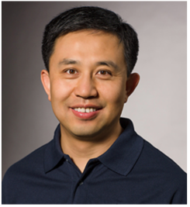
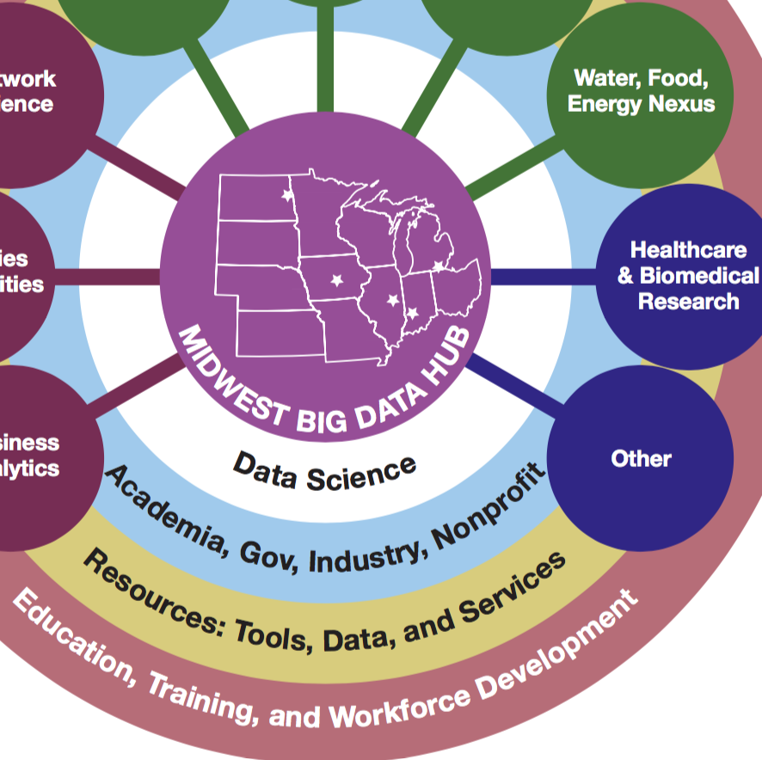
Community Building: NSF MBDH FEW Spoke
Lead: Klara Nahrstedt
Assisted by Shashi Shekhar, Shaowen Wang
Over 40 partners
Multi-disciplinary
Food: AgMIP/GABBS (Purdue)
Energy: NWU Inst … Ren. Energy
Water: Env. Eng. (UIUC, IU), Water Center at UMN & NWU,
UMN Institute on Env., MN Population Center
NCSA CyberGIS
Multi-sector
Academic: TAMU, NCSU, U Glasgow, …
Industry: IBM, Climate Corp.
Govt.: Chicago Water Distr., NCAR, USGS, …
NGO: Nature Conservancy
International: U Glasgow, Govt. of Canada

Slide 31
Monday, August 14th, 2017.
http://ai4good.org/few17/
Details @ https://sites.google.com/site/2016dsfew/home
Thanks: NSF MBDH Travel Support for Early Career Researchers

Slide 33
NSF Multi-year Cross-Directorate Initiative
News: https://foodenergywater.wordpress.com/
Research:
Innovations for F, E, W Nexus (INFEWS)
Education:
NRT solicitation - INFEWS as a priority
Infrastructure & Community Building:
Big Data Hub, Big Data Spoke
EPSCoR
INFEWS Data Science Workshop Draft report available for comments:
http://www.spatial.cs.umn.edu/few/few_report_draft.pdf

Slide 34
Outline
Agriculture Big Data (AgBD) Examples
Data Management Tools
- Limitation of traditional tools
- Promising Spatial Tools
Data Mining Tools
Collaboration Opportunities

Slide 35
Food Big Data & Collaboration Opportunities
Current Big Data Tools are too generic
Click stream mining
false positive costs negligible
One size big data tools do not fit all .Ag big data

Slide 36
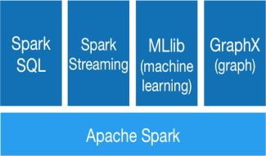
Big DataTools
Current Big Data Tools (e.g., Machine Learning, Hadoop)
For click-stream mining to choose advertisements
False positive cost negligible, Sanity Check via A/B expt.
Google Flu Trends experience
One size big data tools do not fit all (Food) big data
Farm to Table Food Data
Physical Spaces: farms, precision agriculture, remote sensing, …
Location-aware
Spatio-temporal context, e.g., neighbors
False positive costs may be high

Slide 37
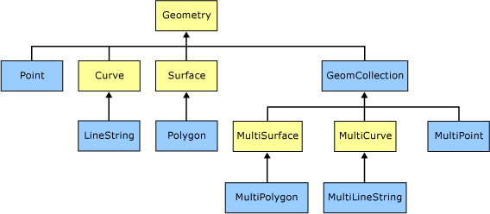
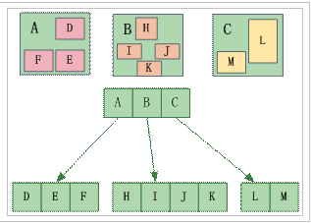
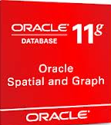
Food Big Data Curation
Meta-data, Schema, DBMS (SQL, Hadoop)
Challenge: One size does not fit all!
Ex. Spatial Querying
Geo-tag. Checkin, Geo-fence
Spatial Querying Software
OGC Spatial Data Type & Operations
Data-structures: B-tree => R-tree
Algorithms: Sorting => Geometric
Partitioning: random => proximity aware

Slide 38
Outline
Agriculture Big Data (AgBD) Examples
Data Management Tools
Data Mining Tools
- Limitation of traditional tools
- Promising Spatial Tools
Collaboration Opportunities

Slide 39
Food Big Data Mining
Current Big Data Mining Tools are generic
Click stream mining
false positive costs negligible
One size big data mining tools do not fit all sensor big data
Food Big Data
are often in Physical Spaces
High cost of false positives

Slide 40
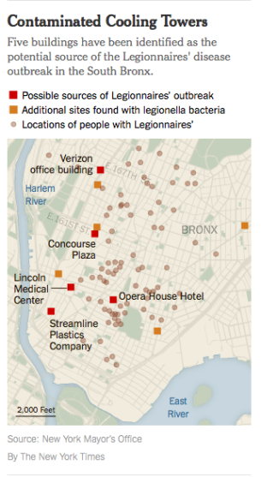
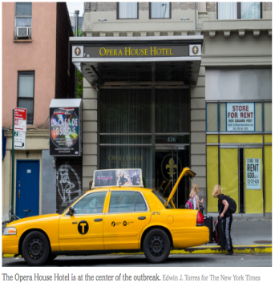

Slide 41
Legionnaires’ Disease Outbreak in New York
Source: Ring-Shaped Hotspot Detection: A Summary of Results, IEEE ICDM 2014 (w/ E. Eftelioglu et al.)

Slide 42
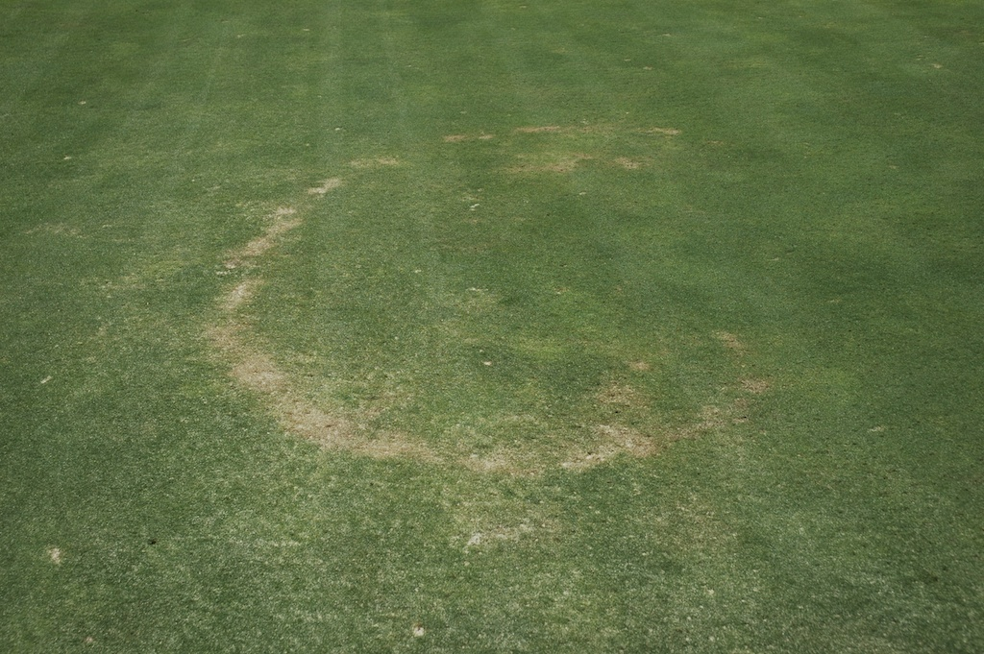
Necrotic Ring Spot Detection
Original Image
Grayscale
Bitmap (0,1)
Log Likelihood Ratio: 3129
p-value: 0.01
Number of Pixels Included: 4169
Inner Radius: 179 pixels
Outer Radius: 229 pixels

Slide 43
Outline
Agriculture Big Data (AgBD) Examples
Data Management Tools
Data Mining Tools
Collaboration Opportunities
- USDA/NIFA FACT
- NSF: INFEWS, CPS/Ag, NRI/Ag, …

Slide 44
NIFA Food & Ag Cyberinfo. Tools (FACT)

Slide 45
NSF CPS/Ag
Excerpts from NSF 17-529: Cyber Physical Systems (CPS)

Slide 46
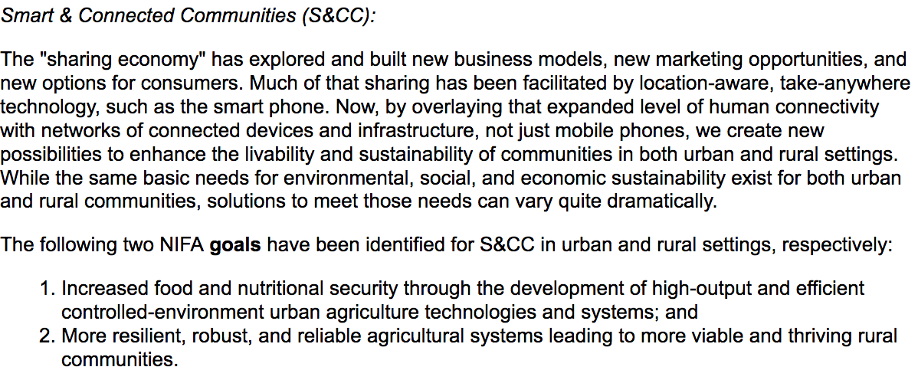
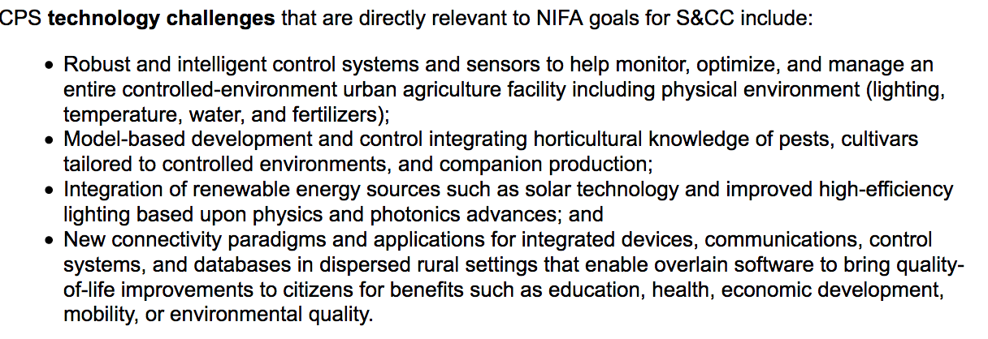
NSF CPS/Ag

Slide 47
References
Spatial Computing, Communications of the ACM, 59(1), Jan. 2016.
From GPS and Virtual Globes to Spatial Computing 2020, Computing Community Consortium Report, 2013. www.cra.org/ccc/visioning/visioning-activities/spatial-computing
Spatiotemporal Data Mining: A Computational Perspective , ISPRS International Journal on Geo-Informtion, 4(4):2306-2338, 2015 (DOI: 10.3390/ijgi4042306).
Identifying patterns in spatial information: a survey of methods , Wiley Interdisciplinary Reviews: Data Mining and Knowledge Discovery, 193-214, 1(3), May/June 2011. (DOI: 10.1002/widm.25).
Notes:
47
47

