Slide 1
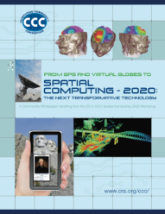
Transforming Smart Cities with Spatial Computing IEEE Intl. Conf. on Smart Cities, Sept. 17th, 2018. .
Shashi Shekhar
McKnight Distinguished University Professor
Dept. of Computer Sc. and Eng., University of Minnesota
www.cs.umn.edu/~shekhar : shekhar@umn.edu
Details: Transforming Smart Cities with Spatial Computing,
Proc. IEEE International Smart Cities Conference, 2018 (w/ Y. Xie et al.).
Notes:
1
1

Slide 2
Acknowledgements
P.I., Connecting the Smart-City Paradigm with a Sustainable Urban Infrastructure Systems Frame- work to Advance Equity in Communities, NSF(Award 1737633), $2.5 M, 9/1/2017 - 8/31/2020.
Co-P.I., Planning Grant: Engineering Research Center for Intelligent Infrastructure for Safe, Efficient and Resilient Mobility, NSF,(Award 1840432), 97K, 9/18-8/19, (PI: Anil Misra, University of Kansas).
Co-P.I., Cloud-Connected Delivery Vehicles: Boosting Fuel Economy Using Physics-Aware Spatio- temporal Data Analysis and Real-Time Powertrain Control, USDOE ARPA-E, $1.78M (1.4M fed.), 2/17 - 2//20. (PI: W. Northrop)
P.I., Identifying and Analyzing Patterns of Evasion (HM0210-13-1-0005), USDOD-NGA, $0.6M, 6/13- 12/18.
Co-P.I., Increasing Low-Input Turfgrass Adoption Through Breeding, Innovation, and Public Education, USDA/NIFA/SCRI (contract 2017-51181-27222), $5.4 M, 9/17 - 8/21. (with E. Watkins).
Notes:
A brief background: Please describe the problem you are addressing and why it is important (20sec slide)

Slide 3
OUTLINE
Motivation
Spatial Methods and Industrial Cities
Spatial Computing in Modern Cities
Knowledge Co-production (KC)
KC Story 1: Evacuation Planning
KC Story 2: A S&CC Project
Conclusions

Slide 4
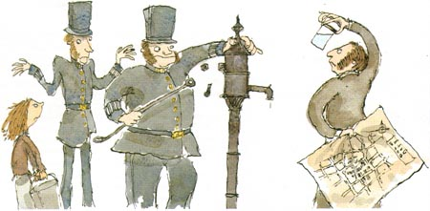
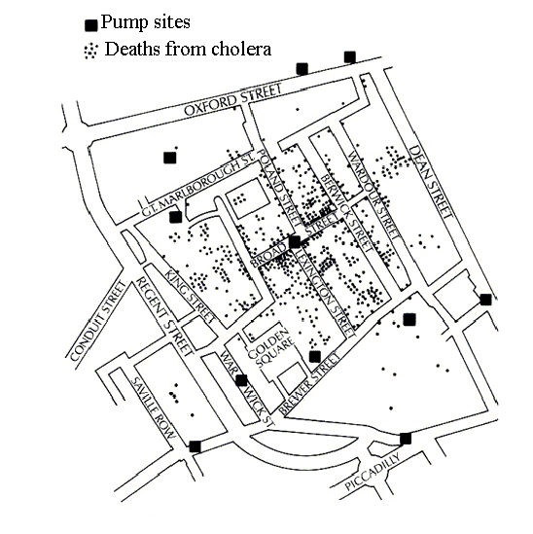
History of Transforming Cities with Spatial Computing
1854: What causes Cholera?
Collect & Curate Data
Discover Patterns,
Generate Hypothesis
Test Hypothesis
(Experiments)
Develop Theory
? water pump
Remove pump handle
Germ Theory
Impact on cities:
Health & well-being, parks,
sewer system to protect
drinking water, …
Q? What are Choleras of today?
Q? How may Spatial Computing Help?

Slide 5
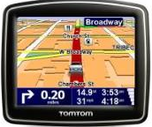
Spatial Computing Examples
Smarter Planet

Slide 6
Spatial Computing is a Critical Infrastructure Today!
2 billion GPS receivers in use, will hit 7 billion by 2022.
Besides location, it reference time for critical infrastructure
Telecommunications industry
Banks
Airlines...
GPS is the single point of failure for the entire modern economy.
50,000 incidents of deliberate (GPS) jamming last two years
Against Ubers, Waymo’s self-driving cars, delivery drones from Amazon
Source: https://www.bloomberg.com/news/features/2018-07-25/the-world-economy-runs-on-gps-it-needs-a-backup-plan

Slide 7
Spatial Computing in Modern Cities
Rank | 2015 | 2016 | 2017
1 | (69%) Geospatial / Mapping | (93%) Public Meeting records | (53%) GeoSpatial / Mapping
2 | (67%) Virtualization | (92%) Wireless Infrastructure | (48%) Cybersecurity
3 | (60%) Performance Benchmarks | (91%) Redundant/ Offsite Data Storage | (34%) Predictive Policing
4 | (58%) Transaction Processing | (90%) Endpoint Security | (32%) eDiscovery
5 | (57%) Project Management | (85%) Broadband Infrastructure | (20%) Predictive Analytics
Source: Digital Cities Survey, Center for Digital Government, GovTech.com, 11/9/2017.

Slide 8
Spatial Computing in Modern Cities
Operational
E-911, CMAS/PLAN, …
Situation awareness
Public Safety, e.g., Floods
Tactical
Property tax
Site selection
Asset tracking
Strategic
Long-term planning
Land-use
Source: https://www.cbronline.com/wp-content/uploads/2017/03/what-is-GIS.png

Slide 9
Outline
Motivation
Next: Knowledge Co-production (KC)
KC Story 1: Evacuation Planning
KC Story 2: A S&CC Project
Conclusions
Source: The Sheffield Mental Health Guide, sheffieldflourish.co.uk, 5 Apr 2017.

Slide 10
Advancing Science Discovery to Application
Knowledge co-production with users
Co-Visioning
Co-define Problems
Co-select Science Questions
Co-Evaluate Discoveries
Ex. NCAR
Source: NCAR/UCAR 2016 Annual Report

Slide 11
Knowledge Co-Production
Co-production Initiatives
CRA/CCC Visioning Workshops
(Midwest) Big Data Hubs & Spokes
NSF Sustainability Research Networks
NSF Smart & Connected Community
Co-Production Examples in my work
2005: Evacuation Planning: MN local governments
Current: NSF SCC Project: counties, cities in MN, FL

Slide 12
Outline
Motivation
Knowledge Co-production (KC)
KC Story 1: Evacuation Planning
KC Story 2: A S&CC Project
Conclusions

Slide 13
Knowledge Co-Production: Evacuation Planning (2005)
FoxTV newsclip (5-minutes), Disaster Area Evacuation Analytics Project
https://www.youtube.com/watch?v=PR9k72W8XK8

Slide 14
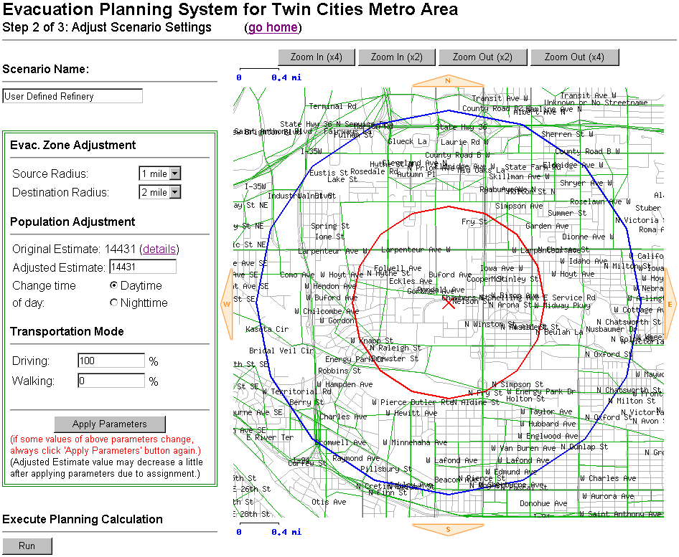
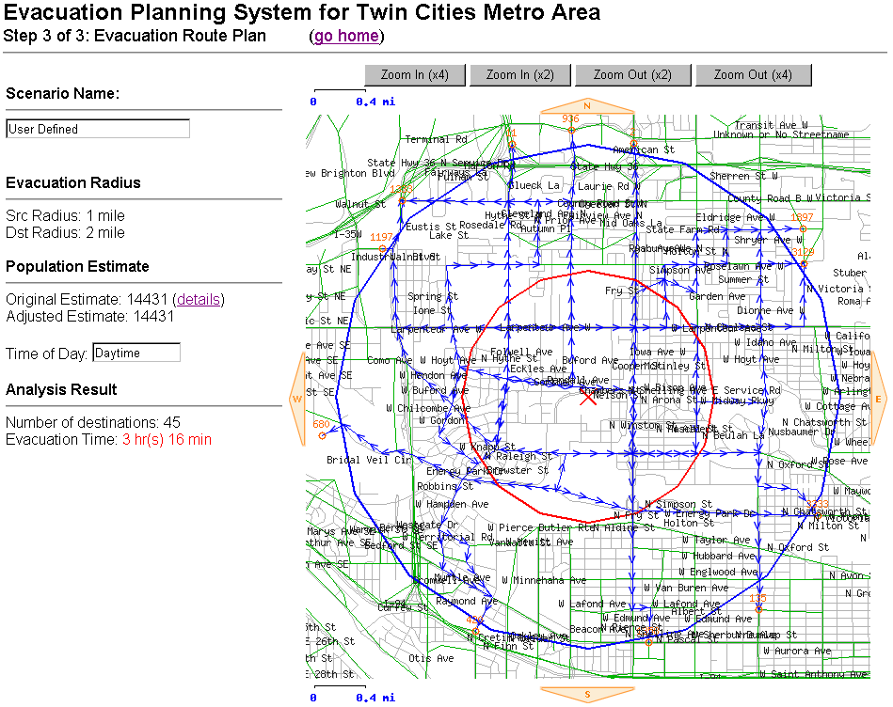
KC Story 1: Evacuation Planning (2005)
Team: US DHS, MN Dept. of Transportation, URS Corp.
Emergency Mangers, Police, Fire Fighters, Natl. Guard
Co-Visioning via monthly meetings
Challenges: evacuees & traffic maps
Police: focus on what can be done!
Problem Co-Definition
1-mile scenarios: 5 sites, work-day or night-time
Co-Discovery
For 1st mile, walking faster than driving
Co-Evaluation
Walk selected routes : avoid wooden bridge near E
Lock parking garages during evacuation ?
Scenario | Population | Vehicle | Walking
A | 143,360 | 4:45 | 1:32
B | 83,143 | 2:45 | 1:04
C | 27,406 | 4:27 | 1:41
D | 50,995 | 3:41 | 1:20
E | 3,611 | 1:21 | 0:36
Details: FoxTV newsclip, Shashi Shekhar Disaster Area Evacuation Analytics,
https://www.youtube.com/watch?v=PR9k72W8XK8

Slide 15
Outline
Motivation
Knowledge Co-production (KC)
KC Story 1: Evacuation Planning
KC Story 2: A S&CC Project
Conclusions

Slide 16
Knowledge Co-Production: NSF Smart & Connected Communities Grant 1737633 (2017-2020)
Team: U of Minnesota, Purdue U, FL State U, U of WA
Schools, Counties (e.g., Hennepin), Cities (e.g., Minneapolis, St. Paul, Tallahassee);
MetroLab Network, National League of Cities, ICLEI-USA, Intl. City/County
Co-Visioning via meetings
Communities planning infrastructure for driver-less, post-carbon future with climate change
Advance Environment, Health, Wellbeing & Equity via infrastructure refinement
Co-select Questions
Understand spatial equity in infrastructure & outcomes (wellbeing. health, environment)?
How does equity first approach differ from average-outcome based approaches ?
Problem Co-Definition: How to measure spatial equity? Well-being?
Co-Discovery
Co-Evaluation
Details: University of Minnesota secures $2.5 million grant to improve quality of life in cities, October 20, 2017 (https://www.cs.umn.edu/news/filter/highlights/professor-shekhar-leads-u-m-team-granted-25-million-nsf-grant )
Social Equity
Research
Education
Community Partners & Outreach
Diversity

Slide 17
KC Story 2: A NSF S&CC Project
Academic History
Humphrey center
Center for Urban & Regional Affairs
Hennepin University Partnership
Center for Transportation Studies
Local Government History
2010-2020: Regional 10-year planning cycle (Metropolitan Council)
2013-14: Thrive MSP 2040
2015: USDOT Smart Cities Challenge proposal by Minneapolis

Slide 18
KC Story 2: S&CC – Co-visioning
Local Context
Metropolitan Council : 2040 Plan
Fall 2016: NSF S&CC Proposal

Slide 19
KC Story 2: S&CC – Co-visioning
Source: https://metrocouncil.org/About-Us/why-we-matter/Equity.aspx

Slide 20
KC Story 2: S&CC – Co-visioning
Co-visioning Meetings (Academics + Local Governments)
2014: Smart City Workshop
2015-16: NSF SRN Sustainable & Health Cities – Equity
Co-Visioning
Infrastructure planning for driver-less, post-carbon future, climate change
Advance Environment, Health, Wellbeing & Equity via infrastructure refinement
Co-select Questions
Understand spatial equity in infrastructure & outcomes
wellbeing. health, environment
How does equity first approach differ from average-outcome based approaches ?
Problem Co-Definition: How to measure spatial equity? Well-being?

Slide 21
KC Story 2: S&CC – Co-select Question
Team: U of Minnesota, Purdue U, FL State U, U of WA
Schools, Counties (e.g., Hennepin), Cities (e.g., Minneapolis, St. Paul, Tallahassee);
MetroLab Network, National League of Cities, ICLEI-USA, Intl. City/County
Co-Discovery:
Co-Evaluation
Social Equity
Research
Education
Community Partners & Outreach
Diversity

Slide 22
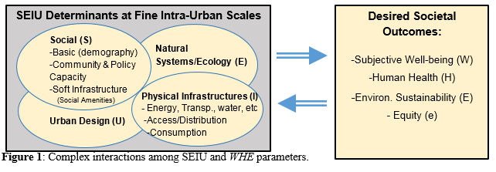
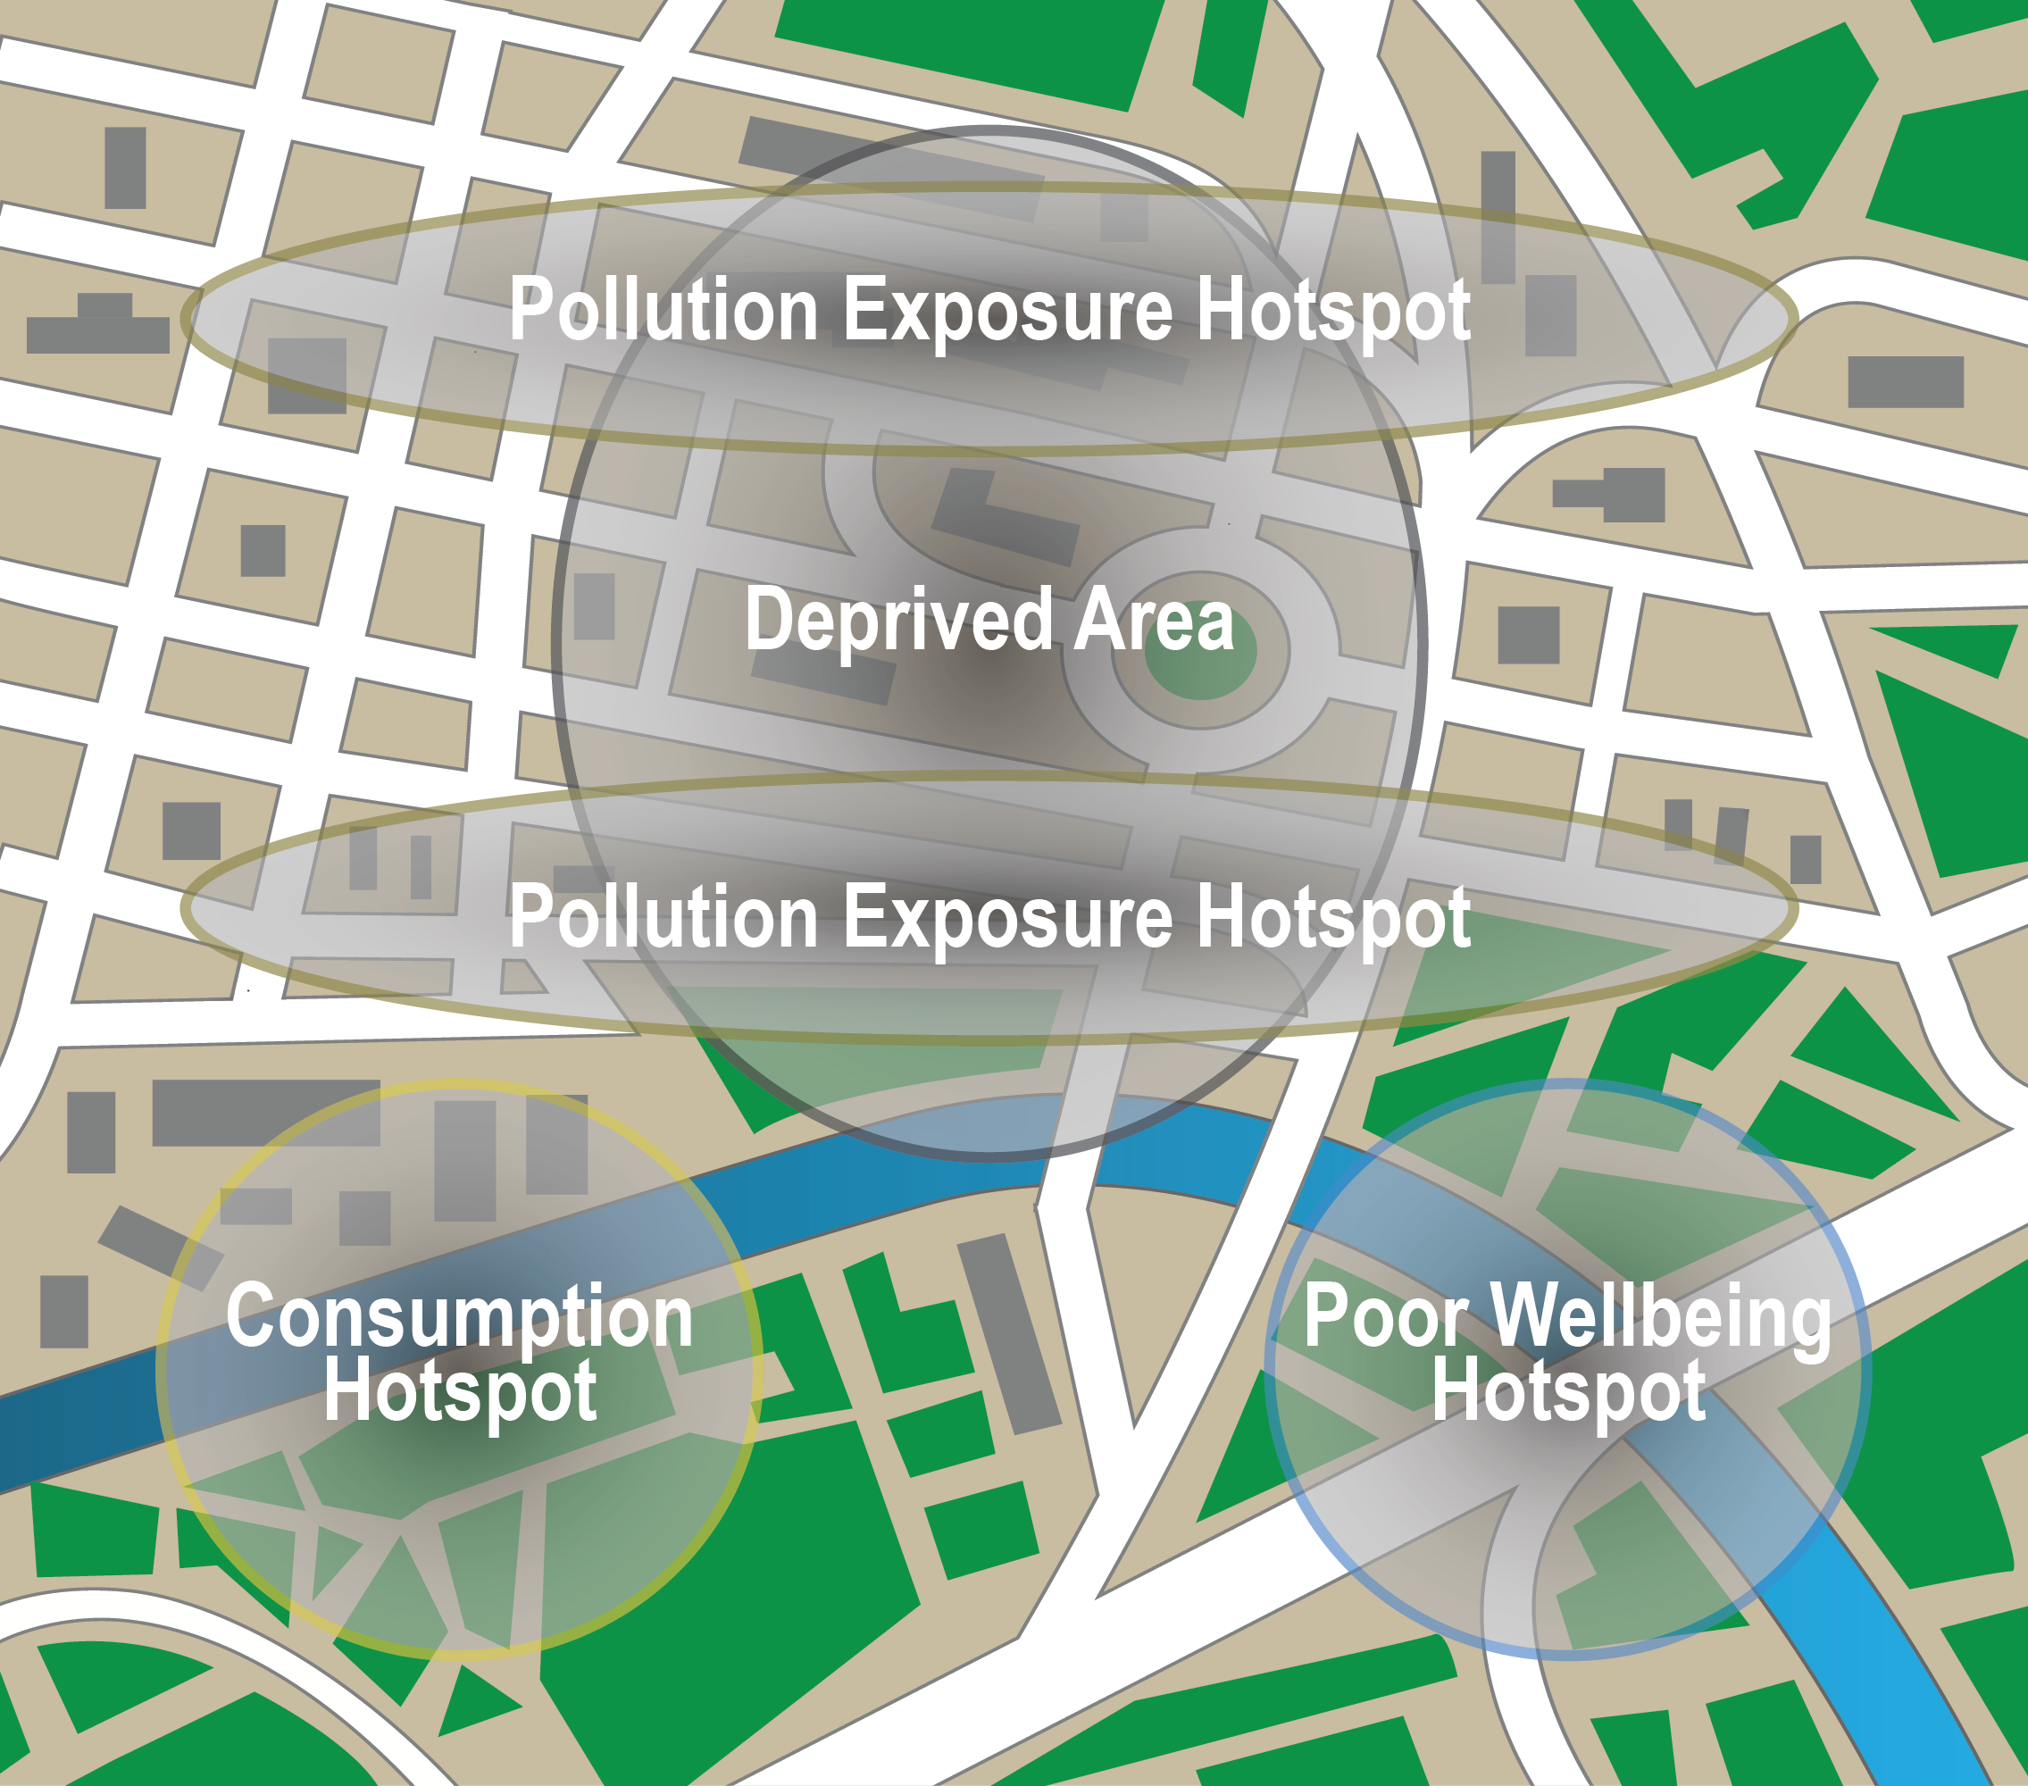
Project Aims & Approach
Objectives
Understand spatial equity (e) in the context of 7 basic infrastructure provisioning and related wellbeing (W), health (H), environment (E) and equity (e) outcomes in cities
Advance all four outcomes using smart spatial infrastructure planning in cities.
Approach in collaboration of Community Partners
Comprehensive fine intra-urban scale data (SEIU-EHW parameters in Figure 1)
Spatial Data Science to understand relationships (Figure 2).
Model & visualize multi-infrastructure spatial smart city futures
Knowledge co-production theories, science and practice
Figure 1. Complex Interactions among SEIU and EHW parameters
Figure 2. Spatial Patterns
Notes:
A brief background: Please describe the problem you are addressing and why it is important (20sec slide)

Slide 23
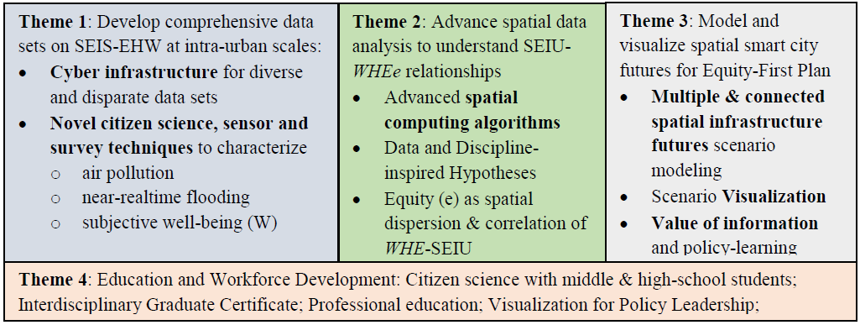
Four Themes
Notes:
A brief background: Please describe the problem you are addressing and why it is important (20sec slide)

Slide 24
Data-Intensive Science of S&CC in 21st Century
Hotspots of infrastructure deprivation, consumption, pollution, investment, disease & well-being. Correlates?
Equity first
policies
Role of policies & urban forms
SEIU EHW
Collect, & Curate
Big Data
Spatial Patterns, Hypothesis Generation
Test Hypothesis
(Policy Intervention)
S&CC Theory
Volume, Variety
Data-driven and Discipline-inspired hypothesis generation

Slide 25
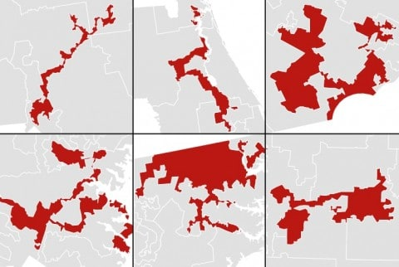
Spatial Data Science: Gerrymandering Challenge
Challenge: Spatial partitioning affects election results
Modifiable Areal Unit Problem (MAUP)
...
US Electoral District with Irregular shapes
Source: Washington Post

Slide 26
Task 2B: Discover co-location and teleconnection patterns
Challenge: Traditional statistical methods miss spatial interactions
Prelim. Results: Co-location and teleconnection reveal spatial interaction
between variables for point data types
Proposed: address data with multiple levels of aggregation, e.g., areal summary
(a) a map of 3 features
(c) Neighbor graph
(b) Spatial Partitions
 | Pearson’s Correlation | Ripley’s cross-K | Participation Index (colocation)
- | -0.90 | 0.33 | 0.5
- | 1 | 0.5 | 1

Slide 27
Outline
Motivation
Knowledge Co-production (KC)
KC Story 1: Evacuation Planning
KC Story 2: Spatial Computing in Smart Cities
Conclusions

Slide 28
CONCLUSIONS & NEXT STEPS
Cities is societally important and facing challenges
Majority live in cities
Challenges: climate change, aging infrastructure, …
Opportunities: renewable energy, self-driving vehicles, …
Spatial Computing has already transformed Cities
Sanitation, green spaces, E-911, public safety, …
Many Transformative opportunities lie ahead
Ex. Spatial equity
However, these will not material without
Knowledge Co-production: local governments, academics, businesses, …
Basic Research, e.g., spatial data science to overcome gerrymandering challenge

Slide 29
Acknowledgements
P.I., Connecting the Smart-City Paradigm with a Sustainable Urban Infrastructure Systems Frame- work to Advance Equity in Communities, NSF(Award 1737633), $2.5 M, 9/1/2017 - 8/31/2020.
Co-P.I., Planning Grant: Engineering Research Center for Intelligent Infrastructure for Safe, Efficient and Resilient Mobility, NSF,(Award 1840432), 97K, 9/18-8/19, (PI: Anil Misra, University of Kansas).
Co-P.I., Cloud-Connected Delivery Vehicles: Boosting Fuel Economy Using Physics-Aware Spatio- temporal Data Analysis and Real-Time Powertrain Control, USDOE ARPA-E, $1.78M (1.4M fed.), 2/17 - 2//20. (PI: W. Northrop)
P.I., Identifying and Analyzing Patterns of Evasion (HM0210-13-1-0005), USDOD-NGA, $0.6M, 6/13- 12/18.
Co-P.I., Increasing Low-Input Turfgrass Adoption Through Breeding, Innovation, and Public Education, USDA/NIFA/SCRI (contract 2017-51181-27222), $5.4 M, 9/17 - 8/21. (with E. Watkins).
Notes:
A brief background: Please describe the problem you are addressing and why it is important (20sec slide)

Slide 30
Key Definitions
Social equity (e): a fair distribution of resources and an avoidance of exclusionary practices, allowing all residents to participate fully in society, socially, economically and politically” (Dempsey, et al., 2012).

