Slide 1




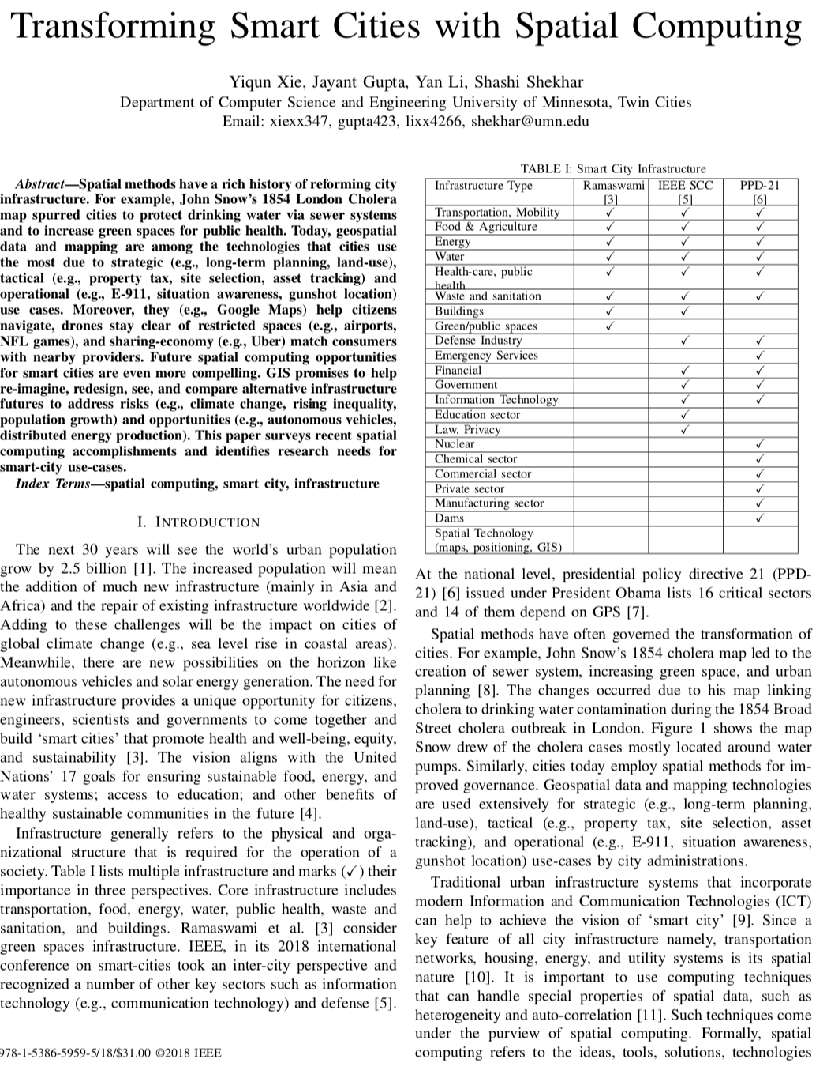
Transforming Smart Cities with Spatial Computing
Workshop on New mobility and cities: Exploring a research network of urban sustainability observatories via data-enabled university-community partnerships,
Ohio State University: July 15th, 2019.
Shashi Shekhar
McKnight Distinguished University Professor, University of Minnesota
www.cs.umn.edu/~shekhar : shekhar@umn.edu
  Ack.: NSF S&CC Award 1737633.
Details: Transforming Smart Cities with Spatial Computing,
Proc. IEEE International Smart Cities Conference, 2018 (w/ Y. Xie et al.).
Notes:
1
1

Slide 2
Acknowledgements
  P.I., Connecting the Smart-City Paradigm with a Sustainable Urban Infrastructure Systems Frame- work to Advance Equity in Communities, NSF(1737633), $2.5 M, 9/17 - 8/20.
  Co-P.I., Planning Grant: Engineering Research Center for Intelligent Infrastructure for Safe, Efficient and Resilient Mobility, NSF,(1840432), 97K, 9/18-8/20, (P.I.: A. Misra, U of Kansas).
  Co-P.I., Cloud-Connected Delivery Vehicles: Boosting Fuel Economy Using Physics-Aware Spatio- temporal Data Analysis and Real-Time Powertrain Control, USDOE ARPA-E, $1.78M (1.4M fed.), 2/17 - 2//20. (P.I.: W. Northrop)
  Co-P.I., Increasing Low-Input Turfgrass Adoption Through Breeding, Innovation, and Public Education, USDA/NIFA/SCRI (2017-51181-27222), $5.4 M, 9/17 - 8/21. (with E. Watkins et al.).
  P.I., III: Medium: Investigating Spatio-Temporal Informatics to Advance Transportation Science, NSF, 1.2M, 9/19-8/23 (recommended), w/ W. Northrop.
  Also part of (a) Ford Motor Company University Research Program, (b) NSF Midwest Big Data Hub: Building Communities to Harness the Data Revolution, $4M, 6/19-5/23; and (c) NIH Clinical and Translational Science Award (CTSA), $42M, 3/18 - 2/23. (P.I.: B. Blazar).
Notes:
A brief background: Please describe the problem you are addressing and why it is important (20sec slide)

Slide 3
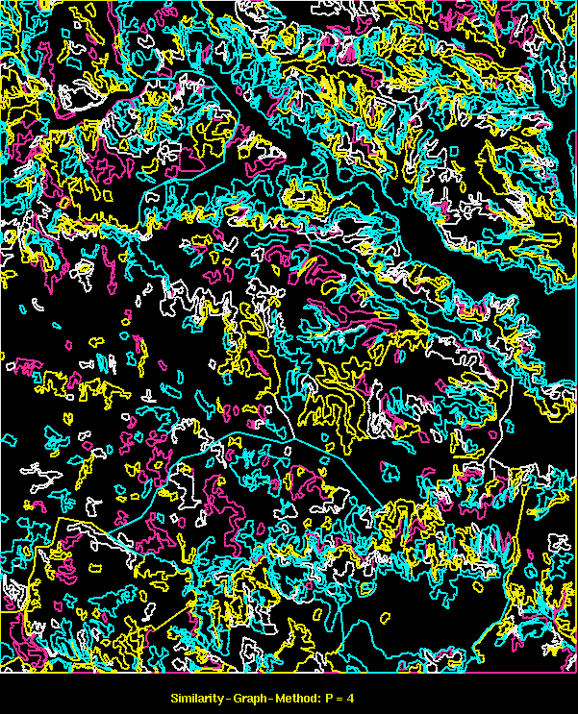
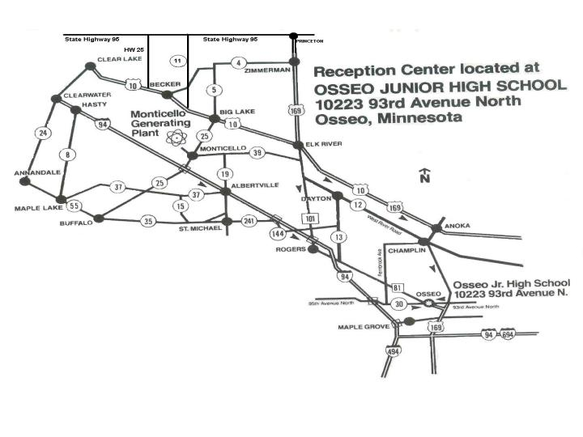
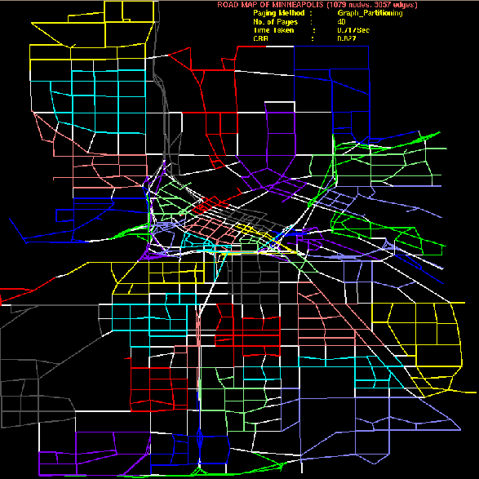

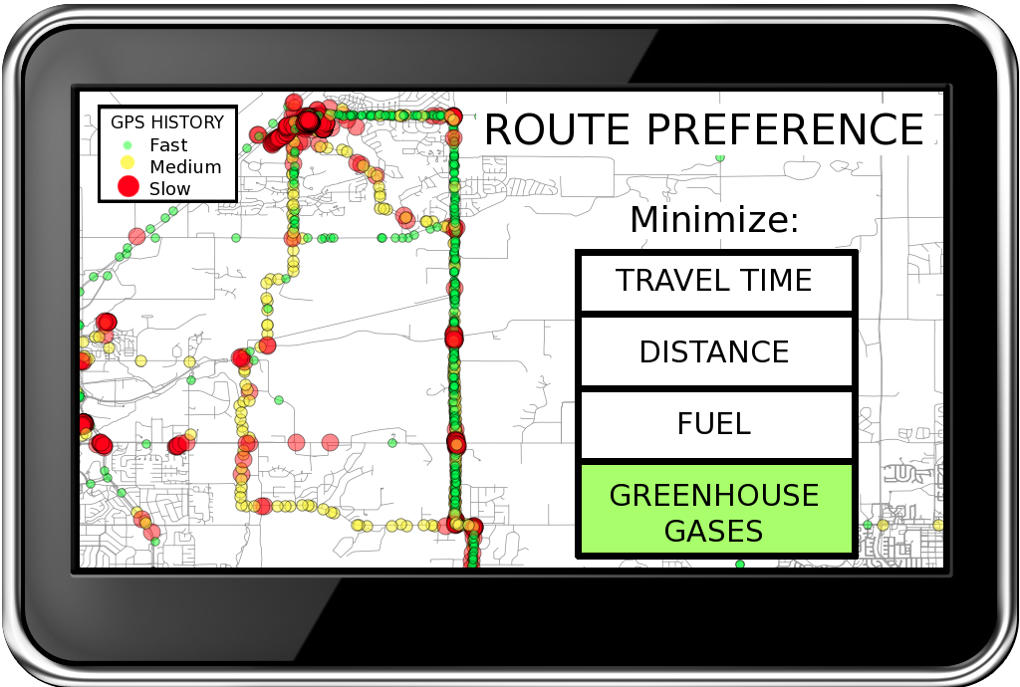
Spatial Databases: Representative Projects
Evacutation Route Planning
Parallelize
Range
Queries
only in old plan
Only in new plan
In both plans
Storing graphs on disk
Eco-Routing
Details: (1) Spatial Computing, MIT Press (Essential Knowledge Series), 2020 (expected).
(2) Spatial Databases: A Tour, Prentice Hall, 2003.
(3) Spatial Database: Accomplishments and Research Needs,
IEEE Trans. on Knowledge and Data Engineering, 11(1), 1999.

Slide 4
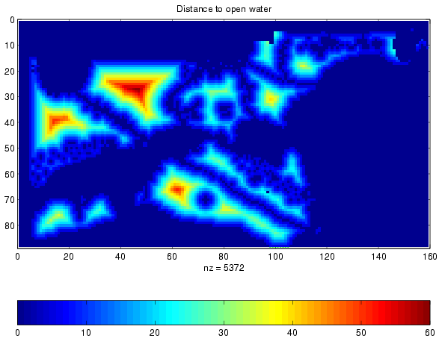
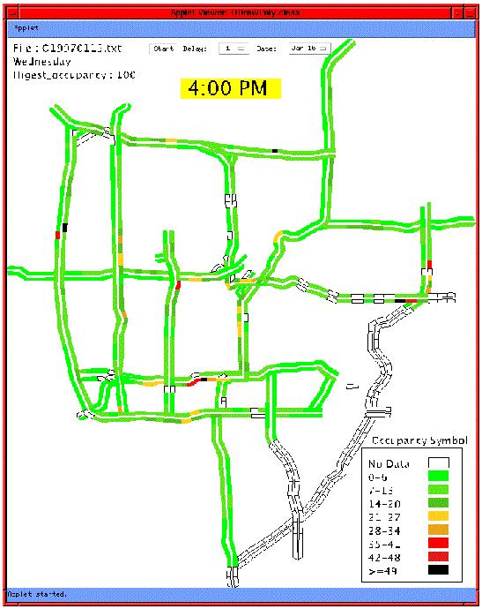
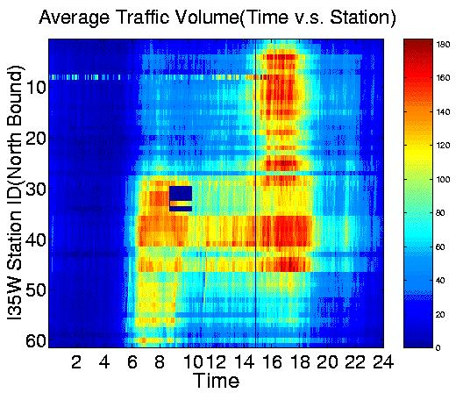
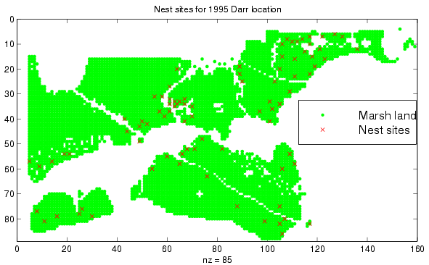
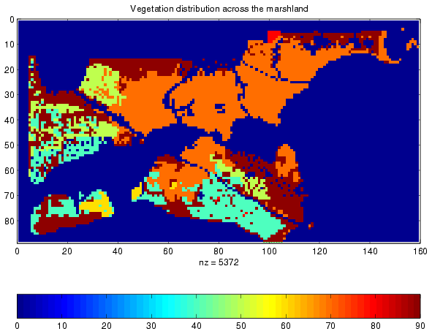
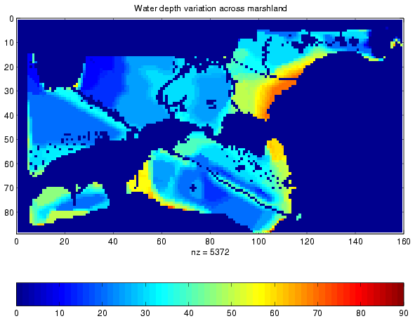
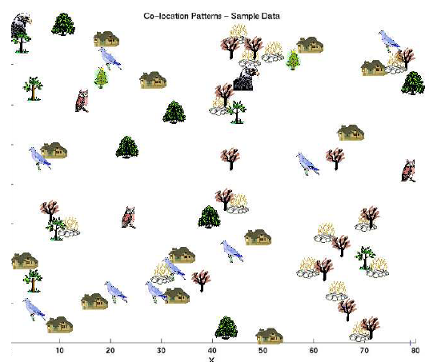
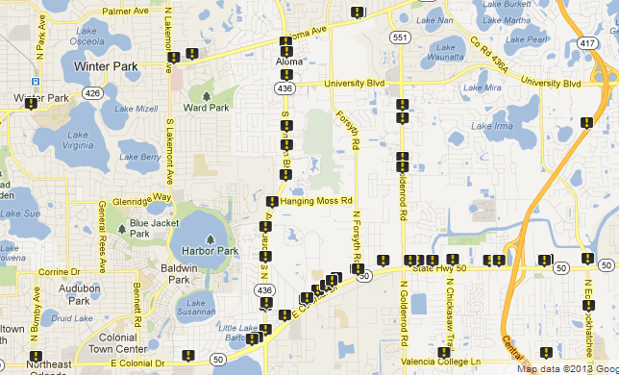
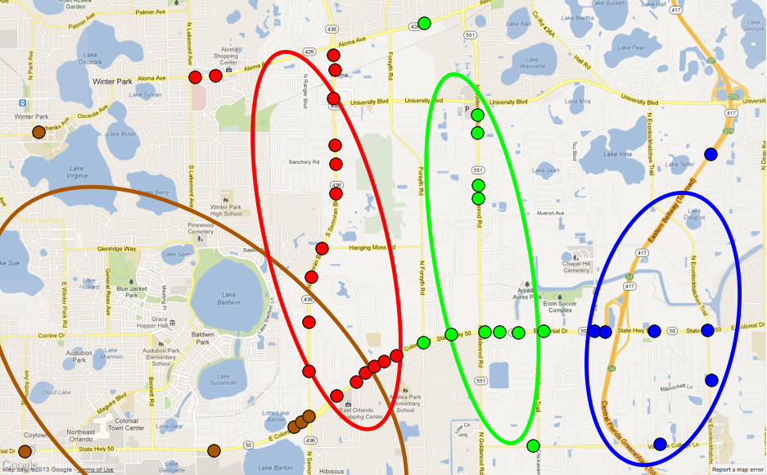
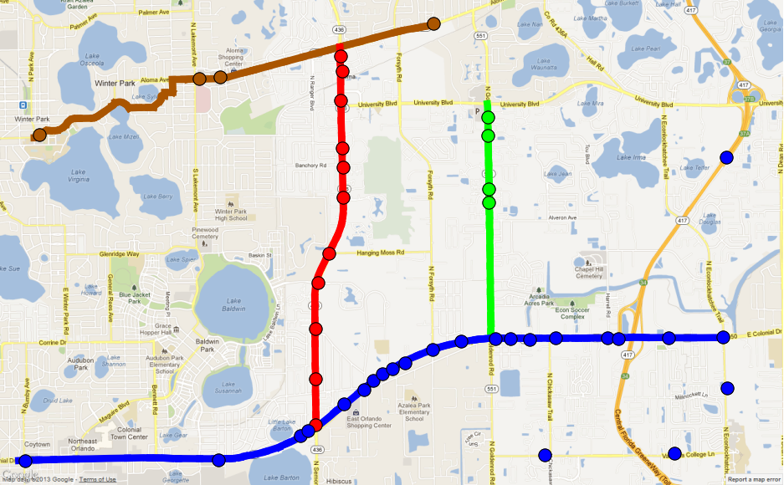
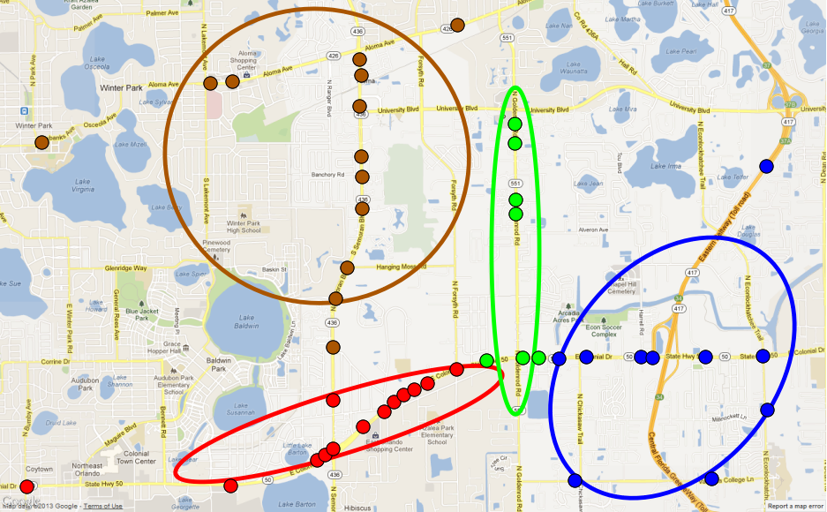
Spatial Data Mining: Representative Projects
Location prediction: nesting sites
Spatial outliers: sensor on I-35
Nest locations
Distance to open water
Vegetation durability
Water depth
Co-location Patterns
Spatial Network Activity Summarization
Input: k = 4, 43 fatalities
K-Means (Euclidean Distance)
K-Means (Network Distance)
Linear Hotspots
Details: (a) Transdisciplinary Foundations of Geospatial Data Science, ISPRS Intl.Jr. of Geo-Informatics, 6(12), 2017. doi:10.3390/ijgi6120395.
(b) Identifying patterns in spatial information: a survey of methods,
Wiley Interdisc. Reviews: Data Mining and Know. Discovery , 1(3):193-214, May/June 2011

Slide 5
OUTLINE
Motivation
  Spatial Methods and Industrial Cities
  Spatial Computing in Modern Cities
Knowledge Co-production (KC)
KC Story 1: Evacuation Planning
KC Story 2: A S&CC Project
Conclusions

Slide 6
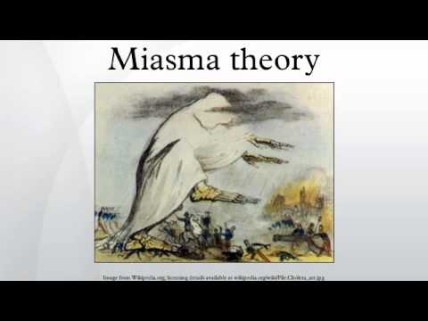
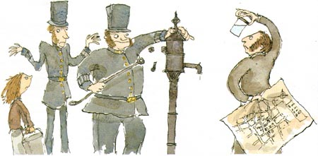
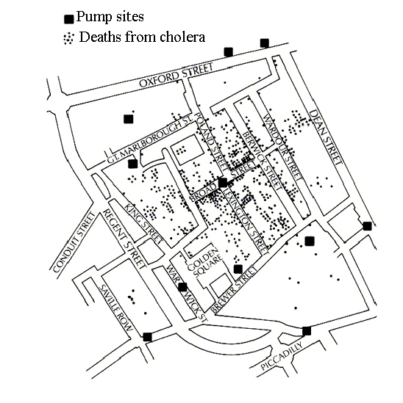

History of Transforming Cities with Spatial Computing
1854: What causes Cholera?
Collect & Curate Data
Discover Patterns,
Generate Hypothesis
Test Hypothesis
(Experiments)
Develop Theory
? water pump
Remove pump handle
Germ Theory
Impact on cities:
Health & well-being, parks,
sewer system to protect
drinking water, …
Q? What are Choleras of today?
Q? How may Spatial Computing Help?

Slide 7



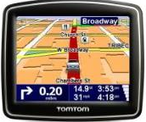











Spatial Computing Examples
Smarter
Planet

Slide 8
What is Spatial Computing?
  A convergence of revolutions in sub-areas
  Positioning, e.g., GPS, wi-fi, …
  Remote Sensing, e.g., nano-satellites, cloud-hosted data
  GIS, e.g., virtual globes, Geo-design, …
  Spatial Data Science, e.g., spatial data mining, …
  Spatial DBMS, e.g., SQL3/OGC
  To solve Societal Problems
    Food : Precision Agriculture, Global Agriculture Monitoring, …
    Mobility : Navigation, e.g., Google Maps
    Mobility : Ride-sharing services, e.g., Uber, Didi, …
  Details:
    Spatial Computing, Communications of the ACM, 59(1), Jan. 2016.
Notes:
8
8

Slide 9
The Changing World of Spatial Computing
 | Last Century | Last Decade
Map User | Well-trained few | Billions
Mappers | Well-trained few | Billions
Software, Hardware | Few layers, e.g., Applications: Arc/GIS, Databases: SQL3/OGIS | Almost all layers
User Expectations & Risks | Modest | Many use-case & Geo-privacy concerns

Slide 10


Spatial Computing is a Critical Infrastructure Today!
2 billion GPS receivers in use, will hit 7 billion by 2022.
Besides location, it reference time for critical infrastructure
  Telecommunications industry
  Banks
  Airlines...
GPS is the single point of failure for the entire modern economy.
50,000 incidents of deliberate (GPS) jamming last two years
  Against Ubers, Waymo’s self-driving cars, delivery drones from Amazon
Source: https://www.bloomberg.com/news/features/2018-07-25/the-world-economy-runs-on-gps-it-needs-a-backup-plan

Slide 11
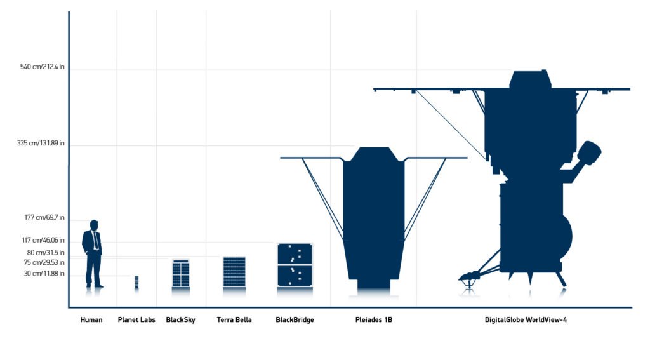

Large Constellations of Small Satellites
Hi-frequency time-series of imagery of entire earth
Large Constellations Ex. Planet Labs: 100 satellites: daily scan of Earth at 1m resolution
Source: WorldView FAQ, blog.digitalglobe.com/news/frequently-asked-questions-about-worldview-4/

Slide 12
  Cheap (or free) satellite data on cloud computers
2008: USGS gave away 35-year LandSat satellite imagery archive
  Analog of public availability of GPS signal in late 1980s
  2017: Many cloud-based Virtual collaboration environment
    Explosion in machine learning on satelliite imagery to map crops, water, buildings, roads, …
 | Google Earth Engines | NEX | AWS Earth
Elevation, Landsat, LOCA, MODIS, NAIP | x | x | x
NOAA | x |  | x
AVHRR, FIA, GIMMM, GlobCover, NARR, TRIMM, Sentinel-1 | x | x
IARPA, GDELT, MOGREPS, OpenStreetMap, Sentinel-2, SpaceNet (building/road labels for ML) |  |  | x
CHIRPS, GeoScience Australia, GSMap, NASS, Oxford Map, PSDI, WHRC, WorldClim, WorldPop, WWF, | x
BCCA, FLUXNET |  | x

Slide 13
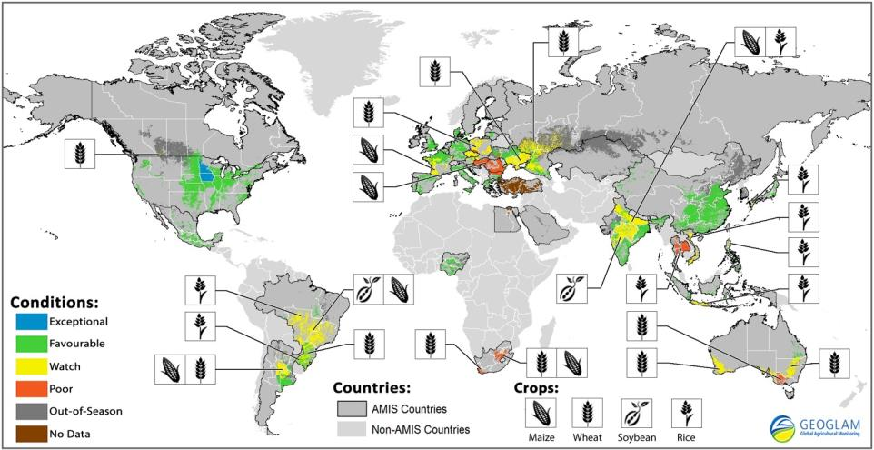


  Global Agriculture Monitoring

Slide 14
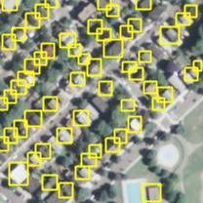
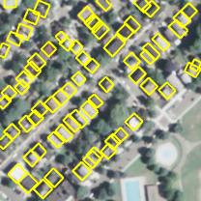
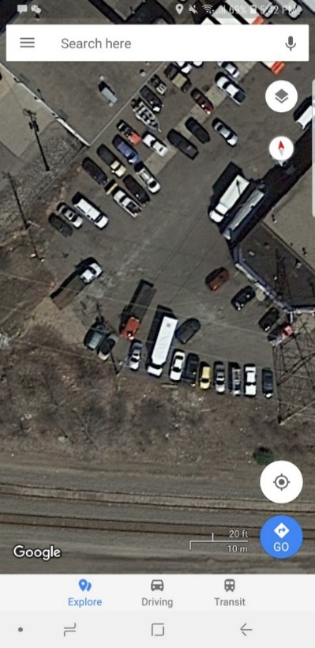
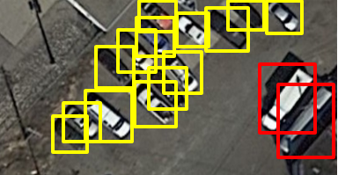
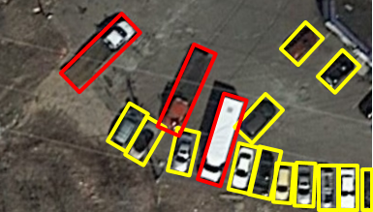
Mapping Urban Objects: Buildings, Vehicles, …
YOLO (baseline)
Proposed method
Q:? How many building does a City have?
Q? Estimate truck supply in a city (CH Robinson).
Data:
  Buildings: NAIP Imagery (1 meter pixels)
    MA Buildings Dataset, 2017 https://www.cs.toronto.edu/~vmnih/data/
  Vehicles: Aerial imagery (3 inch pixels )
    Hennepin & Ramsey counties
Method:
  YOLO Deep Learning
Patterns:
  Detected geospatial objects
    Houses
    Cars, trucks, …
Input training image
Input training MOBRs
Test image
Output MBRs
car
truck
Y. Xie,, R. Bhojwani, S. Shekhar, and J. Knight, An unsupervised augmentation framework for deep learning based geospatial object detection: A summary of results.
In Proc. 26th ACM SIGSPATIAL Intl. Conf. on Adv. in GIS (pp. 349-358), 2018
Notes:
use case: ch robinson estimate supply in a city
7cm resolution image source

Slide 15
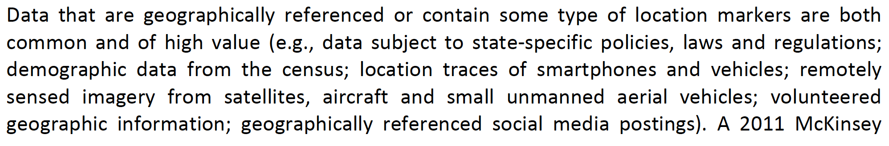
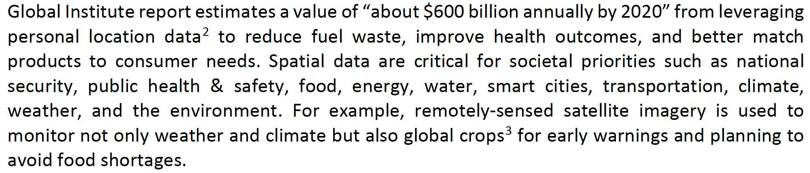



Slide 16
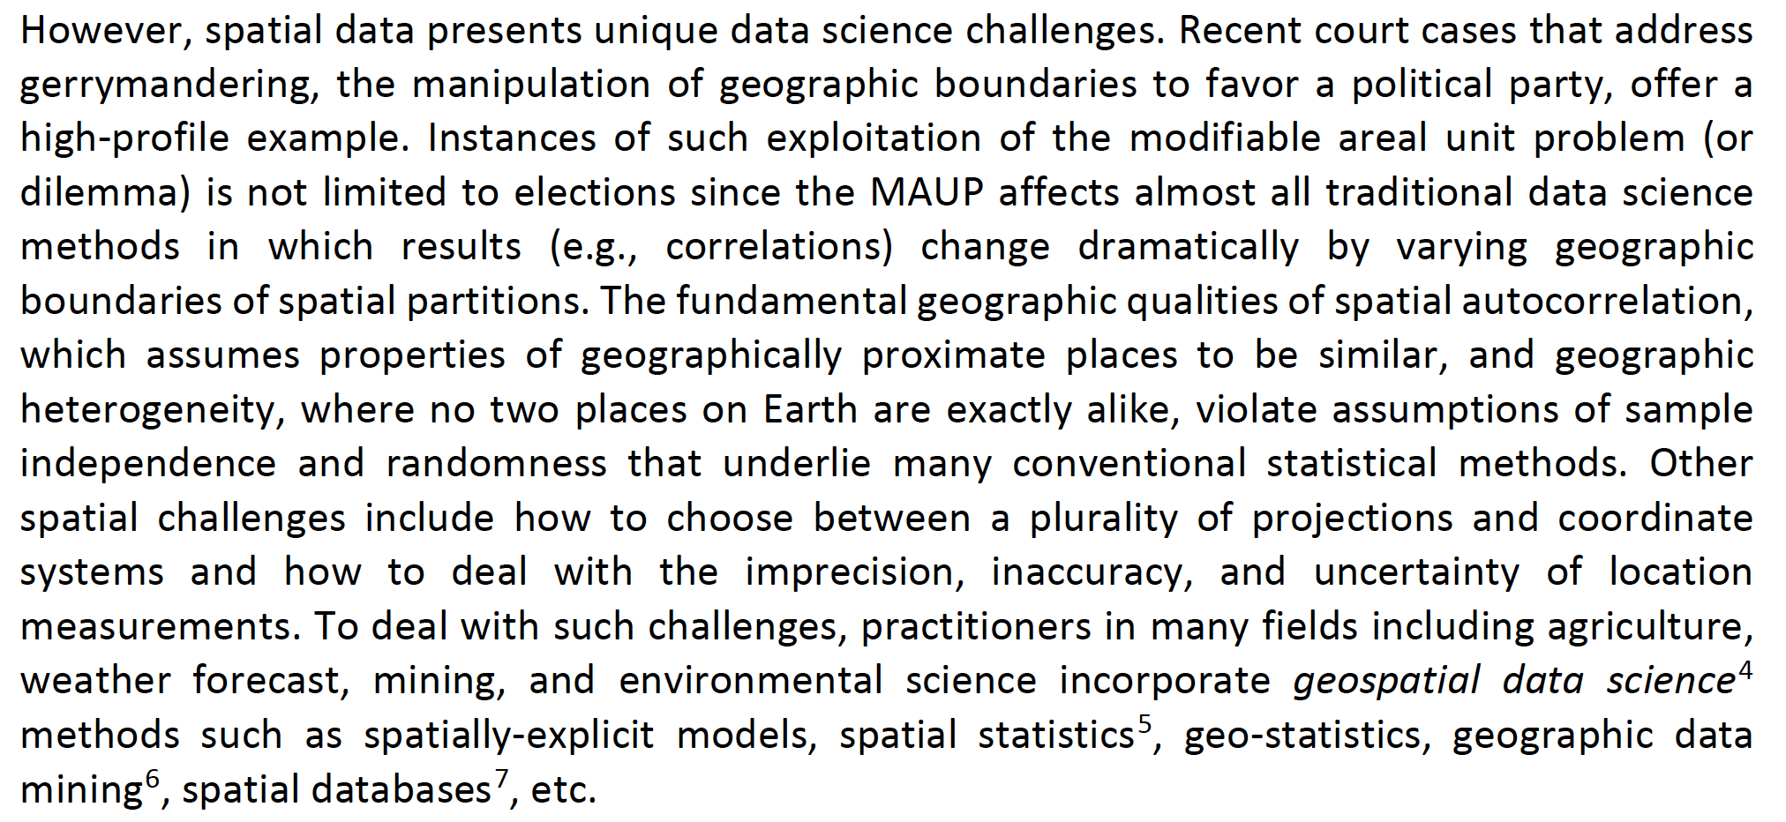
One Size Data Science Does not Fit All Data!

Slide 17
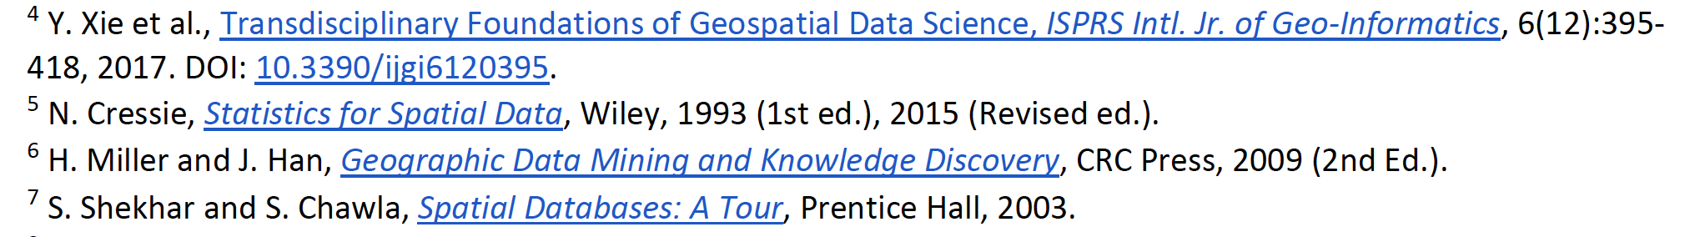
Spatial Data Science Tools

Slide 18

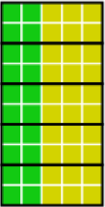
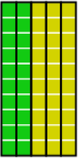
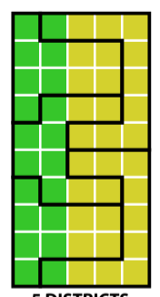
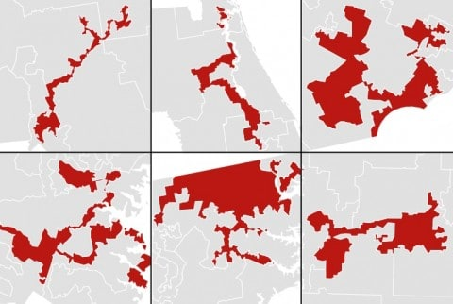
Spatial Partitioning: Gerrymandering
Space partitioning affects statistical results!
  Gerrymandering Elections, Correlations
  Modifiable Areal Unit Problem (MAUP) Dilemma
Partition
Election Results
0 - 5
2 - 3
3 - 2
 | Partition Based Pearson’s Correlation | Support
- | -0.90 | 0
- | 1 | 1
Gini-Index | 0.47 | 0.47 | 0 | 0.36
US Electoral District with Irregular shapes(Source: Washington Post)
Notes:
Policymaker rely upon aggregated surveys and census data to track and respond to various metrics (e.g. Poverty). Various aggregation measures are based on geographical partitions. However, if the partitions are changed the resulting statistical values change as well. Such techniques are often used in elections, called gerrymandering.

Slide 19
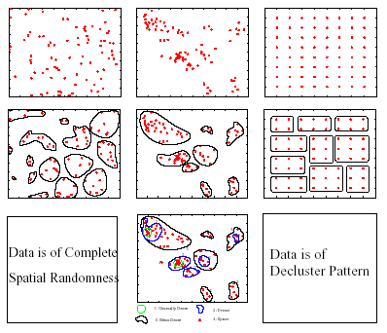
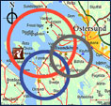
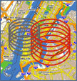

Limitation of Traditional Clustering
Challenge: One size does not fit all
  Prediction error vs. model bias, Cost of false positives, …
Example. Clustering: Find groups of points
Traditional Clustering
(K-means always finds clusters)
Spatial Clustering begs to differ!

Slide 20
OUTLINE
Motivation
  Spatial Methods and Industrial Cities
  Spatial Computing in Modern Cities
Knowledge Co-production (KC)
KC Story 1: Evacuation Planning
KC Story 2: A S&CC Project
Conclusions

Slide 21
Spatial Computing in Modern Cities
Rank | 2015 | 2016 | 2017
1 | (69%) Geospatial / Mapping | (93%) Public Meeting records | (53%) GeoSpatial / Mapping
2 | (67%) Virtualization | (92%) Wireless Infrastructure | (48%) Cybersecurity
3 | (60%) Performance Benchmarks | (91%) Redundant/ Offsite Data Storage | (34%) Predictive Policing
4 | (58%) Transaction Processing | (90%) Endpoint Security | (32%) eDiscovery
5 | (57%) Project Management | (85%) Broadband Infrastructure | (20%) Predictive Analytics
Source: Digital Cities Survey, Center for Digital Government, GovTech.com, 11/9/2017.

Slide 22
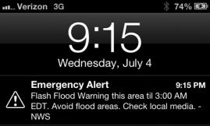



Operational Use: Emergency Services
Gun-shot detection
  triangulate from microphones
E-911: Locate cell-phone calling 911
Reverse 911
CMAS, PLAN: Geo-targeted Alert & Warning
…

Slide 23
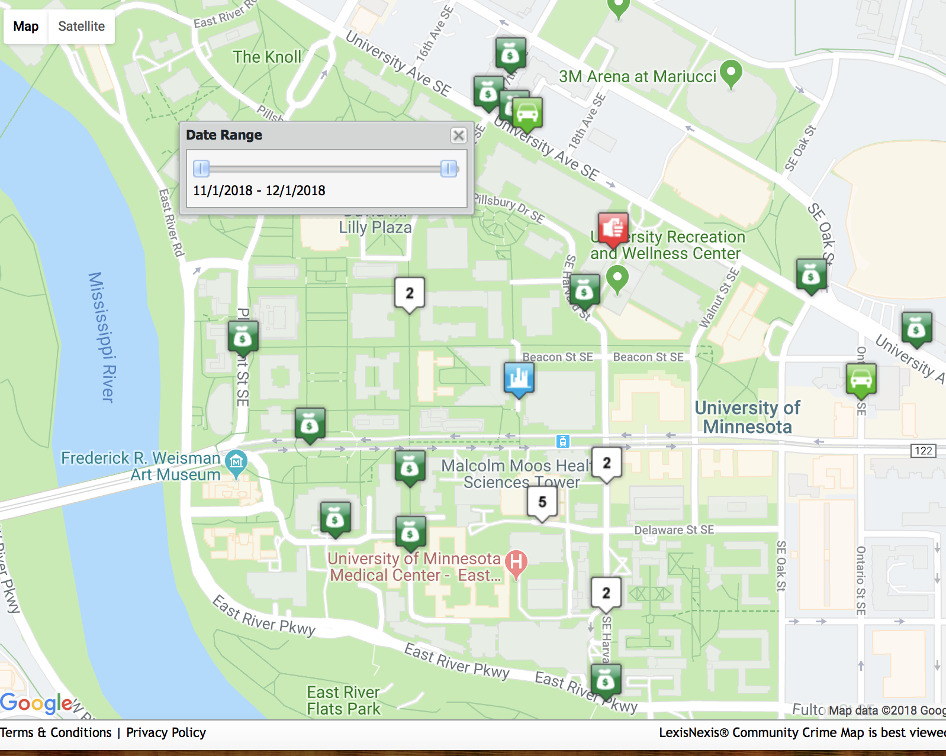
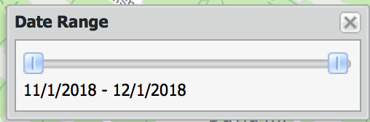
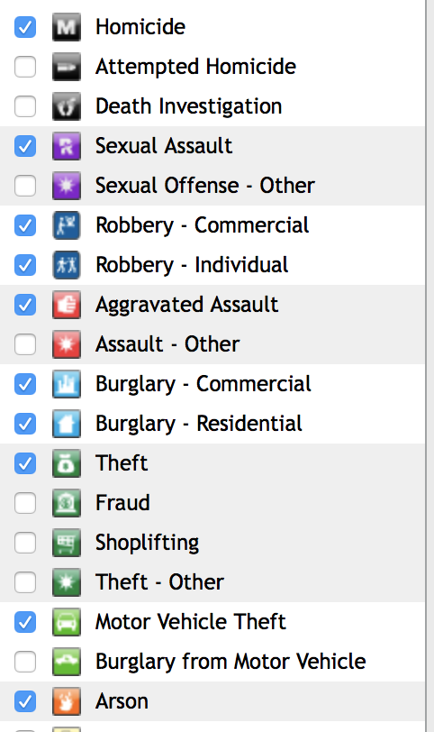
Operational Use: Crime Mapping
Sources: www.ci.minneapolis.mn.us/police/statistics, communitycrimemap.com
23

Slide 24
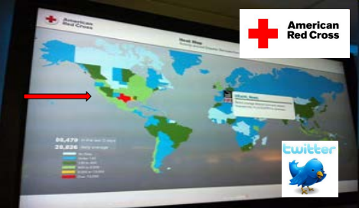
Operational Use: Early Warning Systems
Monitoring Tweets for disaster events & location
Even before cable news outlets began reporting the tornadoes that ripped through Texas on Tuesday, a map of the state began blinking red on a screen in the Red Cross' new social media monitoring center, alerting weather watchers that something was happening in the hard-hit area. (AP, April 16th, 2012).
24

Slide 25
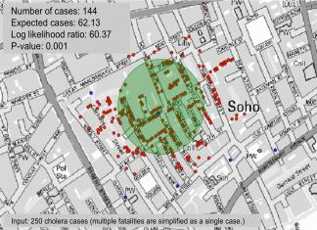
Tactical Use: Hotspots
The 1854 Asiatic Cholera in London
  Near Broad St. water pump except a brewery

Slide 26
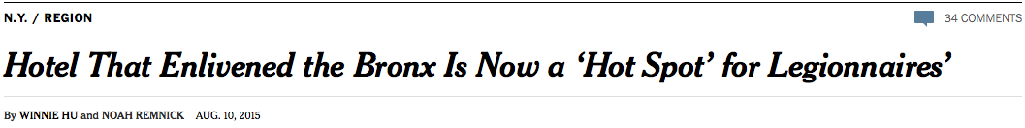
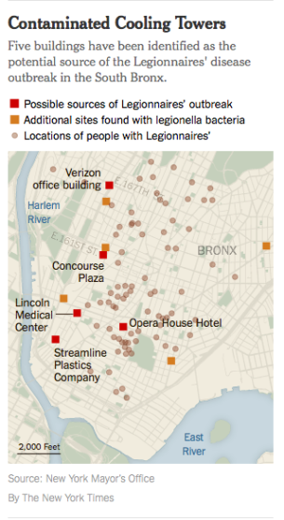
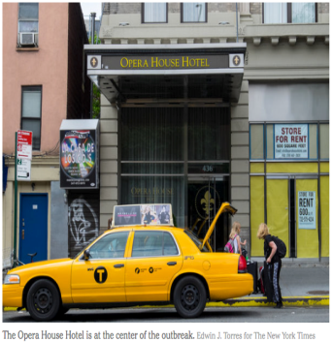

Slide 27
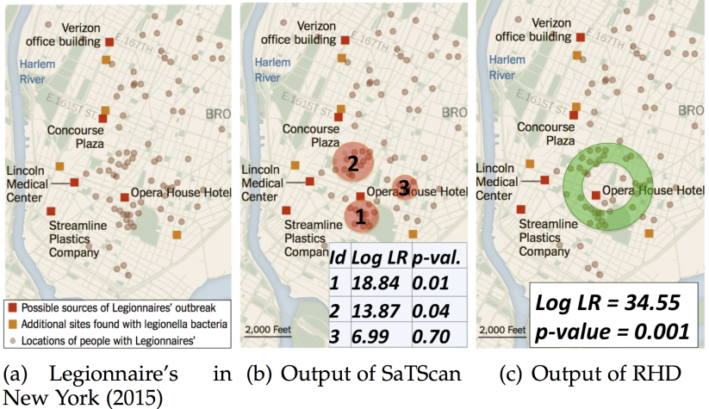
Legionnaires’ Disease Outbreak in New York
Details: Ring-Shaped Hotspot Detection, IEEE Trans. Know. & Data Eng., 28(12), 2016.
(A Summary in Proc. IEEE ICDM 2014) (w/ E. Eftelioglu et al.)

Slide 28
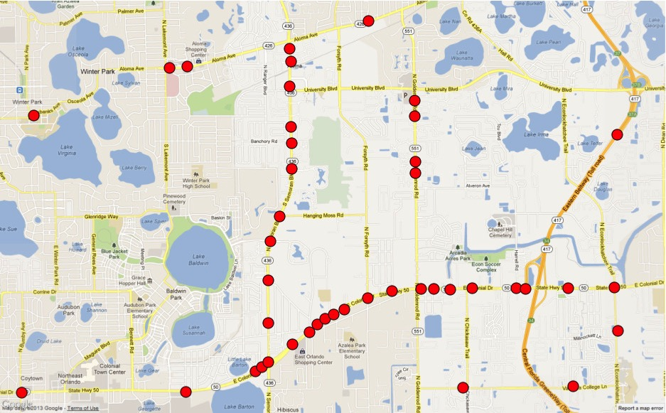
Tactical Use: Linear Hotspots
  Urban data, e.g., road accidents
  Ex. Pedestrian fatalities, Orlando, FL
Circular hotspots (SatScan)
Linear hotspots
Details: Significant Linear Hotspot Discovery, IEEE Transactions on Big Data, 3(2):140-153, 2017.
(Summary in Proc. Geographic Info. Sc., Springer LNCS 8728:284-300, 2014.

Slide 29
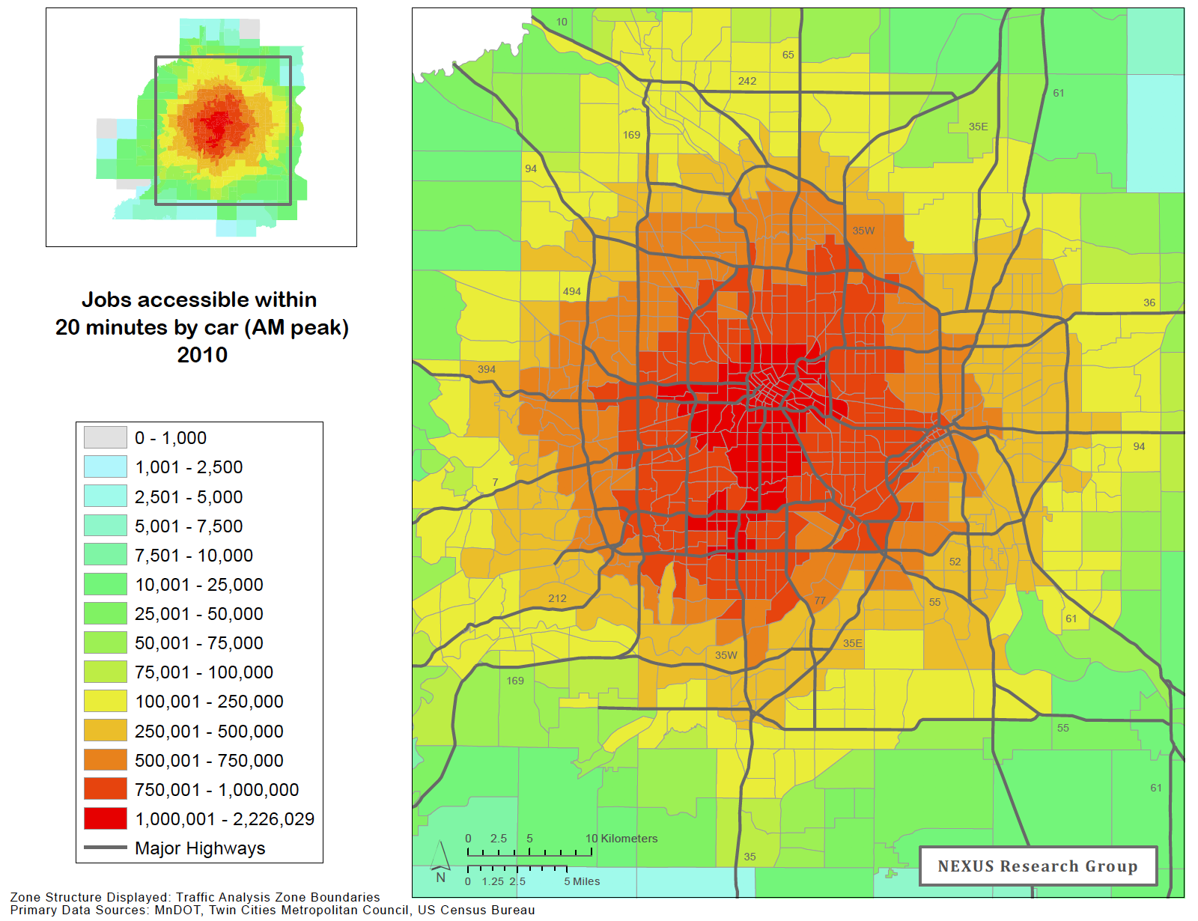

Strategic Use: Mapping Accessibility
Number of jobs Accessible in a 20-minute trip during AM rush hour 2010
By Car
By Public Transit
Source: A. Owens, D. Levinson, Access to Destination, UMN CTS Report MN/RC 2012-34.
29

Slide 30




Strategic Use: Change Monitoring
Google Timelapse:
  Ex. MSP & Minneapolis 1984-2016
  Global 29-frame video
  260,000 CPU core-hours
Spatio-temporal Resolution
  Planet Labs. : daily 1m (visual bands)

Slide 31
Spatial Computing in Modern Cities
Operational
  E-911, CMAS/PLAN
  Early Warning
  Situation awareness
  Public Safety, e.g., Floods
Tactical
  Hotspot Detection
  Property tax
  Site selection
  Asset tracking
Strategic
  Land-use change monitoring
  Long-term planning
Source: https://www.cbronline.com/wp-content/uploads/2017/03/what-is-GIS.png

Slide 32
Outline
Motivation
Next: Knowledge Co-production (KC)
KC Story 1: Evacuation Planning
KC Story 2: A S&CC Project
Conclusions
Source: The Sheffield Mental Health Guide, sheffieldflourish.co.uk, 5 Apr 2017.

Slide 33
Advancing Science Discovery to Application
Convergence
  Solve societal grand challenges
  Harness Spatial Data Revolution, e.g., Cloud hosted satellite imagery, GPS trajectories,
  Power AI, e.g., CNN, to map buildings, roads, trees, …

Slide 34
Collaborate with Stakeholders
Convergence: Solve societal grand challenges via Transdisciplinary Research
Knowledge co-production with stakeholders
Source: https://www.thearcticinstitute.org/future-of-arctic-research/

Slide 35
Knowledge Co-Production with Stakeholders
Knowledge co-production
      Co-Visioning
      Co-define Problems
      Co-select Science Questions
      Co-Evaluate Discoveries
  Ex. NCAR
Source: NCAR/UCAR 2016 Annual Report

Slide 36

Knowledge Co-Production
      Co-production Initiatives
        CRA/CCC Visioning Workshops
          (Midwest) Big Data Hubs & Spokes
          NSF Sustainability Research Networks
          NSF Smart & Connected Community
      Co-Production Examples in my work
          2005: Evacuation Planning: MN local governments
          Current: NSF SCC Project: counties, cities in MN, FL

Slide 37
Outline
Motivation
Knowledge Co-production (KC)
KC Story 1: Evacuation Planning
KC Story 2: A S&CC Project
Conclusions

Slide 38

Knowledge Co-Production: Evacuation Planning (2005)
FoxTV newsclip (5-minutes), Disaster Area Evacuation Analytics Project
https://www.youtube.com/watch?v=PR9k72W8XK8

Slide 39


KC Story 1: Evacuation Planning (2005)
Team: US DHS, MN Dept. of Transportation, URS Corp.
  Emergency Mangers, Police, Fire Fighters, Natl. Guard
Co-Visioning via monthly meetings
  Challenges: evacuees & traffic maps
  Police: focus on what can be done!
Problem Co-Definition
  1-mile scenarios: 5 sites, work-day or night-time
Co-Discovery
  For 1st mile, walking faster than driving
Co-Evaluation
  Walk selected routes : avoid wooden bridge near E
  Lock parking garages during evacuation ?
Scenario | Population | Vehicle | Walking
A | 143,360 | 4:45 | 1:32
B | 83,143 | 2:45 | 1:04
C | 27,406 | 4:27 | 1:41
D | 50,995 | 3:41 | 1:20
E | 3,611 | 1:21 | 0:36
Details: FoxTV newsclip, Shashi Shekhar Disaster Area Evacuation Analytics,
https://www.youtube.com/watch?v=PR9k72W8XK8

Slide 40

Intelligent Shelter Allotment for Emergency Evacuation Planning: A Case Study of Makkah,
Intelligent Systems, IEEE, 30(5):66-76, Sept.-Oct., 2015.

Slide 41
Outline
Motivation
Knowledge Co-production (KC)
KC Story 1: Evacuation Planning
KC Story 2: A S&CC Project (NSF Award #1737633)
NSF S&CC-IRG Track 1: Connecting the Smart-City Paradigm with
a Sustainable Urban Infrastructure Systems Framework
to Advance Equity in Communities
Conclusions

Slide 42
KC Story 2: A NSF S&CC Project
NSF Workshops
  Big Data and Urban Informatics, U.I.C., 2014.
Academic History at UMN
  Humphrey center
  Center for Urban & Regional Affairs
  Hennepin University Partnership
  Center for Transportation Studies Workshop on Smart Cities 2015
Local Government History
  2010-2020: Regional 10-year planning cycle (Metropolitan Council)
  2013-14: Thrive MSP 2040
  2015: USDOT Smart Cities Challenge proposal by Minneapolis

Slide 43
KC Story 2: S&CC – Co-visioning
Local Context
  Metropolitan Council : 2040 Plan
  Fall 2016: NSF S&CC Proposal

Slide 44
KC Story 2: S&CC – Co-visioning
Source: https://metrocouncil.org/About-Us/why-we-matter/Equity.aspx

Slide 45

KC Story 2: S&CC – Co-visioning
Co-visioning Meetings (Academics + Local Governments)
    2014: Smart City Workshop
  2015-16: NSF SRN Sustainable & Health Cities – Equity
      Co-Visioning
        Infrastructure planning for driver-less, post-carbon future, climate change
        Advance Environment, Health, Wellbeing & Equity via infrastructure refinement
Co-select Questions
  Understand spatial equity in infrastructure & outcomes
    wellbeing. health, environment
  How does equity first approach differ from average-outcome based approaches ?
Problem Co-Definition: How to measure spatial equity? Well-being?

Slide 46








KC Story 2: S&CC – Co-select Question
Team: U of Minnesota, Purdue U, FL State U, U of WA
  Schools, Counties (e.g., Hennepin), Cities (e.g., Minneapolis, St. Paul, Tallahassee);
  MetroLab Network, National League of Cities, ICLEI-USA, Intl. City/County
Co-Discovery:
Co-Evaluation
Social Equity
Research
Education
Community Partners & Outreach
Diversity

Slide 47





Academic and Community Partnerships
Shashi Shekhar; UMN; PI
  Spatial data mining & spatial DB
Anu Ramaswami; UMN; Co-PI
  Env science/policy, sustainable urban sys.
Julian Marshall; UW; Co-PI
  Env eng., air pollution & public health
Venkatesh Merwade; Purdue; Co-PI
  Civil engineering, hydrologic modeling
Richard Feiock; FSU; Co-PI
  Political science & public affairs
Julie C. Brown; UMN; SP
  Education
Diana M. Dalbotten; UMN; SP
  Diversity
Robert Johns; UMN; SP
  Leadership; strategy; and management
Jason Cao & Frank Douma UMN; SP
  Urban planning
Len Kne, UMN; SP
  Cyberinfrastructure & U Spatial
City Partners:
Brette Hjelle & Kathleen Mayell; Minneapolis
Michael Olson; Tallahassee
Schools Partners:
Charlene Ellingson; Minneapolis Public Schools
Betsy Stretch; Minneapolis Public Schools
NSF Sustainable Research Network:
Sustainable Health Cities (SHC)
Multi-Community Organizations/Other:
Cooper Martin; National League of Cities
Angie Fyfie; ICLEI-USA
Tad McGalliard; Intl. City/County Management Association
Ben Levine; MetroLab Network
Notes:
Are the school and city partners listed correct? Should we update any names?

Slide 48
Objectives & Challenges
Scope:
  Cities: multi-sector, multi-scalar Social-Ecological-Infrastructural Urban Systems (SEIUS).
  Infrastructures: Food, Energy, Water, Buildings, Transportation, Sanitation, Public Spaces
Objectives
  Understand spatial equity (e) in the context of 7 basic infrastructure provisioning and related wellbeing (W), health (H), environment (E) and equity (e) outcomes in cities
  Advance all four outcomes using smart spatial infrastructure planning in cities
Challenges:
Data Gaps: need intra-urban scale data on SEIU and EHW parameters (Theme 1)
Knowledge Gaps (Themes 2, 3):
  Data science to understand spatial interactions among SEIU-WHEe parameters.
  All-infrastructure models of spatial futures in changing climate, with disruptive infrastructures (e.g., renewable energy) & technologies (e.g., CAVS)

Slide 49

Four Themes
Notes:
A brief background: Please describe the problem you are addressing and why it is important (20sec slide)

Slide 50


Project Update (1/2018- 4/2019)
New sociotechnical outcomes.
Theme-1:
Assessment of infrastructure & Well-being (primary survey)
  Streamlined survey and analysis techniques
  On line survey developed (267 surveys completed).
  Air pollution sensors
    Improved sensor design, tests in laboratory and in field.
    Significance: Cheaper sensors for wider use
  Citizen Science for near real-time urban flood simulations
      Hyper-resolution physical distributed flood modeling (Minneapolis).
      Significance: urban flooding for extreme weather (e.g. Storms).
Notes:
Describe at least one deliverable in terms of the science (technical and social). Why is this deliverable significant/what did it accomplish or what will it allow? Include photos.
Emphasize activities that have been carried out after last year's PI meeting and how these activities along with what was accomplished last year fits within the overall vision of your project. Inclusion of photos are encouraged.

Slide 51


Developing an ultra low cost passive black carbon air pollution sampling approach for citizen science
Updates:
Redesigned passive sampler prototype and sampling approach
Tested prototype samplers in laboratory
Tested prototype samplers in field
Presented at Jt Annual Meeting of Intl. Society of Exposure Sc. and Intl. Society for Env. Epidemiology
Being tested in India
  Comparison with long-term.
Next steps:
Develop a calibration curve using reference methods for black carbon concentration estimation
Sampler surface
Cage
Prototype sampler
Hook with mounting bracket
3 unexposed samplers
Blackening of sampler surface (change in mean pixel intensity; %)
3 exposed
samplers
Legend
Unexposed sampler
X Exposed sampler
Task Lead: PI Marshall

Slide 52

Update 10/24/18
  Household level Tallahassee database
  Spatial equity in energy efficiency and programs adoptions across households and neighborhoods
    Sample of 3,000 homes to entire household population
Energy Consumption (2011-2018)
  30 mins interval energy consumption of electricity and gas, monthly consumption of water for about 120,000 customers
Voter Registration (2005-2016) -- Yearly/monthly based voter affiliation, voter status, age
Tax Roll Record ( 1995-2016) -- Property Tax data including house value, homestead exemption, housing features
Property Appraiser Data (2014-2015) -- Property assessment information
Zillow (2018) – Listed price, house characteristics, room type, appliances, heating/cooling system
Building Footprint Data (2015) -- LiDar (GIS) data of parcel area, shape
Tree Cover (2015) -- LiDar (GIS) data on tree cover percentage in 0.39 by 0.39 meter pixels.
Task Lead: PI Feiock

Slide 53
  Energy Star Rebate Participation (2011-2017) -- Type of rebate program, participation date and rebate amount
  Energy Star Rebate Participation (2011-2017) -- Type of loan program, participation date, loan time span, amount
  Solar Farm Enrollment (2018) -- Percentage of electricity from solar, participation date.
  Solar Panel Installation (2007-2018) – Capacity, estimated generation, date of participation, and information on installer
  Energy Audit Comments (2011-2017) -- Actual audit comment notes
  eBill Registration (2012-2018) -- Date of eBilling Registration
  Neighborhood Reach (2001-2017) -- Date of reach and house address, name neighborhood
  Neighborhood and Homeowner associations (Current) -- Demographic characteristics, Legal status, functional status, participation/interaction with city
  Homeowner Association Covenants, Conditions, and Restrictions (Current) – rules and regulations on solar panel adoption
Task Lead: PI Feiock

Slide 54


Comparing Consumption Hot Spots
Task Lead: PI Feiock

Slide 55

Mapping Trees for Green Infrastructure Equity
Theme 2: Advance spatial data analysis
Task 2A: Algorithms for spatial patterns
Accomplishments: individual tree detection for Ash Borer problem
  A TIMBER (Tree Inference by Minimizing Bound-and-band ERrors)
    Optimization to find tree locations and sizes
    Deep learning to construct features to distinguish trees and non-trees
    A CORE (Core Object REduction) to accelerate the detection process
Legend
Tree canopy
  Details: TIMBER: A Framework for Mining Inventories of Individual Trees in Urban Environments using Remote Sensing Datasets, IEEE Intl. Conf. on Data Mining (ICDM), 2018.

Slide 56












Mapping Ash Trees for Green Infrastructure Equity
Work in progress: Tree species classification, including ash tree
  Idea: Use tree shadows from high-resolution leaf-off imagery
  Data collected
    St. Paul road-side tree inventory with location and species (no canopy size), 2018 update.
    Tree inventory on University of Minnesota campus (no canopy size).
    High resolution leaf-off imagery (3’’ resolution) by Hennepin and Ramsey County
    About 2500 training samples of tree shadows (i.e., profile geometry)
  Next steps
    Algorithms for tree shadow enhancement and clipping
    Deep learning for tree species prediction
Ash tree
Pine tree
Tilia tree
Task Lead: PI Shekhar

Slide 57



Project Update (1/18- 4/19): Community Outcomes
Major community outcomes
Theme 1: Minneapolis PWD and Public Schools
    Long term tracking of inequality in wellbeing and relationship to infrastructure.
    Neighborhood associations, (Seward, Prospect Park)
    Contacted all 87 Neighborhoods Associations (via Newsletters, Facebook)
    Dissemination in 8 MSP schools
Theme 2:
  Shared Ash tree detection results with Hennepin county PWD
Theme 4: Minneapolis School District:
  Developed initial curriculum materials,
  set up Air Pollution Monitors at all schools sites,
  Professional Development of 13 high school teachers
Notes:
Describe at least one deliverable that you accomplished together with your community partners and at least one outcome in terms of capacity building. Also describe something unexpected about working with your community partners. Anecdotes are highly encouraged. Include photos.
Emphasize activities that have been carried out after last year's PI meeting and how these activities along with what was accomplished last year fits within the overall vision of your project.

Slide 58






Teacher’s Workshop
Updates
August teacher workshop complete
Monthly web-meetings to support teachers, provide updates, status checks and refine curriculum product
Responsive Curriculum website set up for 8-12 classroom use
Partial set up of Air Pollution Monitors at school locations
Soft implementing of curriculum materials December through March
Task Lead: PI Upadhyay

Slide 59
Outline
Motivation
Knowledge Co-production (KC)
KC Story 1: Evacuation Planning
KC Story 2: Spatial Computing in Smart Cities
Conclusions

Slide 60

CONCLUSIONS & NEXT STEPS
Cities is societally important and facing challenges
  Majority live in cities
  Challenges: climate change, aging infrastructure, …
  Opportunities: renewable energy, self-driving vehicles, …
Spatial Computing has already transformed Cities
  Sanitation, green spaces, E-911, public safety, …
Many Transformative opportunities lie ahead
  Ex. Spatial equity
However, these will not material without
  Knowledge Co-production: local governments, academics, businesses, …
  Basic Research, e.g., spatial data science to overcome gerrymandering challenge

