Slide 1




June 24th-25th, 2021 Workshop on Data Science and Curation: Spatial Data Science
Indian Statistical Institute: Tech. Inno. Hub on Data Sc., Big Data Analytics, and Data Curation,(https://www.isical.ac.in/~tihisi)
What is Special about Spatial Data Science and GeoAI?
Shashi Shekhar
McKnight Distinguished University Professor, University of Minnesota
www.cs.umn.edu/~shekhar, shekhar@umn.edu
Acks: Collaborators, Sponsors (NSF, USDOD NGA, USDOE ARPA-E, USDA NIFA, NIH, …)
Notes:
1
1

Slide 2
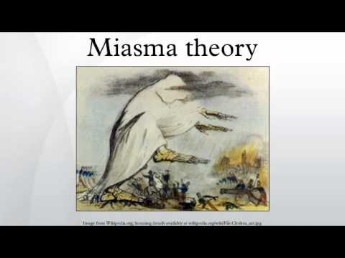
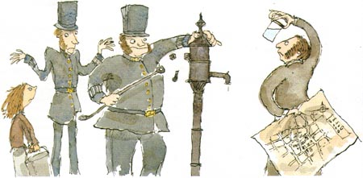
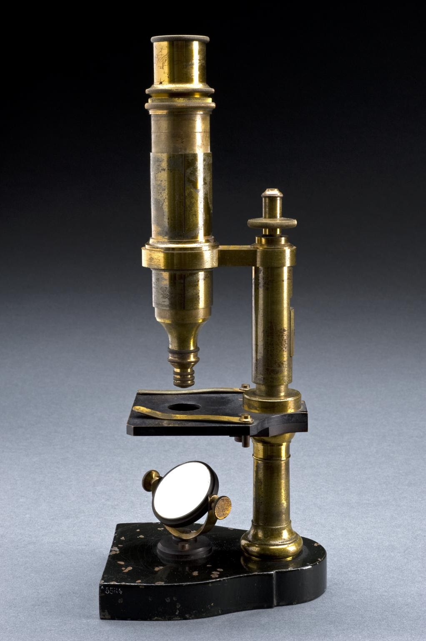
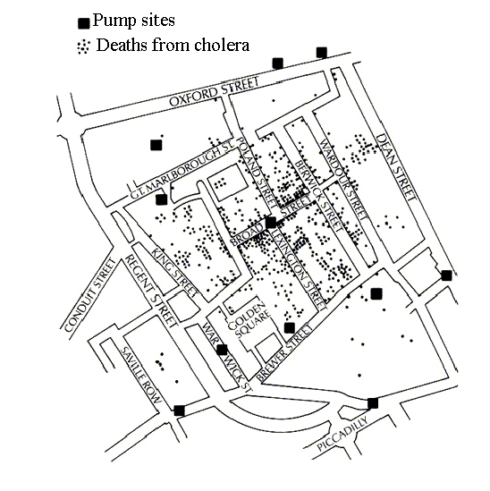



A Spatial Data Science Story
1854: What causes Cholera?
Collect & Curate Data
Discover Patterns,
Generate Hypothesis
Test Hypothesis
(Experiments)
Develop Theory
? water pump
Remove pump handle
Impact: hygiene,
drinking water supply, sewage system, …
Q? What are Choleras of today?
Q? How may Spatial Data Sc. Help?

Slide 3
What has changed? Spatial Data Revolution
Spatial | Last Century | Last Decade
Data | Few satellites and sensors | Nano-satellites, Billions of GPS enabled smartphones
Data Access | Need special hardware and network
Spatial Platforms | ESRI Arc/Info
Spatial Data Science | Spatial Patterns, e.g., hotspots (SatScan, ESRI Geostatistics)
Spatial Visualization | Quilt, e.g., MS Terraserver

Slide 4


Spatial Computing is Ubiquitous Today!
2 billion GPS receivers in use, will hit 7 billion by 2022.
Besides location, it reference time for critical infrastructure
  Telecommunications industry
  Banks
  Airlines...
GPS is the single point of failure for the entire modern economy.
50,000 incidents of deliberate (GPS) jamming last two years
  Against Ubers, Waymo’s self-driving cars, delivery drones from Amazon
Source: https://www.bloomberg.com/news/features/2018-07-25/the-world-economy-runs-on-gps-it-needs-a-backup-plan

Slide 5
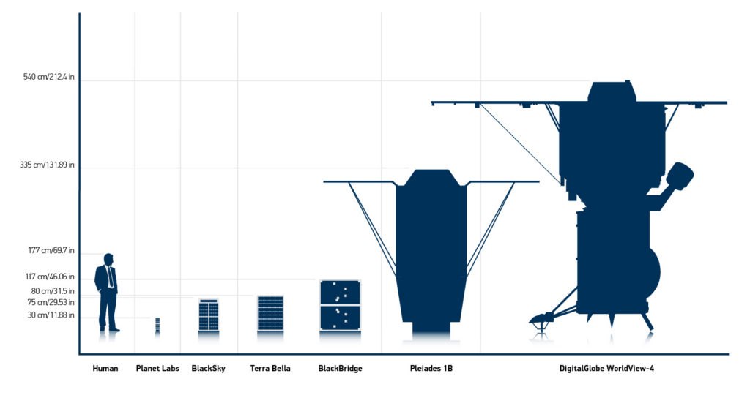

Large Constellations of Small Satellites
Hi-frequency (e.g., daily or hourly) time-series of imagery of entire earth
Small Satellites: video (5-minutes): https://geospatialstream.com/sciencecasts-nasa-embraces-small-satellites/
Large Constellations
  2017: Planet Labs: 100 satellites: daily scan of Earth at 1m resolution in visible band
Source: WorldView FAQ, blog.digitalglobe.com/news/frequently-asked-questions-about-worldview-4/

Slide 6



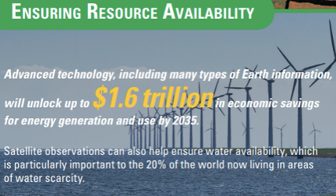
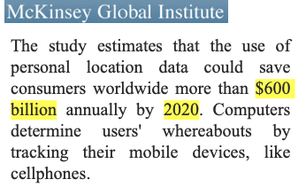

Spatial Data Revolution
GPS & Location traces
  2 billion GPS receivers today (7 billion by 2022)
  Reference clock for telecom, banks, …
  Help understand Spatio-temporal patterns of life
(Nano-)Satellite Imagery, …
Source: Y. Xie et al., Transforming Smart Cities With Spatial Computing, Proc. IEEE Intl. Conf. on Smart Cities, 2018.

Slide 7
What has changed? Spatial Data Access
Spatial | Last Century | Last Decade
Data | Few satellites and sensors | Nano-satellites, Billions of GPS enabled smartphones
Data Access | Need special hardware and network | Cloud based repositories and analytics (e.g., DARPA GCA)
Spatial Platforms | ESRI Arc/Info
Spatial Data Science | Spatial Patterns, e.g., hotspots (SatScan, ESRI Geostatistics)
Spatial Visualization | Quilt, e.g., MS Terraserver

Slide 8

  Easier Access: Cheap (or free) Cloud Repositories
2008: USGS gave away 35-year LandSat satellite imagery archive
  Analog of public availability of GPS signal in late 1980s
  2017: Cloud-based repositories of geospatial data
    Explosion in machine learning on satellite imagery to map crops, water, buildings, roads, …
 | Google Earth Engines | NEX | AWS Earth
Elevation, Landsat, LOCA, MODIS, NAIP | x | x | x
NOAA | x |  | x
AVHRR, FIA, GIMMM, GlobCover, NARR, TRIMM, Sentinel-1 | x | x
IARPA, GDELT, MOGREPS, OpenStreetMap, Sentinel-2, SpaceNet (building/road labels for ML) |  |  | x
CHIRPS, GeoScience Australia, GSMap, NASS, Oxford Map, PSDI, WHRC, WorldClim, WorldPop, WWF, | x
BCCA, FLUXNET |  | x

Slide 9
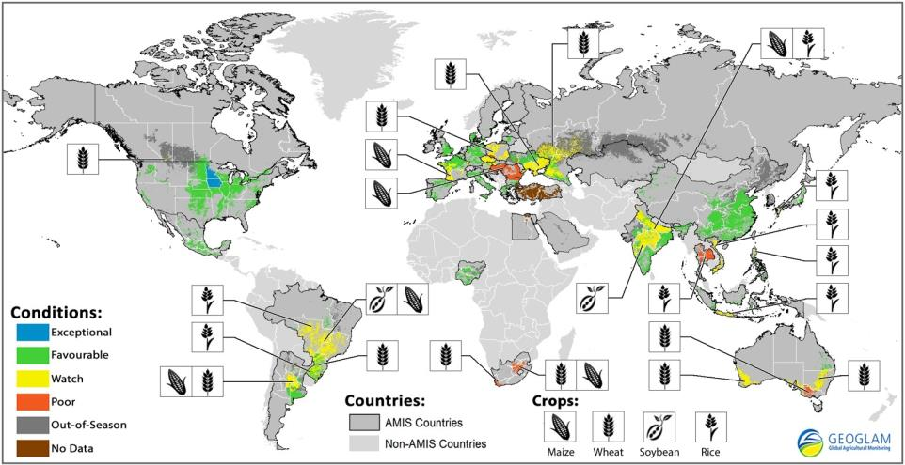


  Global Agriculture Monitoring

Slide 10
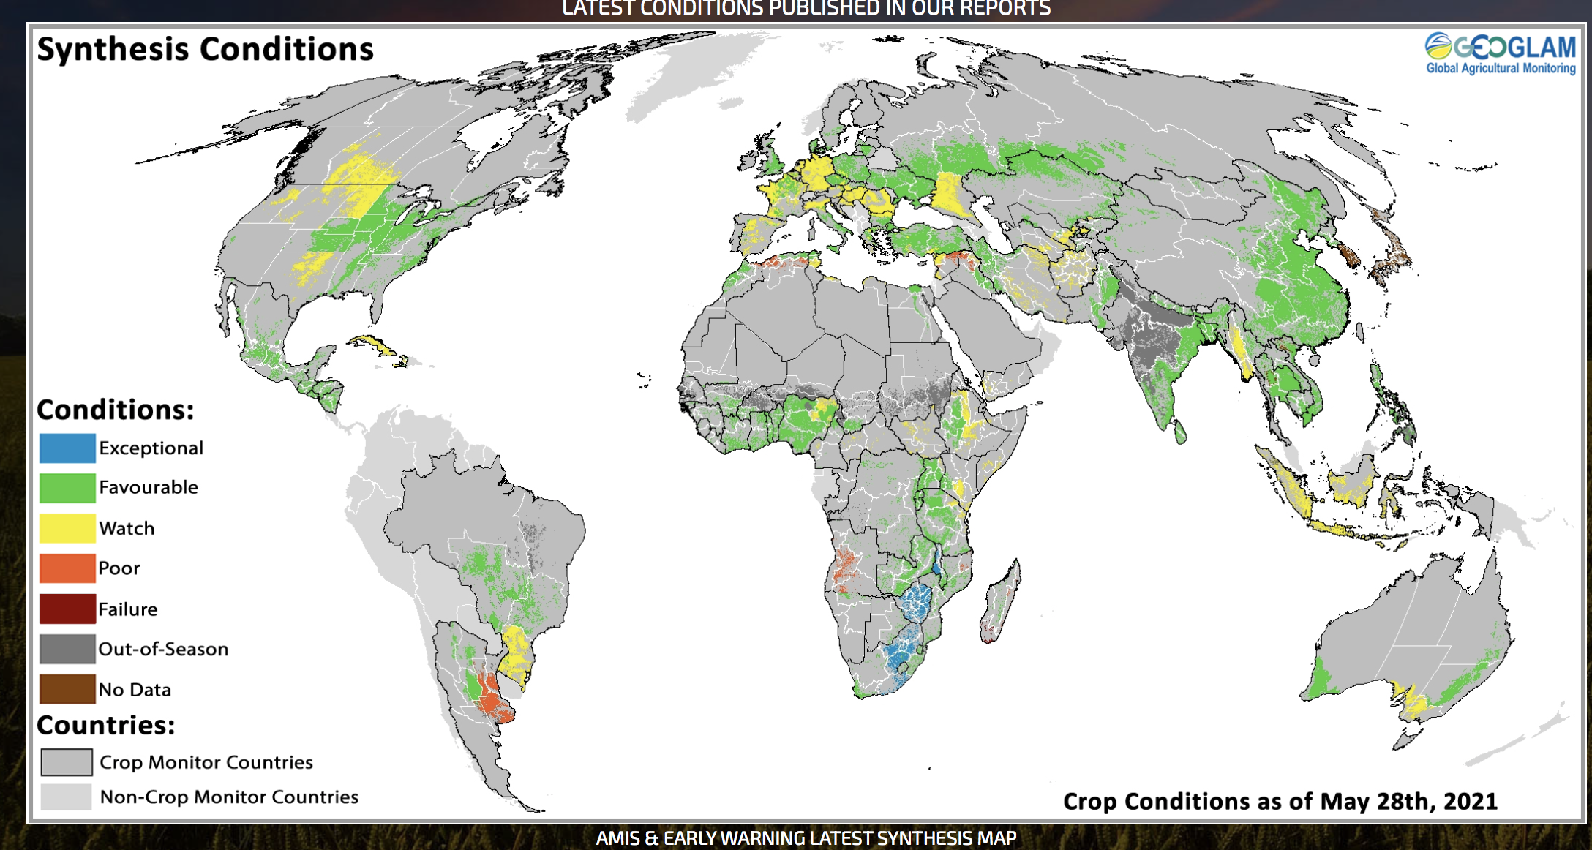
  Global Agriculture Monitoring

Slide 11
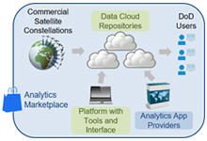
What has changed? Spatial Big Data Platforms
Spatial | Last Century | Last Decade
Data | Few satellites and sensors | Nano-satellites, Billions of GPS enabled smartphones
Data Access | Need special hardware and network | Cloud based repositories, e.g., Earth on AWS
Spatial Platforms | ESRI Arc/Info, SQL3/OGC, e.g., Postgis, | Geospatial Cloud Analytics (Monitor crops, fracking, illegal fishing), ESRI GIS Tools for Hadoop, …
Spatial Data Science | Spatial Patterns, e.g., hotspots (SatScan, ESRI Geostatistics)
Spatial Visualization | Quilt, e.g., MS Terraserver

Slide 12
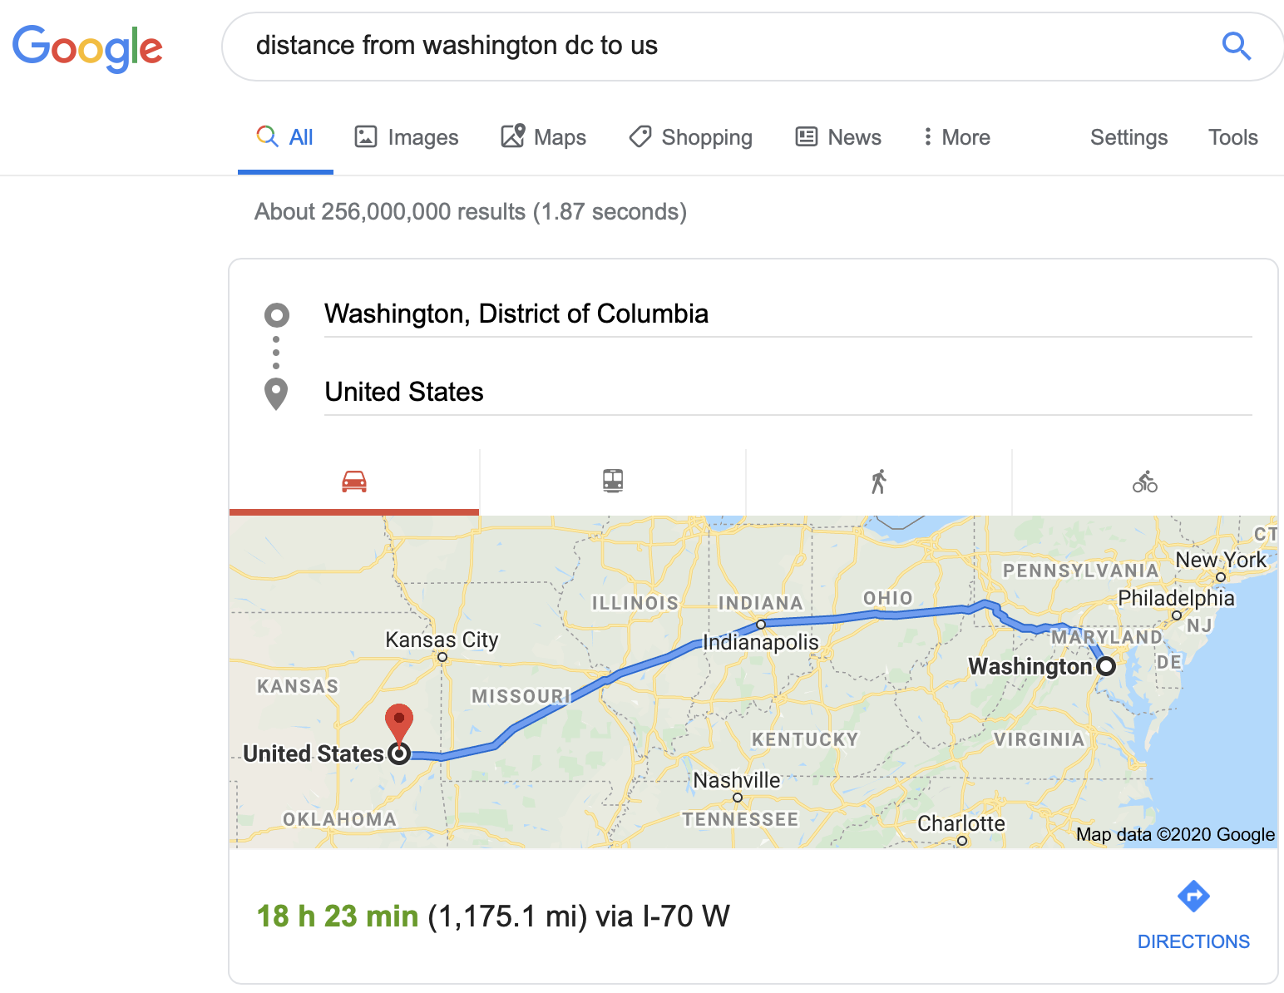
Spatial Data Types >> Points
Q? What is distance between Washington D.C. and U.S.A.?
    Zero ( Washington D.C. is inside U.S.A. )
    NSF OKN funded 2 grants on geo-knowledge networks!
AI:
?

Slide 13
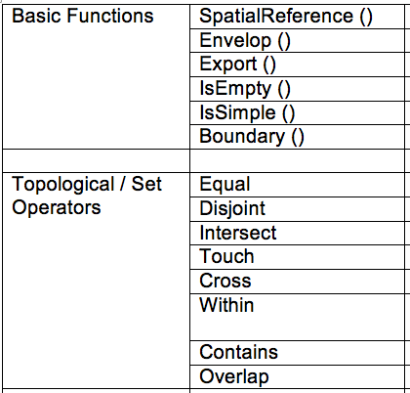
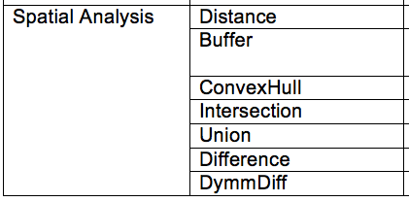
  Spatial Data Types: OGC Simple Features Standard
Data types: Point, LineString, Polygon, Collections
Relationships: Topological, Metric, …
Helps in feature selection for machine learning
  Ex. Distance to key geo-features, Neighbor relationship
[Details: Spatial Databases: Accomplishments and Research Needs,
S. Shekhar et al., IEEE Trans. on Knowledge and Data Eng., 11(1), Jan.-Feb. 1999.
Notes:
ww.dailymail.co.uk/news/article-3236684/Transport-bosses-secret-geographically-accurate-Tube-map-showing-REAL-distances-stations.html
http://qz.com/503631/do-you-want-your-subway-map-to-look-pretty-or-to-reflect-reality/

Slide 14

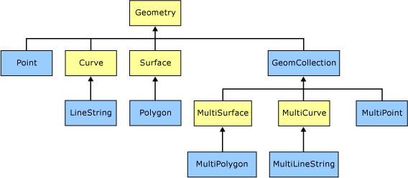
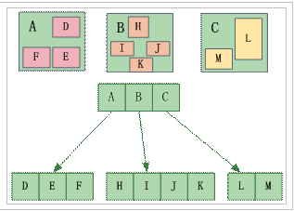


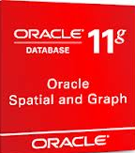


Spatial Big Data Curation
Meta-data, Schema, DBMS (SQL, Hadoop)
Challenge: One size does not fit all!
Ex. Spatial Querying
  Geo-tag. Checkin, Geo-fence
Spatial Querying Software
  OGC Spatial Data Type & Operations
  Data-structures: B-tree => R-tree
  Algorithms: Sorting => Geometric
  Partitioning: random => proximity aware

Slide 15
Spatial Big Data Platforms
Genre | Examples
Relational DBMS, Spatial Library | Oracle, IBM DB2, PostgreSQL, MS SQL Server OGC Simple Features, …
Parallel DBMS | Teradata, Vertica, Greenplum, DataAllegro, ParAccel
Big Data Platforms | Hadoop, MapReduce, Spark, Hbase, Hive, …
Spatial Big Data Platforms | ESRI GIS Tools for Hadoop, GeoWave, SpatialSpark, GeoSpark, Simba, Hadoop-GIS, SpatialHadoop, ST-Hadoop
Source: X.Yao et al.,
Computers and GeoScience,
106:60-67, 2017
Notes:
ST-Hadoop: Louai Alarabi, Mohamed F. Mokbel, Mashaal Musleh: ST-Hadoop: A MapReduce Framework for Spatio-Temporal Data. SSTD 2017: 84-104

Slide 16
What has changed? Spatial Data Science
Spatial | Last Century | Last Decade
Data | Few satellites and sensors | Nano-satellites, Billions of GPS enabled smartphones
Data Access | Need special hardware and network | Cloud based repositories, e.g., Earth on AWS
Spatial Platforms | ESRI Arc/Info | SQL3/OGC, e.g., Postgis, ESRI GIS Tools for Hadoop, Google Earth Engine
Spatial Data Science | Spatial Patterns, e.g., hotspots (SatScan, ESRI Geostatistics) | Spatial Network Patterns, e.g., linear hotspots Spatio-temporal (ST) patterns, e.g., Change time-series
Spatial Visualization | Quilt, e.g., MS Terraserver

Slide 17
Limitations of Traditional Data Science
Traditional methods not robust in face of
  Spatial continuity
    Gerrymandering risk: Classical methods not robust
    Result changes if spatial partitioning changes
  Auto-correlation, Heterogeneity , Edge-effect, …
  Noise
Partition A
Spatial Data
Partition B
Partition A Based Pearson’s Correlation | Pairs | Partition B Based Pearson’s Correlation
1 | - | - 0.90
- 0.90 | - | 1

Slide 18
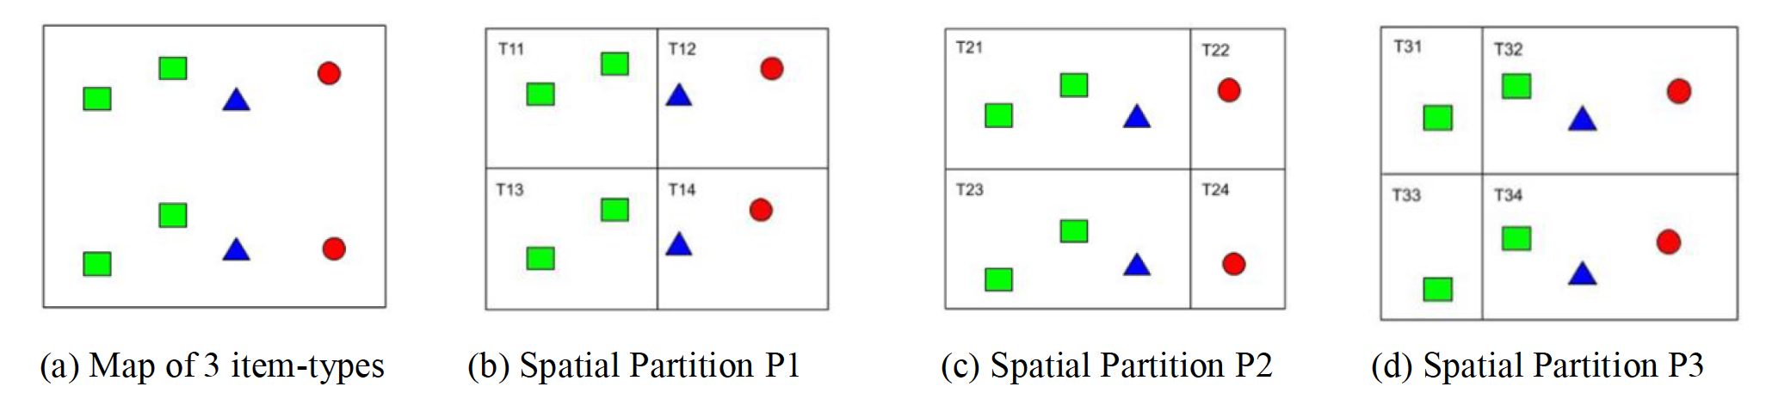
Classical Data Mining Methods not robust either!
Consider the spatial Data in Figure (a)
Along with 3 alternative partitions in Figures (b), (c) and (d).
Spatial Partitioning Definition | P1 | P2 | P3
Transactions | T11, T12, T13, T14 | T21, T22, T23, T24 | T31, T32, T33, T44
Associations with support >= 0.5 | ( ) | ( ) | ( )

Slide 19
Neighbor Graph Approach
Challenge: One size does not fit all
Ex. Interaction patterns
(a) a map of 3 features
(b) Spatial Partitions
(c) Neighbor graph
 | Pearson’s Correlation | Ripley’s cross-K | Participation Index
 | -0.90 | 0.33 | 0.5
 | 1 | 0.5 | 1
Details: Discovering Spatial Co-location Patterns: A General Approach,
IEEE Transactions on Knowledge and Data Eng., 16(12), December 2004 (w/ H.Yan, H.Xiong).

Slide 20
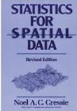
A Metric of Spatial Cross-Correlation
  Ripley’s Cross K-Function Definition
  Cross K-function of some pair of spatial feature types
  Example
    Which pairs are frequently co-located
    Statistical significance
[number of type j event within distance h
of a randomly chosen type i event]

Slide 21
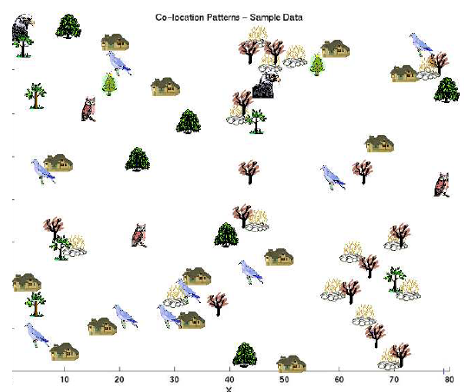

Co-locations
Given: A collection of different types of spatial events
Find: Co-located subsets of event types
Source: Discovering Spatial Co-location Patterns: A General Approach, IEEE Transactions
on Knowledge and Data Eng., 16(12), December 2004 (w/ H.Yan, H.Xiong).

Slide 22
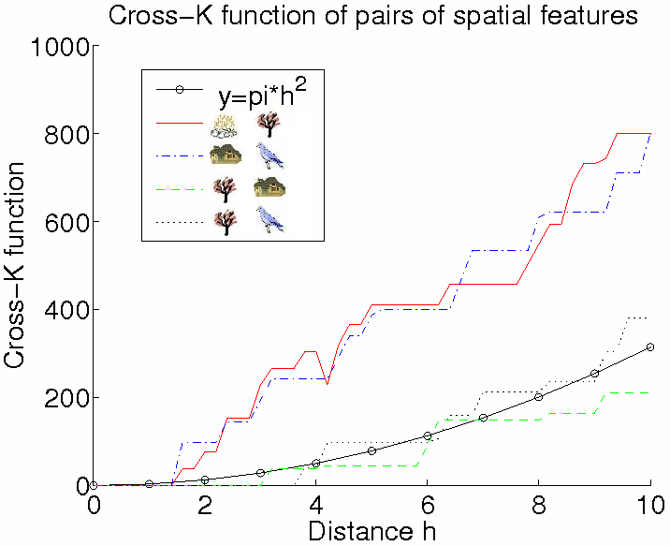
Illustration of Cross-Correlation
  Illustration of Cross K-function for Example Data

Slide 23
Spatial Colocation
Feature set: ( , , , , )
Feature Subsets:
Participation ratio (pr):
pr(A , (A,B) ) = fraction of A instances neighboring feature { B} = 2/3
pr(B. , (A,B). ) = ½
Participation index (A,B. ) = pi(A,B. )
= min{ pr(A. , (A,B). ), pr(B. , (A,B). ) }
= min (2/3, ½ ) = ½
Participation Index Properties:
(1) Computational: Non-monotonically decreasing like support measure
(2) Statistical: Upper bound on Ripley’s Cross-K function

Slide 24
Participation Index >= Cross-K Function
B.1
A.1
B.1
A.1
B.1
A.1
A.3
A.3
A.3
B.2
A.2
B.2
A.2
B.2
A.2
Cross-K (A,B) | 2/6 = 0.33 | 3/6 = 0.5 | 6/6 = 1
PI (A,B) | 2/3 = 0.66 | 1 | 1

Slide 25
Spatial Colocation: Trends
  Algorithms
    Join-based algorithms
      One spatial join per candidate colocation
    Join-less algorithms
  Statistical Significance
    ?Chance-patterns
  Spatio-temporal
    Which events co-occur in space and time?
      (bar-closing, minor offenses, drunk-driving citations)
    Which types of objects move together?

Slide 26
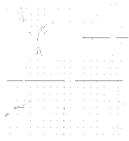
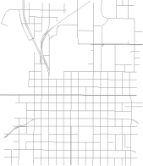
Cascading spatio-temporal pattern (CSTP)
TimeT1
TimeT2
TimeT3
Aggregate(T1,T2,T3)
Bar Closing(B)
Assault(A)
Drunk Driving (C)
Input: Urban Activity Reports
Output: CSTP
  Partially ordered subsets of ST event types.
  Located together in space.
  Occur in stages over time.
Applications: Public Health, Public Safety, …
CSTP: P1
C
B
A
Details: Cascading Spatio-Temporal Pattern Discovery, IEEE Trans. on Know. & Data Eng, 24(11), 2012.
Notes:
1. Public Safety/ Crime analysis is the primary motivation, where Bars in large cities serve as crime generators , and events such as Drunk driving and assaults are observed after bar closing. This illustrative example shows 3 time spans from 1 am, within an interval of 20 min to 1 hr. Patterns observed are partially ordered, where events are located together in space and occur in stages over time, we call such patterns cascading spatio-temporal patterns, they are also observed in climate change (e.g. El-nino), epidemiology and evacuation planning)

Slide 27
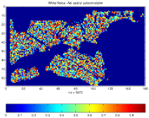
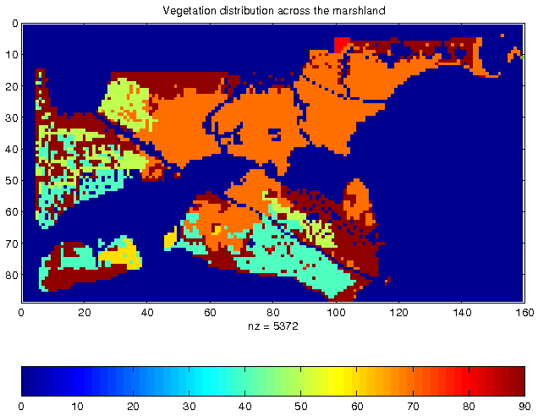
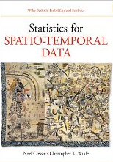
Spatial Auto-correlation and Prediction
Spatial Statistics, Spatial Data Mining
  Honor spatial continuity
  Auto-correlation
  Heterogeneity
  Edge-effect, …
Limitation of i.i.d assumption
  Ignores auto-correlation
  Salt n Pepper noise

Slide 28
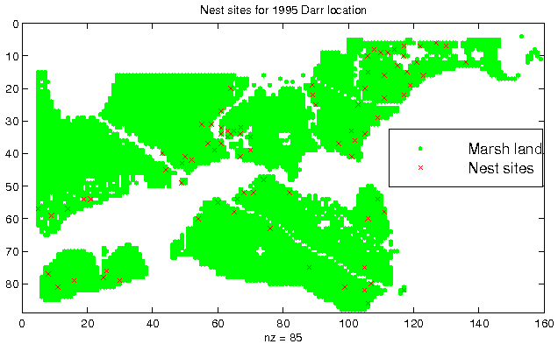
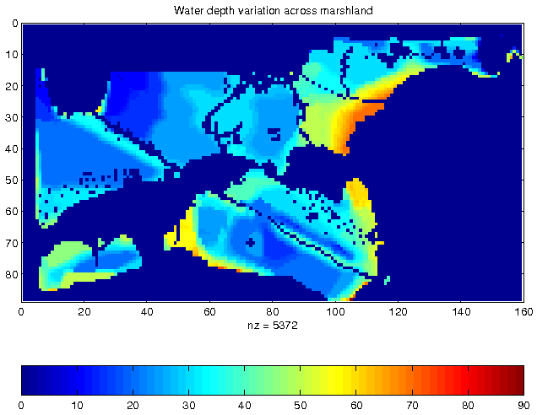
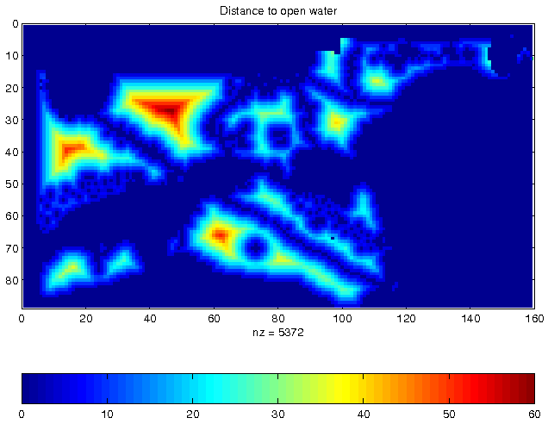
Illustration of Location Prediction Problem
Nest Locations
Vegetation Index
Water Depth
Distance to Open Water

Slide 29
Spatial Auto-Regression & Parameter Estimation
Maximum Likelihood Estimation
Computing determinant of large matrix is a hard (open) problem!
  size(W) is quadratic in number of locations/pixels.
  Typical raster image has Millions of pixels
  W is sparse but not banded.
Details: A parallel formulation of the spatial auto-regression model for mining large geo-spatial datasets, SIAM Intl. Workshop on High Perf. and Distr. Data Mining, 2004. (with B. Kazar)
Notes:
y: n-by-1 vector of dependent variable
x: n-by-k matrix of the explanatory variables
Beta: k-by-1 vector of regressions
Epsilon: n-by-1 vector of unobservable error term N(0,sigma^2 I )
Example: Linear Regression Model
Given a vector of y of n observations and a matrix x of explanatory variables
Encapsulates their interrelationship using the linear equation y=xbeta+epsilon
Does not work well for spatial datasets
Low prediction accuracy
Spatial Data Dependencies (Auto-correlation)
Residual error may vary systematic over space
The occurrence of one feature is influenced by the distribution of similar features in the adjacent area
May yield biased and inconsistent estimation
May lead to poor fit of the model

Slide 30
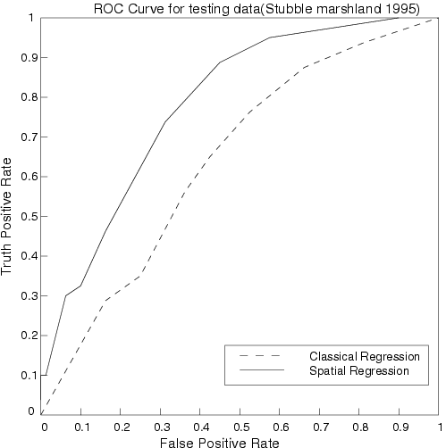
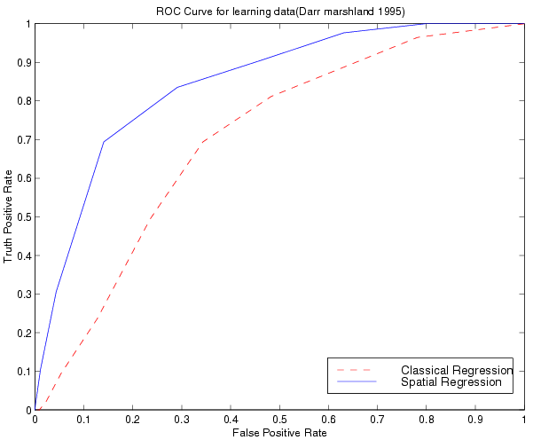
Comparing Traditional and Spatial Models
  Dataset: Bird Nest prediction
  Linear Regression
    Lower prediction accuracy, coefficient of determination,
    Residual error with spatial auto-correlation
  Spatial Auto-regression outperformed linear regression
ROC Curve
for learning
ROC Curve
for testing

Slide 31
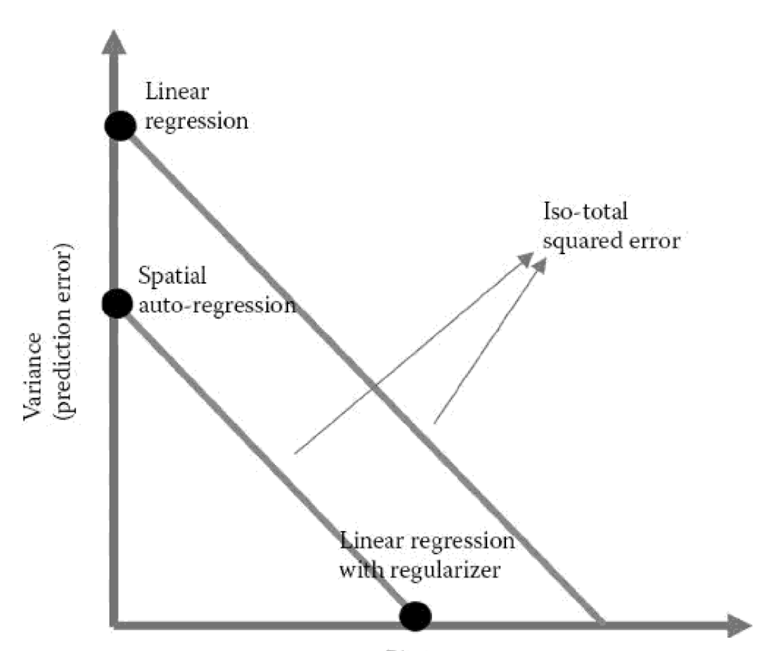
Prediction Error and Bias Trade-off
Linear Regression (LR)
LR with Auto-correlation Regularizer
Spatial Auto-Regression
$$ε= {\left\|y−Xβ\right\|}^{2}+{\left\|y−y_{neighbor}\right\|}^{2}$$
Prediction Accuracy
Bias
Source: Geospatial Data Science: A Transdisciplinary Approach.
In Geospatial Data Science Techniques and Applications (pp. 17-56). CRC Press, 2017
(E. Eftelioglu,R. Ali, X. Tang., Y. Xie, Y., Li and S. Shekhar).

Slide 32
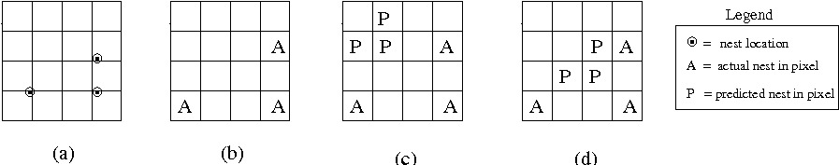
Research Needs for Location Prediction
Spatial Auto-Regression
  Estimate W
  Scaling issue
Spatial interest measure
  e.g., distance(actual, predicted)
Actual Sites
Pixels with
actual sites
Prediction 1
Prediction 2.
Spatially more interesting
than Prediction 1

Slide 33
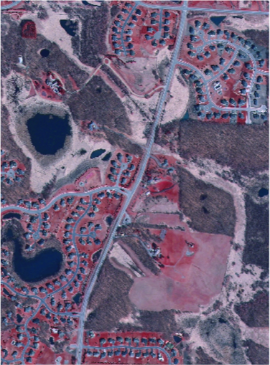
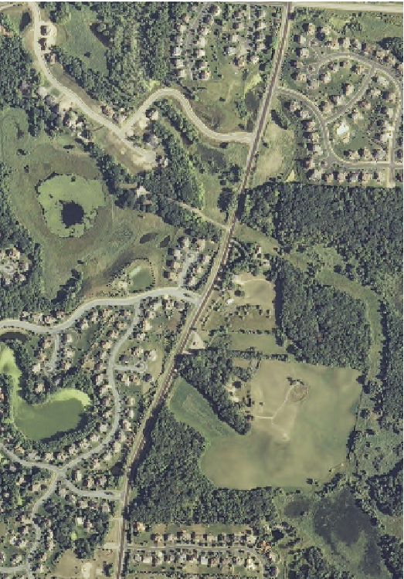
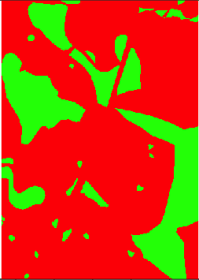
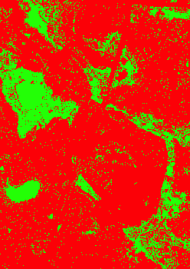
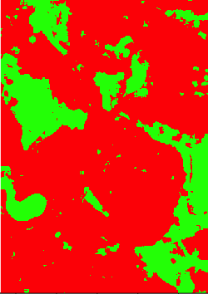
Salt n Pepper Noise
wetland
dry land
Input:
Output:
train
test
(a) aerial photo
(b) aerial photo
(c) true classes
(d) DT prediction (Salt n Pepper Noise)
(e) SDT prediction
DT: decision tree
SDT: spatial decision tree
Training samples: upper half
Test samples: lower half
Spatial neighborhood: maximum 11 pixels by11 pixels
Details: Focal-Test-Based Spatial Decision Tree Learning. IEEE Trans. Knowl. Data Eng. 27(6): 1547-1559, 2015 (summary in Proc. IEEE Intl. Conf. on Data Mining, 2013).(w/ Z. Jiang et al.)

Slide 34
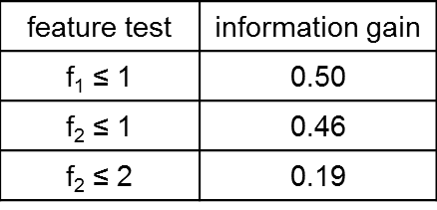
Spatial Decision Tree

Slide 35

Location Prediction Models
  Traditional Models, e.g., Regression (with Logit or Probit),
    Linear Regression, Bayes Classifier, …
Semi-Spatial : auto-correlation regularizer
Spatial Models
  Spatial autoregressive model (SAR)
  Markov random field (MRF) based Bayesian Classifier
$$ε= {\left\|y−βX\right\|}^{2}+{\left\|βX−{βX}_{neighbor}\right\|}^{2}$$
Traditional | Spatial
Neural Networks | Convolutional Neural Networks
Decision Trees | Spatial Decision Trees

Slide 36




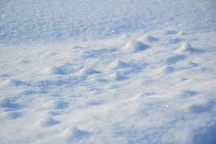
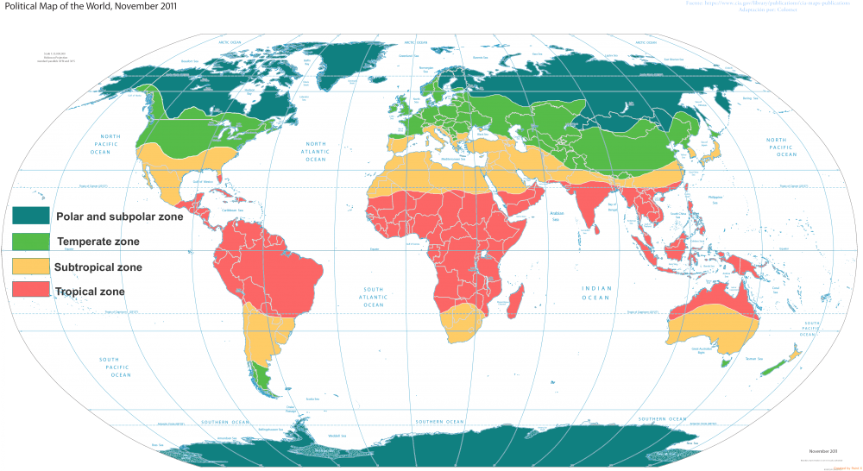
Spatial Variability Challenge: Amorphous Features
Q1. Which images show snow ?
Q2. Which geo-challenges are addressed by Convolutional Neural Network (CNN) ?
(a) High Cost of spurious and missed patterns (b) Spatial Auto-correlation
(c) Spatial Heterogeneity (d) Teleconnections
(a)
(b)
(c)
(d)
(e)
Runn of Kutch, Gujarat, India
Lake Karum, Ethiopia
Snow
Snow
Details: Towards Spatial Variability Aware Deep Neural Networks (SVANN): A Summary of Results, J. Gupta, Y. Xie, and S. Shekhar, DeepSpatial2020 (1st ACM SIGKDD Workshop on Deep Learning for Spatiotemporal Data, Applications, and Systems). Best paper award.

Slide 37
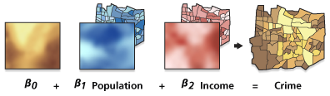
Modeling Spatial Heterogeneity: GWR
  Geographically Weighted Regression (GWR)
  Goal: Model spatially varying relationships
  Example:
  Where are location dependent
Source: resources.arcgis.com

Slide 38



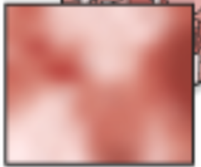


Spatial Variability Aware Neural Networks (SVANN)
A Neural Network (NN)
SVANN
0.3
0.3
0.5
0.8
0.5
0.6
Each NN parameter is a map i.e., a function of location
  Similar to Geographically Weighted Regression
Evaluation Task:
  Urban Garden Detection across Hennepin County, MN and Fulton County, GA.
  SVANN outperformed OSFA by 14.34% on F1-scores.
Details: J. Gupta, Y, Xie and S. Shekhar,
Towards Spatial Variability Aware Deep Neural Networks (SVANN): A Summary of Results,
ACM SIGKDD Workshop on Deep Learning for Spatiotemporal Data, Applications,
and Systems (Deepspatial 2020), 2020. (Best Paper Award). arXiv:2011.08992v1
Full paper accepted for ACM Transaction on Intelligent Systems and Technology.

Slide 39
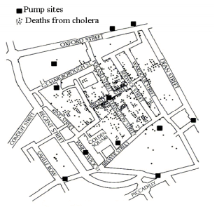
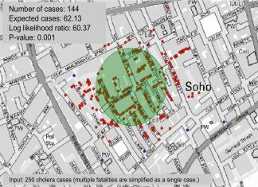
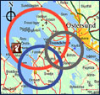
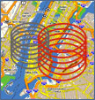

Dealing with Noise & Spurious Chance Patterns
Statistics: Deal with Noise
  Quantify uncertainty, confidence, …
  Is it (statistically) significant?
  Is it different from a chance event or rest of dataset?
    e.g., SaTScan finds circular hot-spots
Spatial Statistics, Spatial Data Mining
  Auto-correlation, Heterogeneity, Edge-effect, …

Slide 40
Spatial Scan Statistics (SatScan)
  Goal: Omit chance clusters
  Ideas: Likelihood Ratio, Statistical Significance
  Steps
    Enumerate candidate zones & choose zone X with highest likelihood ratio (LR)
      LR(X) = p(H1|data) / p(H0|data)
      H0: points in zone X show complete spatial randomness (CSR)
      H1: points in zone X are clustered
    If LR(Z) >> 1 then test statistical significance
      Check how often is LR( CSR ) > LR(Z)
        using 1000 Monte Carlo simulations

Slide 41
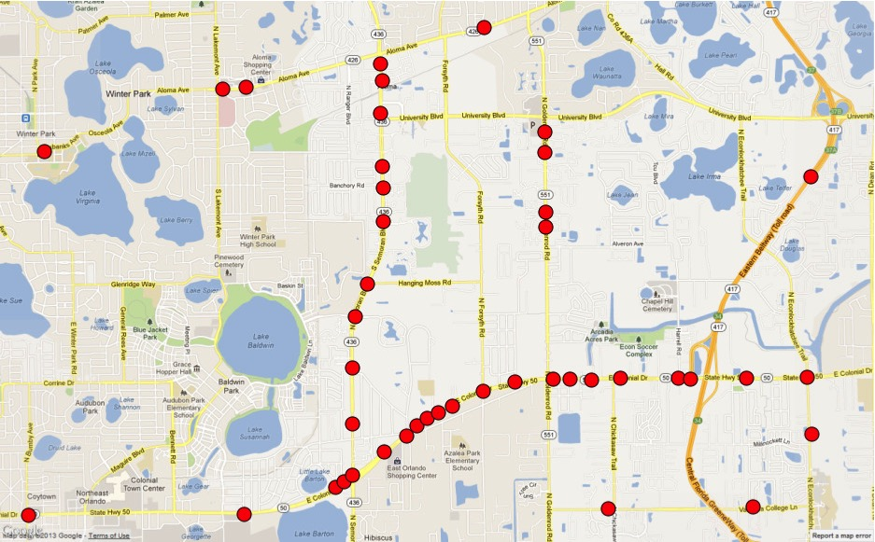
Beyond SatScan: Spatial Concept/Theory-Aware Hotspots
  Geographic features, e.g., rivers, streams, roads, …
    Hot-spots => Hot Geographic-features, e.g., Linear Hotspots
  Spatial Theories, e.g,, environmental criminology
    Circles ➔ Doughnut holes
Pedestrian fatalities Orlando, FL
Circular hotspots
by SatScan
Linear hotspots
Details: Significant Linear Hotspot Discovery, IEEE Transactions on Big Data, 3(2):140-153, 2017.
(Summary in Proc. Geographic Info. Sc., Springer LNCS 8728, pp. 284-300, 2014.)

Slide 42
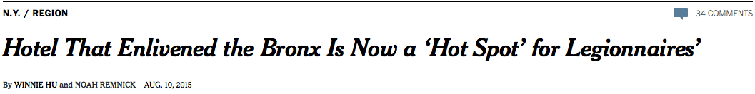
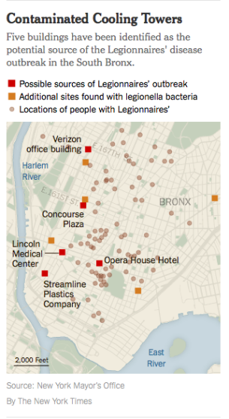
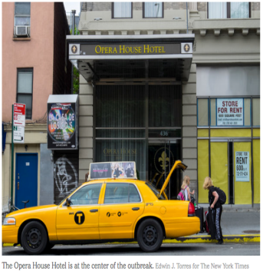

Slide 43

Legionnaires’ Disease Outbreak in New York
Details: Ring-Shaped Hotspot Detection, IEEE Trans. Know. & Data Eng., 28(12), 2016.
(A Summary in Proc. IEEE ICDM 2014) (w/ E. Eftelioglu et al.)

Slide 44

Robust Clustering (Hotspot Detection)
Problem definition
  Inputs: Collection of event locations, Test statistic; Significance level
  Output: Significant clusters (hotspots)
  Constraints: Avoid chance patterns despite non-trivial noise in data
Limitations of Related Work
  DBSCAN cannot avoid chance patterns
  SaTScan cannot detect clusters of arbitrary shapes
Contributions
  Significance modeling in DBSCAN
  A fast dual-convergence algorithm
Complete Spatial Random
(no significant hotspots)
Significant Hotspots with Noise
Details: Significant DBSCAN towards Statistically Robust Clustering, (w/ Yiqun Xie),
In Proc. 16th Intl. Symposium on Spatial and Temporal Databases (SSTD), 2019, ACM. (Best Paper Award)

Slide 45

Limitation of Traditional Clustering
Challenge: One size does not fit all
  Prediction error vs. model bias, Cost of false positives, …
Example. Clustering: Find groups of points
Traditional Clustering
(K-means always finds clusters)
Spatial Clustering begs to differ!

Slide 46
What has changed? Spatial Data Revolution
Spatial | Last Century | Last Decade
Data | Few satellites and sensors | Nano-satellites, Billions of GPS enabled smartphones
Data Access | Need special hardware and network | Cloud based repositories, e.g., Earth on AWS
Spatial Platforms | ESRI Arc/Info | SQL3/OGC, e.g., Postgis, ESRI GIS Tools for Hadoop, Google Earth Engine
Spatial Data Science | Spatial Patterns, e.g., hotspots (SatScan, ESRI Geostatistics) | Spatial Network Patterns, e.g., linear hotspots Spatio-temporal (ST) patterns, e.g., Change time-series (Google Timelapse)
Spatial Visualization | Quilt: MS Terraserver Fly through: Google Earth | Space time: Timelapse There Dimensions

Slide 47



Towards Time-Travel and Depth in Virtual Globes
Virtual globes are snapshots
How to add time? depth?
  Ex. Google Earth Engine, NASA NEX
  Ex. Google Timelapse: 260,000 CPU core-hours for global 29-frame video
How may one convey provenance, accuracy, age, and data semantics?
What techniques are needed to integrate and reason about diverse available sources?
http://googleblog.blogspot.com/2013/05/a-picture-of-earth-through-time.html

Slide 48





Slide 49

One Size Data Science Does not Fit All Data!

Slide 50

Spatial Data Science Tools

Slide 51
Summary : One size data science does not fit all
Spatial Data are ubiquitous & important
Traditional Data Science Tools are inadequate
  Gerrymandering, Spatial Auto-correlation, …
Ask:
  Spatial Data Science Methods
  Spatial Statistics, Spatial Data Mining, SDBMS, …

Slide 52
References :Surveys, Overviews
Spatial Computing, MIT Press (Essential Knowledge Series), 2020. (ISBN: 9780262538046).
Spatial Computing ( html , short video , tweet ), Communications of the ACM, 59(1):72-81, January, 2016.
Transdisciplinary Foundations of Geospatial Data Science ( html , pdf ), ISPRS Intl. Jr. of Geo-Informatics, 6(12):395-429, 2017. ( doi:10.3390/ijgi6120395 )
Spatiotemporal Data Mining: A Computational Perspective , ISPRS Intl. Jr. on Geo-Information, 4(4):2306-2338, 2015 (DOI: 10.3390/ijgi4042306).
Identifying patterns in spatial information: a survey of methods ( pdf ), Wiley Interdisciplinary Reviews: Data Mining and Knowledge Discovery, 1(3):193-214, May/June 2011. (DOI: 10.1002/widm.25).
Theory-Guided Data Science: A New Paradigm for Scientific Discovery from Data, IEEE Transactions on Knowledge and Dat Mining, 29(10):2318-2331, June 2017. ( DOI: 10.1109/TKDE.2017.2720168 ).
Parallel Processing over Spatial-Temporal Datasets from Geo, Bio, Climate and Social Science Communities: A Research Roadmap. IEEE BigData Congress 2017: 232-250.
Spatial Databases: Accomplishments and Research Needs, IEEE Transactions on Knowledge and Data Engineering, 11(1):45-55, 1999.

Slide 53
C3. Auto-correlation and Heterogeneity in Prediction
Traditional | Spatial Autocorrelation | Spatial Heterogeneity
Linear Regression | Spatial Auto-Regression | GWR
Bayesian Classifier | Neighborhood Based Bayesian Classifier
Decision Trees | Spatial Decision Trees | Spatial Ensemble
Neural Networks | Convolutional Neural Networks | SVANN

