Slide 1




What is special about mining spatial data?
Sept. 13th, 2022
Monthly Seminar of the HDR Institute: HARP- Harnessing Data and Model Revolution in the Polar Regions
Shashi Shekhar
McKnight Distinguished University Professor
Dept. of Computer Sc. and Eng., University of Minnesota
www.cs.umn.edu/~shekhar : shekhar@umn.edu
Notes:
1
1

Slide 2
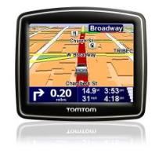

















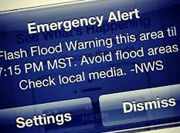




Spatial Revolution
Smarter
Planet

Slide 3


Spatial is a Critical Infrastructure Today!
2 billion GPS receivers in use, will hit 7 billion by 2022.
Besides location, it reference time for critical infrastructure
  Telecommunications industry, Banks, Airlines...
GPS is the single point of failure for the entire modern economy.
50,000 incidents of deliberate (GPS) jamming last two years
  Against Ubers, Waymo’s self-driving cars, delivery drones from Amazon
Source: https://www.bloomberg.com/news/features/2018-07-25/the-world-economy-runs-on-gps-it-needs-a-backup-plan

Slide 4
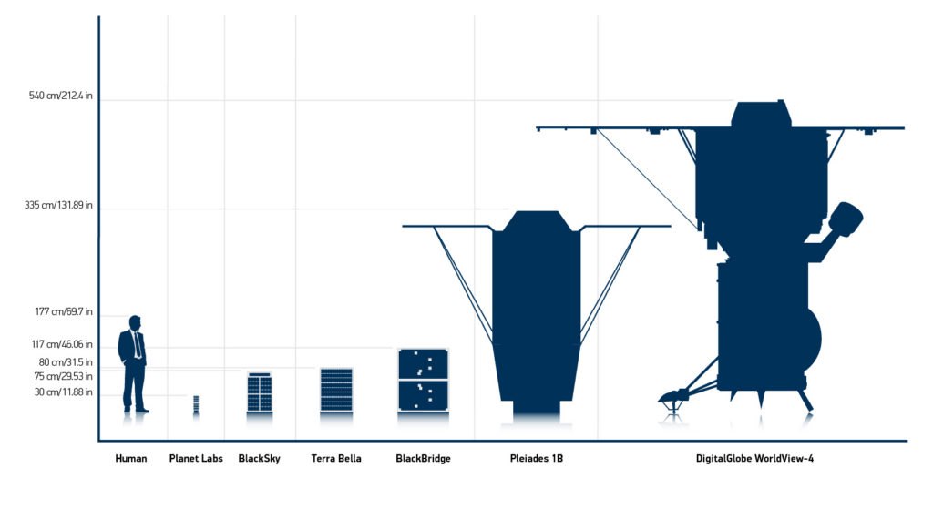
Growth of Spatial Data
Hi-frequency (e.g., daily or hourly) time-series of imagery of entire earth
  Monitor illegal fishing, forest fires, crops (2017 DARPA Geospatial Cloud Analytics)/
Large Constellations
  2017: Planet Labs: 200+ satellites: daily scan of Earth at 1m resolution
Source: WorldView FAQ, blog.digitalglobe.com/news/frequently-asked-questions-about-worldview-4/

Slide 5
  Easier Access to Spatial Data
2008: USGS gave away 35-year LandSat satellite imagery archive
  Analog of public availability of GPS signal in late 1980s
  2017: Many cloud-based Virtual collaboration environment
    Explosion in machine learning on satelliite imagery to map crops, water, buildings, roads, …
 | Google Earth Engines | NEX | AWS Earth
Elevation, Landsat, LOCA, MODIS, NAIP | x | x | x
NOAA | x |  | x
AVHRR, FIA, GIMMM, GlobCover, NARR, TRIMM, Sentinel-1 | x | x
IARPA, GDELT, MOGREPS, OpenStreetMap, Sentinel-2, SpaceNet (building/road labels for ML) |  |  | x
CHIRPS, GeoScience Australia, GSMap, NASS, Oxford Map, PSDI, WHRC, WorldClim, WorldPop, WWF, | x
BCCA, FLUXNET |  | x

Slide 6
Outline
Motivation
  Use cases
  Pattern families
Spatial Data Types
Spatial Statistical Foundations
Spatial Data Mining
Conclusions

Slide 7
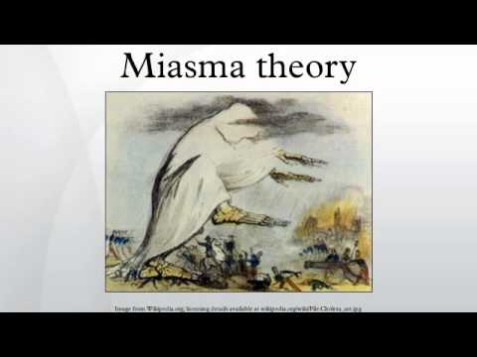
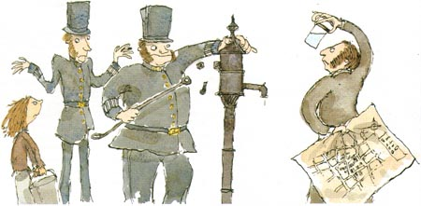

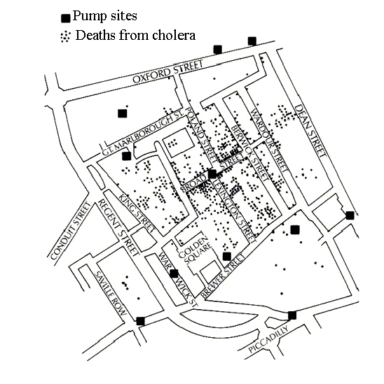


A Spatial Data Mining Story
1854: How does Cholera spread?
Collect & Curate Data
Discover Patterns,
Generate Hypothesis
Test Hypothesis
(Experiments)
Develop Theory
? water pump
Remove pump handle
Germ Theory
Impact:
Hygiene
Drinking water supply, Sewage system,
…

Slide 8
Why Data Mining?
Holy Grail - Informed Decision Making
Sensors & Databases increased rate of Data Collection
  Transactions, Web logs, GPS-track, Remote sensing, …
Challenges:
  Volume (data) >> number of human analysts
  Some automation needed
Approaches
  Database Querying, e.g., SQL3/OGIS
  Data Mining for Patterns
  …

Slide 9
Spatial Data Mining (SDM)
The process of discovering
  interesting, useful, non-trivial patterns
    patterns: non-specialist
    exception to patterns: specialist
  from large spatial datasets
Spatial pattern families
  Hotspots, Spatial clusters
  Spatial outlier, discontinuities
  Co-locations, co-occurrences
  Location prediction models
  …

Slide 10
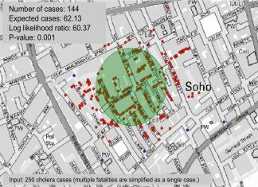
Pattern Family 1: Hotspots, Spatial Cluster
The 1854 Asiatic Cholera in London
  Near Broad St. water pump except a brewery

Slide 11
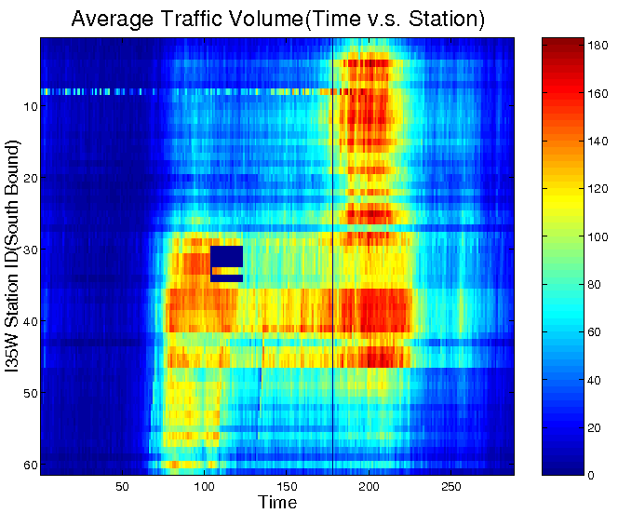
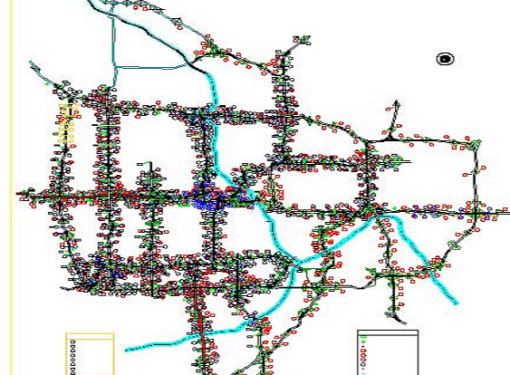
Pattern Family 2: Spatial Outliers
Spatial Outliers, Anomalies, Discontinuities
  Traffic Data in Twin Cities
  Abnormal Sensor Detections
  Spatial and Temporal Outliers
Source: A Unified Approach to Detecting Spatial Outliers, GeoInformatica, 7(2), Springer, June 2003.
(A Summary in Proc. ACM SIGKDD 2001) with C.-T. Lu, P. Zhang.

Slide 12
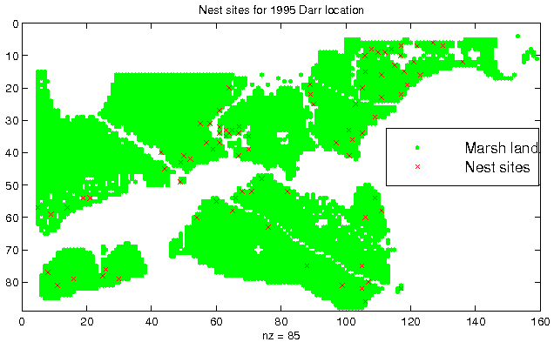
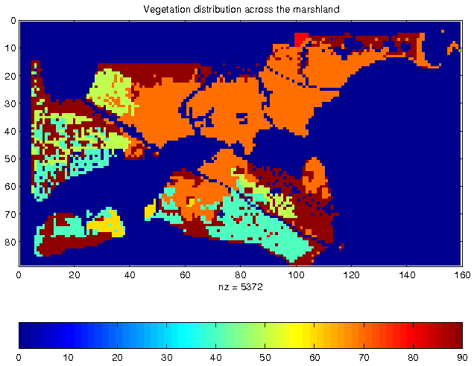
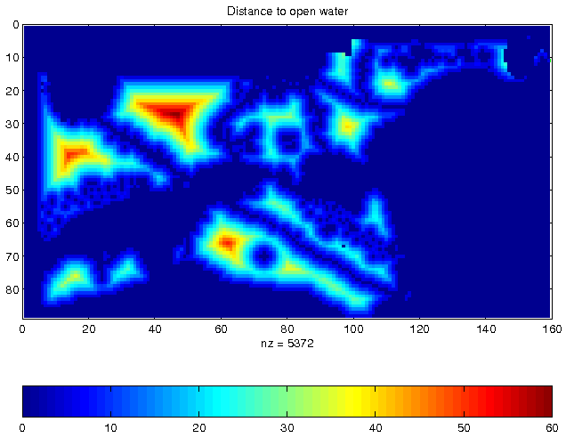
Pattern Family 3: Spatial Prediction
Location Prediction:
  Predict Bird Habitat Prediction
  Using environmental variables
Details: Spatial Contextual Classification and Prediction Models for Mining Geospatial Data, S. Shekhar et al.,
IEEE Transactions on Multimedia, 4(2):174 - 188. 10.1109/TMM.2002.1017732.

Slide 13
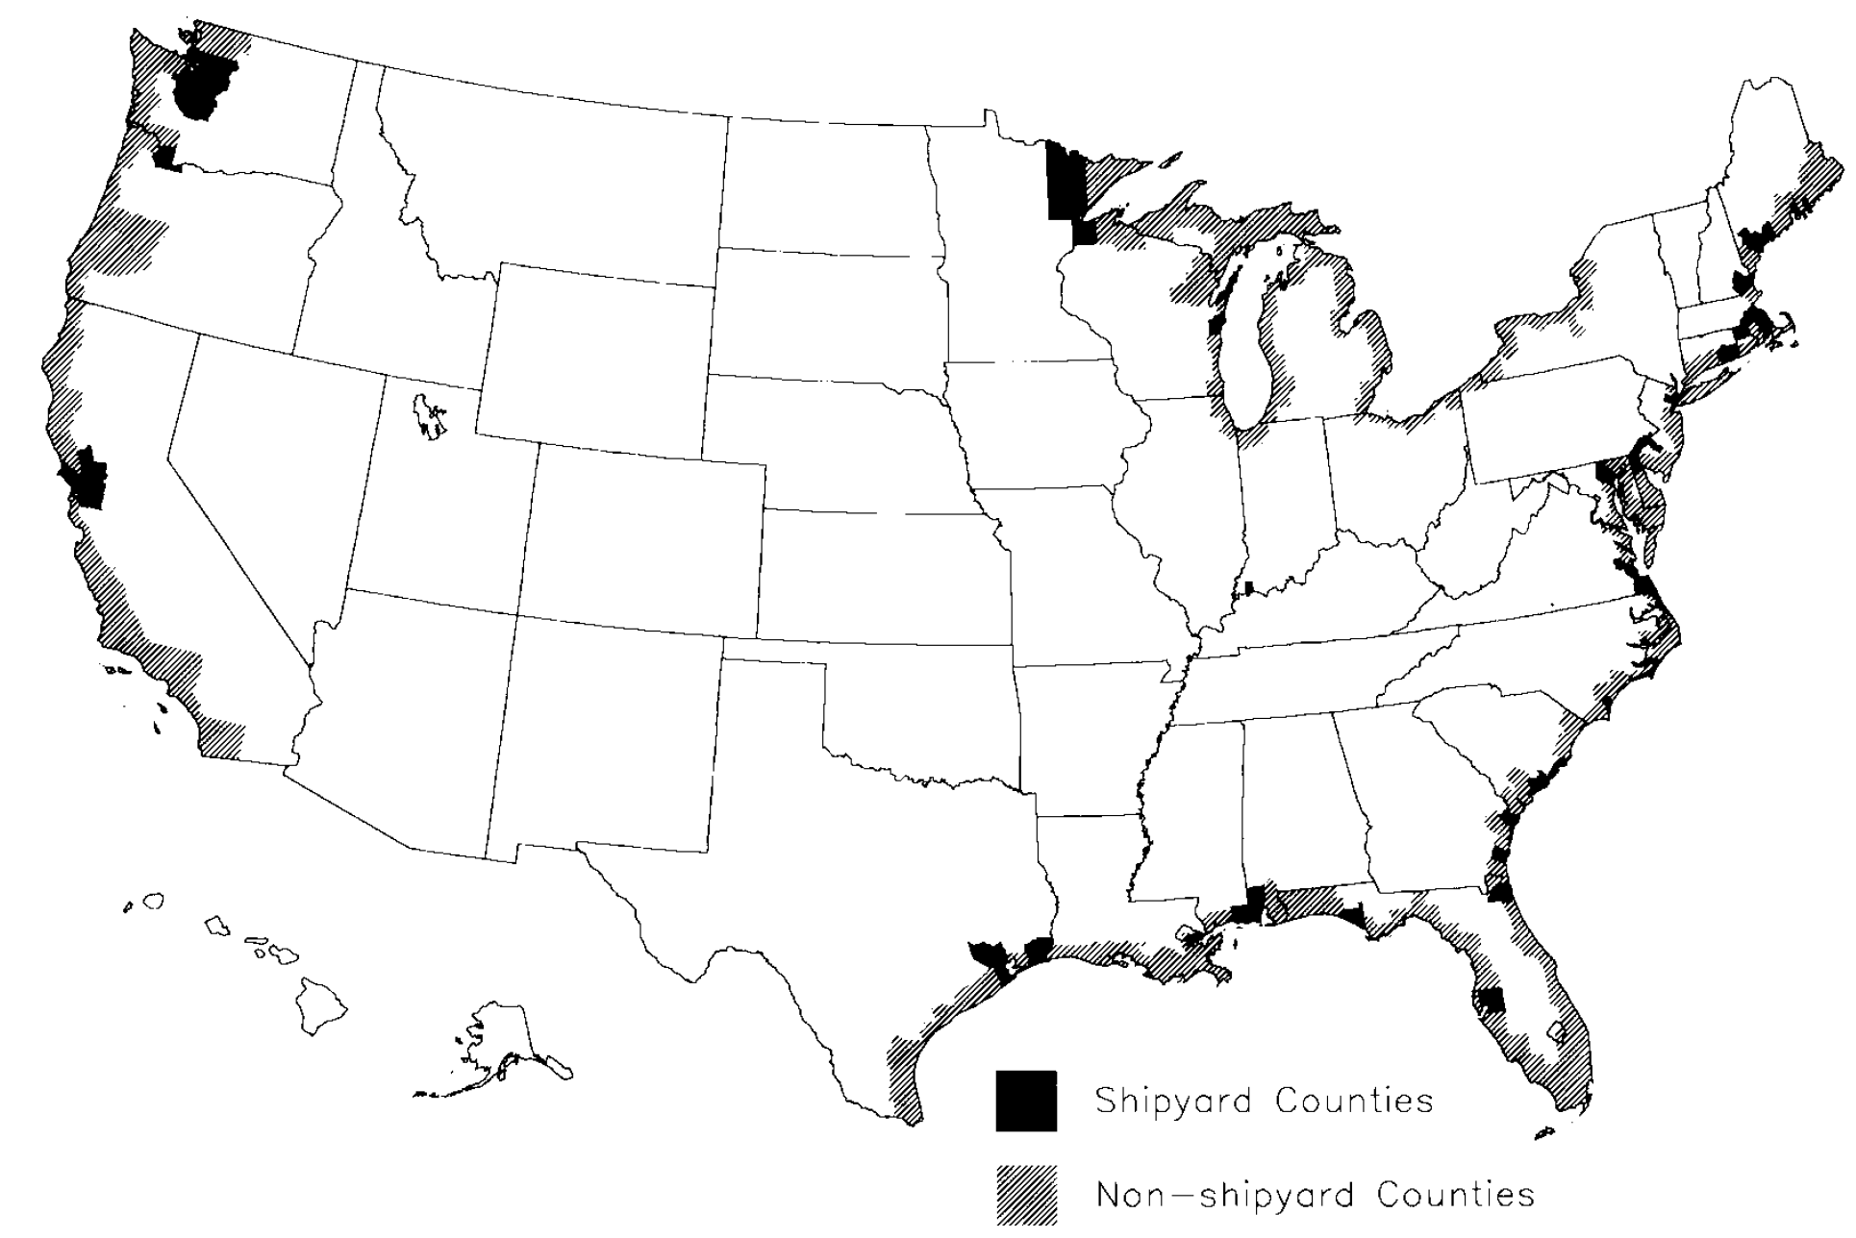
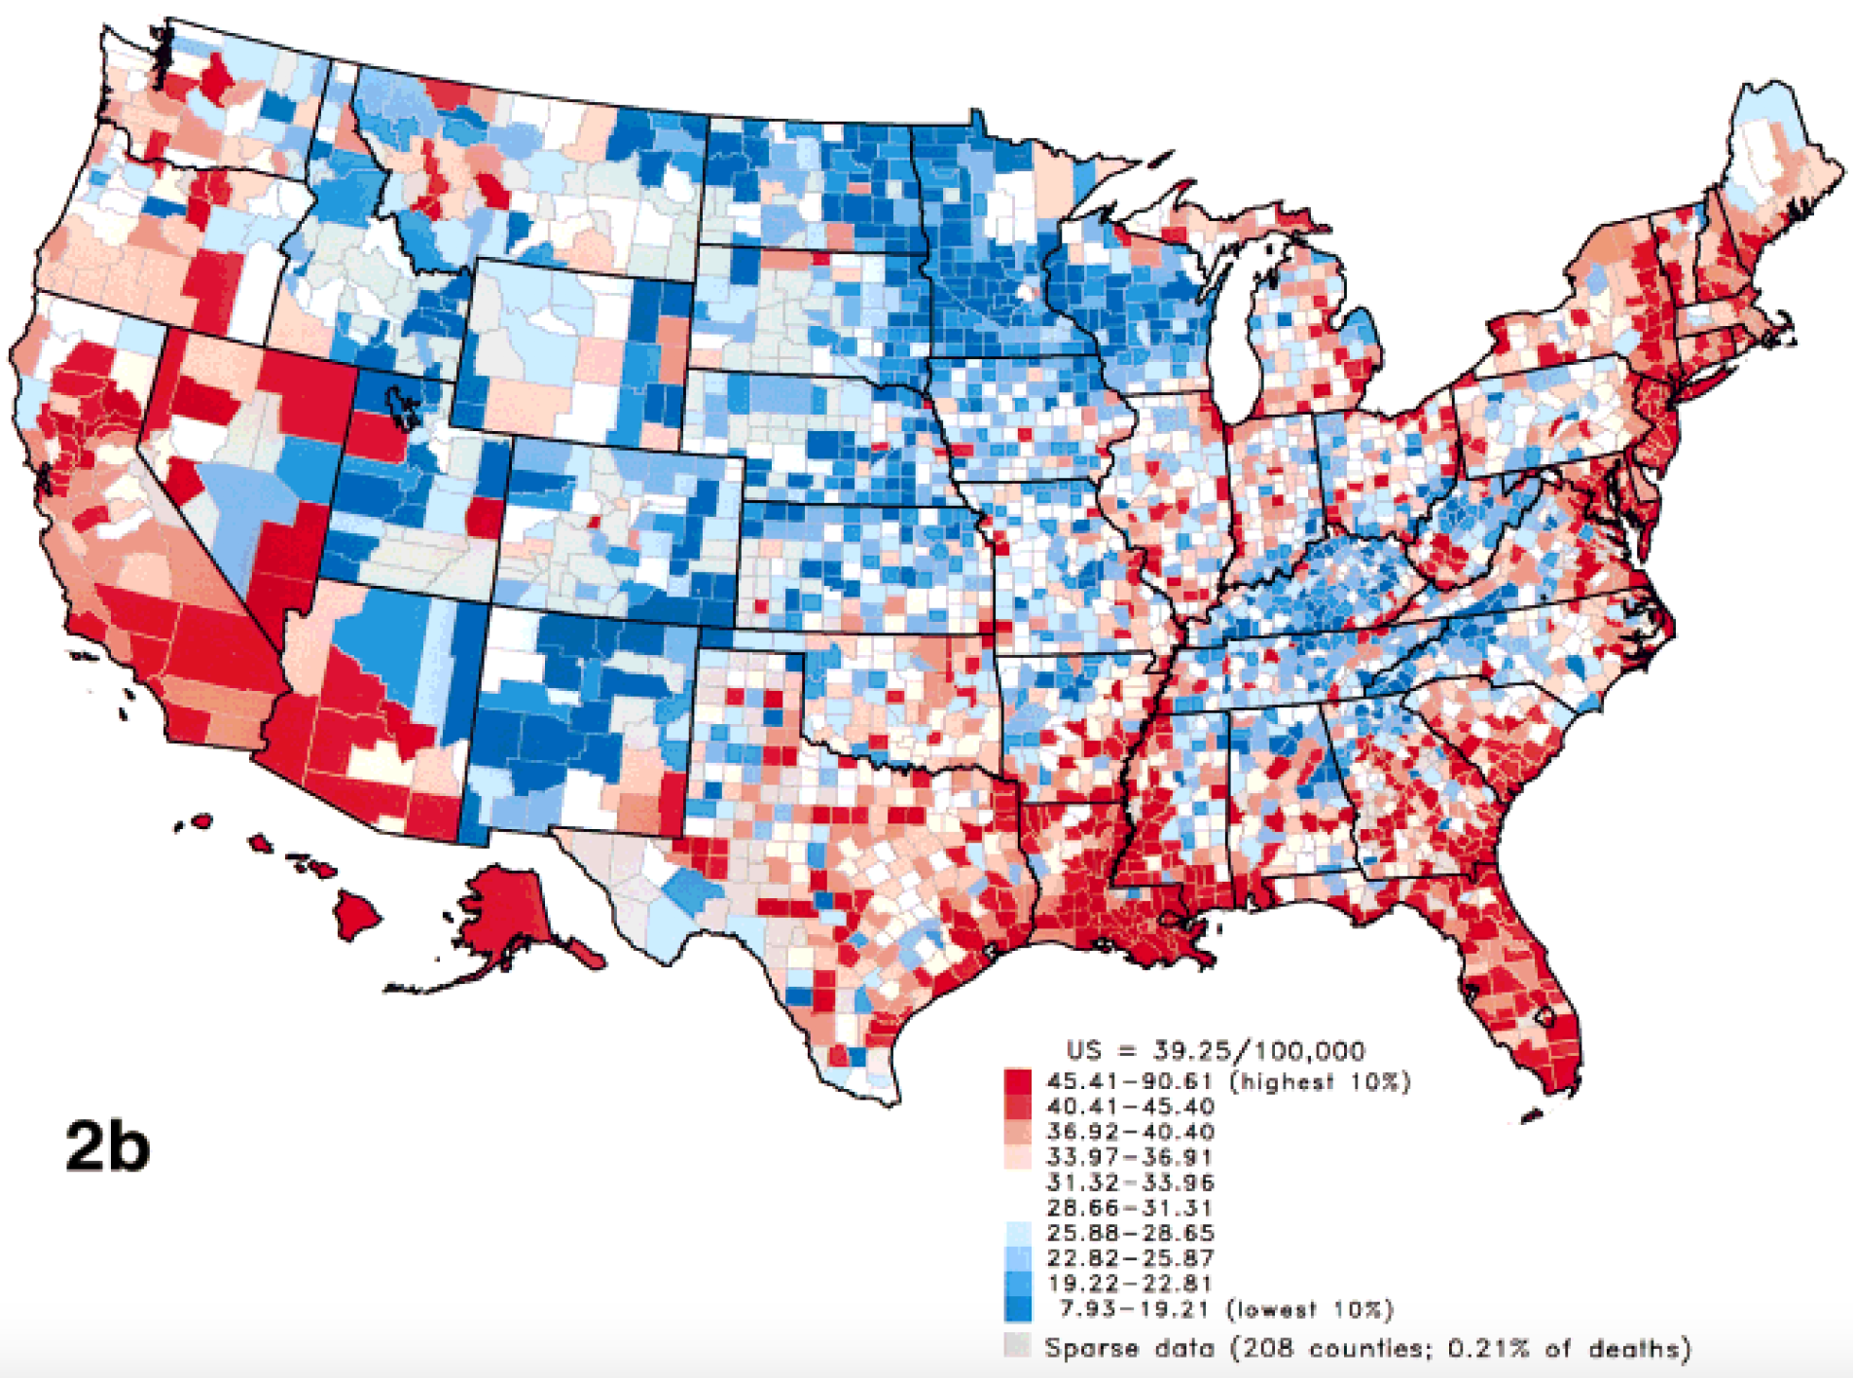
Pattern Family 4: Colocation Example
  Cholera death, Broad Street water pump (1854, London)
Higher Lung-cancer mortality (white males, 1950-69), WW2 ship building ( Asbestos )
Food deserts, increased rate of obesity & cancer
…
Sources: A. Jemal et al., “Recent Geographic Patterns of Lung Cancer and Mesothelioma Mortality Rates in 49 Shipyard Counties in the U.S., 1970-94”, Am J. Ind. Med. 2000, 37(5):512-21.
E. Paskett, Place as a rick factor: how Geography shapes where cancer strikes, Elektra Paskett, www.nyp.org/cancer/cancerprevention/cancer-prevention-articles/029-how-geography-shapes-where-cancer-strikes;
B. Tedeschi, Breaking the cycle of despair: One woman's battle for the health of Appalachia, June 20, 2016. https://www.statnews.com/2016/06/20/breaking-cycle-despair-one-womans-battle-health-appalachia/

Slide 14
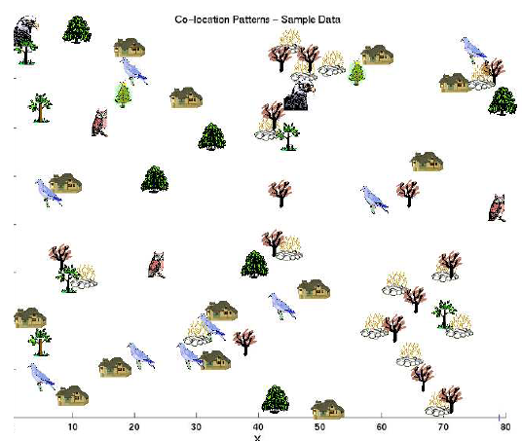

Family 4: Co-locations/Co-occurrence
Given: A collection of different types of spatial events
Find: Co-located subsets of event types
Source: Discovering Spatial Co-location Patterns: A General Approach, IEEE Transactions
on Knowledge and Data Eng., 16(12), December 2004 (w/ H.Yan, H.Xiong).

Slide 15
Scope: What’s NOT Spatial Data Mining?
Simple Querying of Spatial Data
  Find neighbors of Canada, or shortest path from Boston to Houston
Testing a hypothesis via a primary data analysis
  Ex. Is cancer rate inside Hinkley, CA higher than outside ?
  SDM: Which places have significantly higher cancer rates?
Uninteresting, obvious or well-known patterns
  Ex. (Warmer winter in St. Paul, MN) => (warmer winter in Minneapolis, MN)
  SDM: (Pacific warming, e.g. El Nino) => (warmer winter in Minneapolis, MN)
Non-spatial data or pattern
  Ex. Diaper and beer sales are correlated
  SDM: Diaper and beer sales are correlated in blue-collar areas (weekday evening)

Slide 16
Outline
Motivation
Spatial Data
  Spatial Data Types & Relationships
  OGIS Simple Feature Types
Spatial Statistical Foundations
Spatial Data Mining
Conclusions

Slide 17
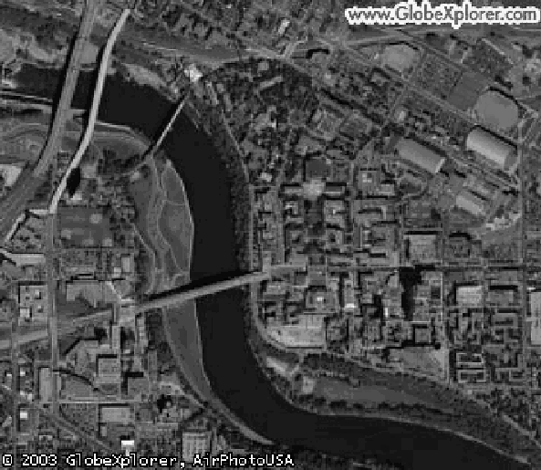
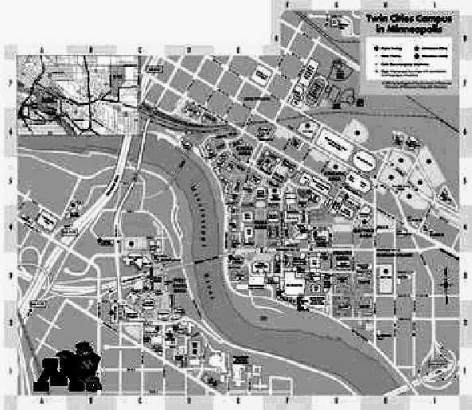
Data-Types: Non-Spatial vs. Spatial
Non-spatial
  Numbers, text-string, …
  e.g., city name, population
Spatial (Geographically referenced)
  Location, e.g., longitude, latitude, elevation
  Neighborhood and extent
Spatial Data-types
  Raster: gridded space
  Vector: point, line, polygon, …
  Graph: node, edge, path
Raster (Courtesy: UMN)
Vector (Courtesy: MapQuest)

Slide 18
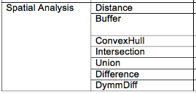
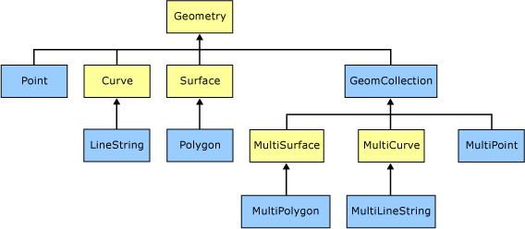
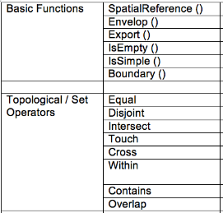
OGC Simple Features Standard
[Details: Spatial Databases: Accomplishments and Research Needs, S. Shekhar et al., IEEE Trans. on Knowledge and Data Eng., 11(1), Jan.-Feb. 1999.
Notes:
ww.dailymail.co.uk/news/article-3236684/Transport-bosses-secret-geographically-accurate-Tube-map-showing-REAL-distances-stations.html
http://qz.com/503631/do-you-want-your-subway-map-to-look-pretty-or-to-reflect-reality/

Slide 19
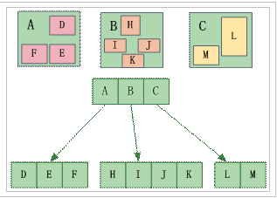



Spatial Database Management Systems
Meta-data, Schema, DBMS (SQL, Hadoop)
Challenge: One size does not fit all!
Ex. Spatial Querying
  Geo-tag. Checkin, Geo-fence
Spatial Querying Software
  OGC Spatial Data Type & Operations
  Data-structures: B-tree => R-tree
  Algorithms: Sorting => Geometric
  Partitioning: random => proximity aware

Slide 20
Research Needs for Data
Limitations of OGC Simple Features
  Direction predicates - e.g. absolute, ego-centric
  Terrains and visibility, Network analysis, Raster operations
  Spatio-temporal
Needs for New Standards & Research
  Modeling richer spatial properties listed above
  Spatio-temporal data, e.g., moving objects

Slide 21
Outline
Motivation
Spatial Data Types
Spatial Statistical Foundations
  Spatial Auto-correlation
  Heterogeneity
  Edge Effect
Spatial Data Mining
Conclusions

Slide 22
Limitations of Traditional Statistics
Classical Statistics
  Data samples: independent and identically distributed (i.i.d)
  Simplifies mathematics underlying statistical methods, e.g., Linear Regression
Spatial data samples are not independent
  Spatial Autocorrelation metrics
    distance-based (e.g., K-function), neighbor-based (e.g., Moran’s I)
  Spatial Cross-Correlation metrics
Spatial Variability and Heterogeneity
  Spatial data samples may not be identically distributed!
  No two places on Earth are exactly alike!
…

Slide 23
Challenge: Modifiable Areal Unit Problem (MAUP)
Result changes if spatial partitioning changes (similar to Gerrymandering)
  Neighbor Graph Based Measures are more robust
Neighbor graph
Partition A
Spatial Data
Partition B
Partition A Based Pearson’s Correlation | Pairs | Partition B Based Pearson’s Correlation | Ripley’s Cross-K | Participation Index
1 | - | - 0.90 | 0.33 | 0.66
- 0.90 | - | 1 | 0.5 | 1
[Details: Data Science for Earth: The Earth Day Report , E. Eftelioglu, S. Shekhar, J. Hudson, L. Joppa, C. Baru, V. Janeja, et al. ACM SIGKDD Explorations Newsletter, 22(1), May 2020.

Slide 24
Challenge: Modifiable Areal Unit Problem (MAUP)
Result changes if spatial partitioning changes (similar to Gerrymandering)
  Neighbor Graph Based Measures are more robust
Neighbor graph
Partition A
Spatial Data
Partition B
Partition A Based Pearson’s Correlation | Pairs | Partition B Based Pearson’s Correlation | Ripley’s Cross-K | Participation Index
1 | - | - 0.90 | 0.33 | 0.66
- 0.90 | - | 1 | 0.5 | 1
[Details: Data Science for Earth: The Earth Day Report , E. Eftelioglu, S. Shekhar, J. Hudson, L. Joppa, C. Baru, V. Janeja, et al. ACM SIGKDD Explorations Newsletter, 22(1), May 2020.

Slide 25
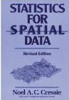
Spatial Statistics: An Overview
  Point process
  Discrete points, e.g., locations of trees, accidents, crimes, …
  Complete spatial randomness (CSR): Poisson process in space
  K-function: test of CSR
Geostatistics
  Continuous phenomena, e.g., rainfall, snow depth, …
  Methods: Variogram measure how similarity decreases with distance
  Spatial interpolation, e.g., Kriging
Lattice-based statistics
  Polygonal aggregate data, e.g., census, disease rates, pixels in a raster
  Spatial Gaussian models, Markov Random Fields, Spatial Autoregressive Model

Slide 26
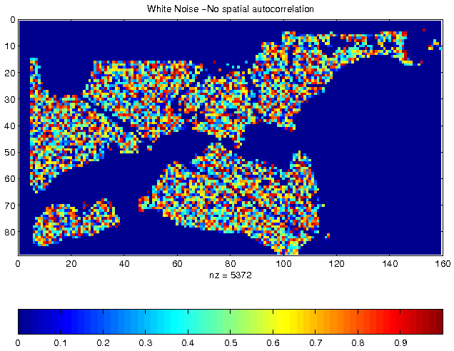
Spatial Autocorrelation (SA)
  First Law of Geography
  All things are related, but nearby things are more related than distant things. [Tobler70]
  Spatial autocorrelation
  Traditional i.i.d. assumption is not valid
  Measures: K-function, Moran’s I, Variogram, …
Independent, Identically Distributed
pixel property
Vegetation Durability with SA

Slide 27
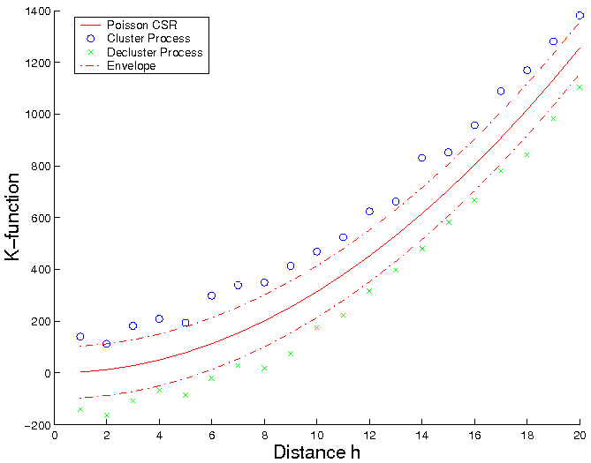
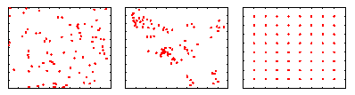
Spatial Autocorrelation: K-Function
  Purpose: Compare a point dataset with a complete spatial random (CSR) data
  Input: A set of points
  where λ is intensity of event
Interpretation: Compare k(h, data) with K(h, CSR)
  K(h, data) = k(h, CSR): Points are CSR
      > means Points are clustered
      < means Points are de-clustered
[number of events within distance h of an arbitrary event]
CSR
Clustered
De-clustered

Slide 28
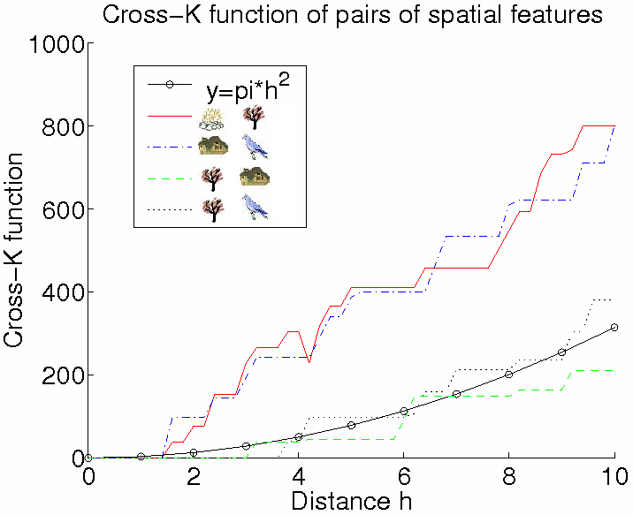
Spatial Cross-Correlation
  Cross K-Function Definition
[number of type j event within distance h of a type i event]

Slide 29
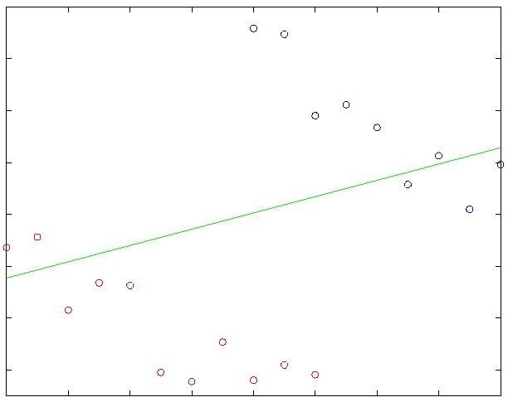
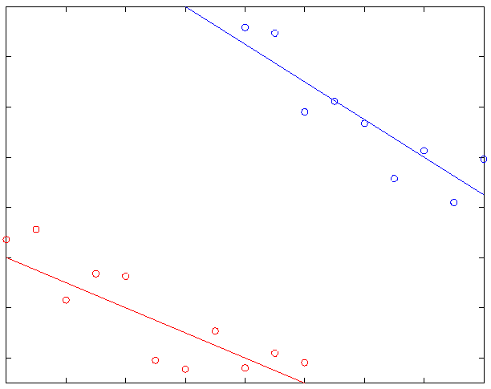

Spatial Variability and Heterogeneity
  “Second law of geography” [M. Goodchild, UCGIS 2003]
  Global model might be inconsistent with regional models
  Spatial Simpson’s Paradox (linked to MAUP)
  May improve the effectiveness of SDM, show support regions of a pattern

Slide 30
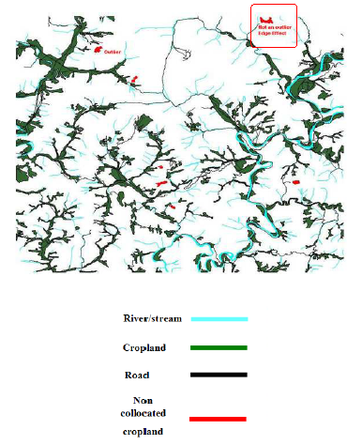
Edge Effect
  Cropland on edges may not be classified as outliers
  No concept of spatial edges in classical data mining
Korea Dataset,
Courtesy: Architecture Technology Corp.

Slide 31

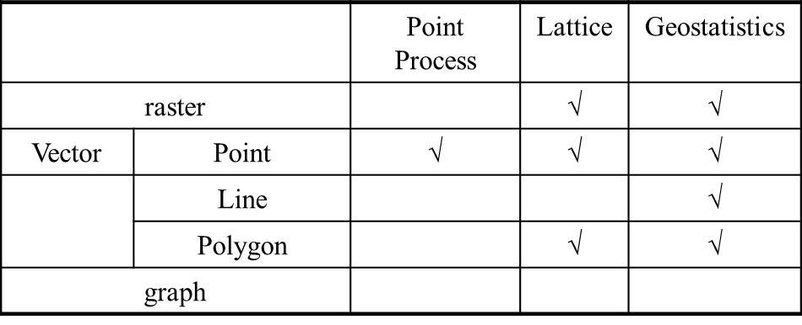

Research Needs
  State-of-the-art of Spatial Statistics
Data Types and Statistical Models
  Research Needs
  Correlating extended features, road, rivers, cropland
  Spatio-temporal statistics
  Spatial graphs, e.g., reports with street address

Slide 32
Outline
Motivation
Spatial Data Types
Spatial Statistical Foundations
Spatial Data Mining
  Location Prediction
  Hotspots
  Spatial Outliers
  Colocations
Conclusions

Slide 33
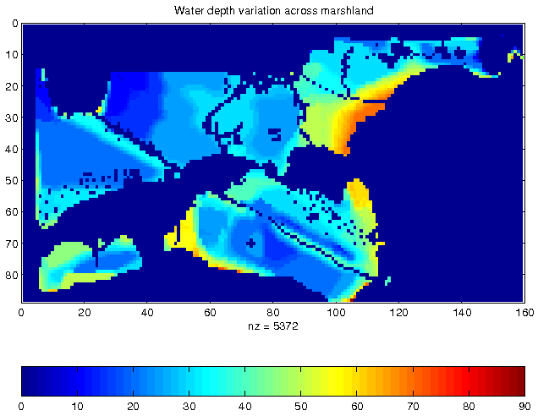
Illustration of Spatial Prediction Problem
Nest Locations
Vegetation Index
Water Depth
Distance to Open Water

Slide 34
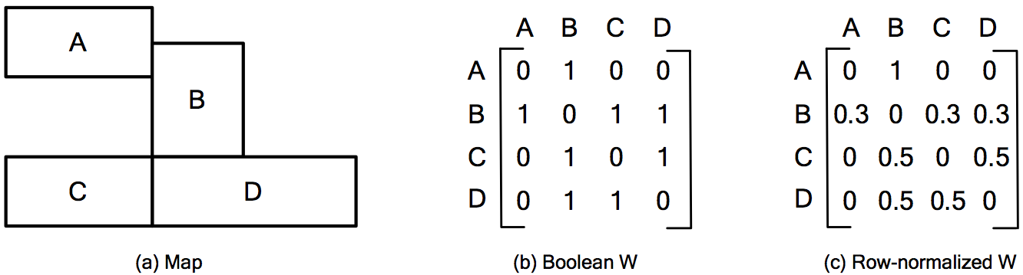
Neighbor Relationship: W Matrix

Slide 35
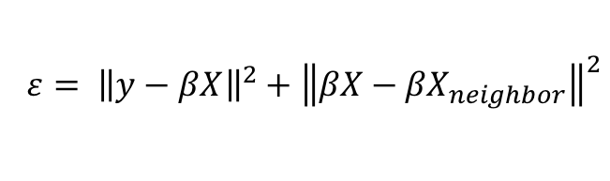
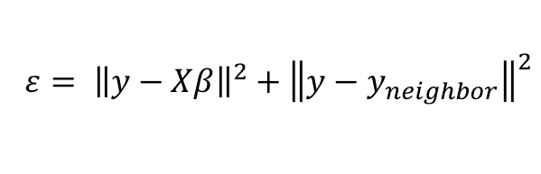
Spatial Prediction Models
$$ε= {\left\|y−Xβ\right\|}^{2}+{\left\|y−y_{neighbor}\right\|}^{2}$$
  Traditional Models, e.g., Regression (with Logit or Probit),
    Linear Regression, Bayes Classifier, …
Semi-Spatial : auto-correlation regularizer
Spatial Models
  Spatial autoregressive model (SAR)
  Markov random field (MRF) based Bayesian Classifier
$$ε= {\left\|y−βX\right\|}^{2}+{\left\|βX−{βX}_{neighbor}\right\|}^{2}$$
Traditional | Spatial
Decision Trees | Spatial Decision Trees
Neural Networks | Convolutional Neural Networks

Slide 36
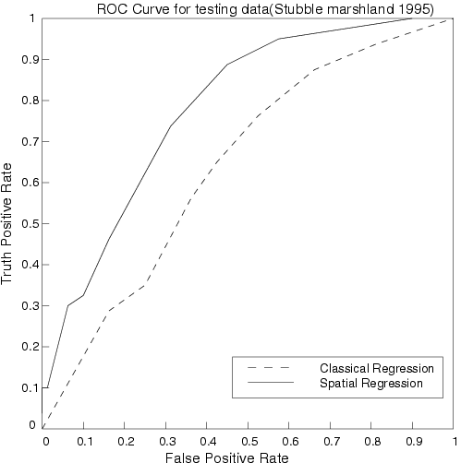
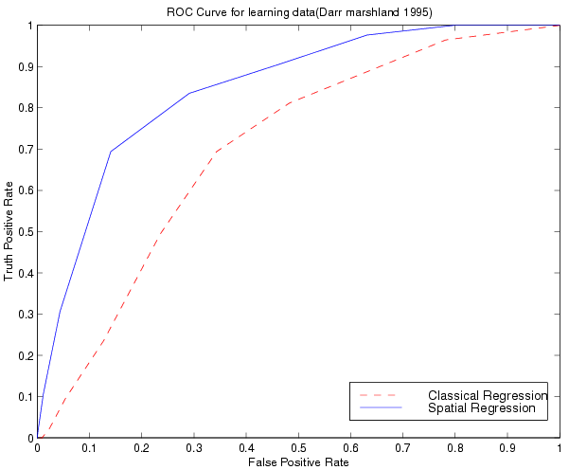
Comparing Traditional and Spatial Models
  Dataset: Bird Nest prediction
  Linear Regression
    Lower prediction accuracy, coefficient of determination,
    Residual error with spatial auto-correlation
  Spatial Auto-regression outperformed linear regression
ROC Curve
for learning
ROC Curve
for testing

Slide 37


Prediction Error and Bias Trade-off
Linear Regression (LR): Least Squares estimator
LR with Auto-correlation Regularizer
  Least squares estimator
Spatial Auto-Regression:
  Maximum Likelihood Estimator
LR: Linear Regression
$$ε= {\left\|y−βX\right\|}^{2}+{\left\|βX−{βX}_{neighbor}\right\|}^{2}$$
Prediction Error
$$ε= {\left\|y−βX\right\|}^{2}+{\left\|y−{βX}_{neighbor}\right\|}^{2}$$
LR with
Auto-correlation
Regularizer
Spatial
Auto-
Regression
Bias
Source: Geospatial Data Science: A Transdisciplinary Approach. In Geospatial Data Science Techniques and Applications (pp. 17-56). CRC Press, 2017 (E. Eftelioglu,R. Ali, X. Tang., Y. Xie, Y., Li and S. Shekhar).

Slide 38


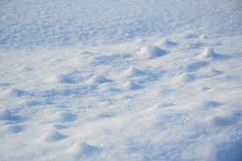
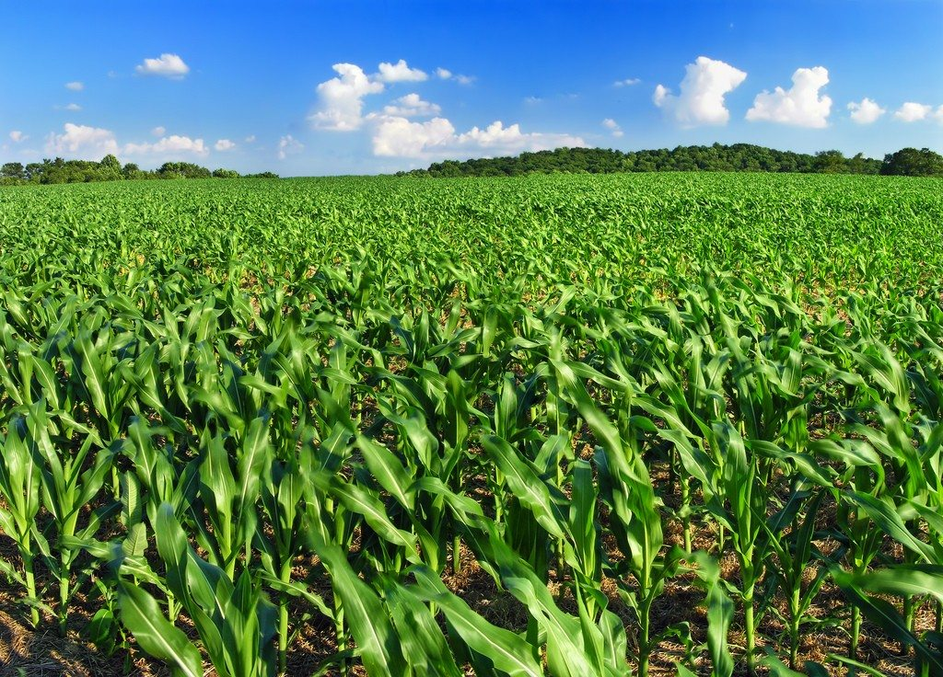
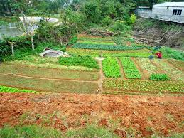
Spatial Heterogeneity
Knowledge of location can improve land-cover and object recognition ( Ex. Snow vs. salt )
Coarse Satellite Imagery (e.g., 30m pixels)
  Better for mono-crop farms than mixed-crop plots
However, Convolutional Neural Networks does not model geographic heterogeneity.
Q? Which of these problem may be addressed by “attention” in DNN ?
Salt Marsh (Runn of Kutch, India)
Snow
Snow

Slide 39
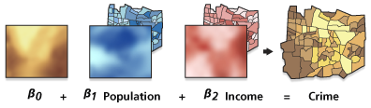
Geographically Weighted Regression (GWR)
Goal: Model spatially varying relationships
Example:
  Where are location dependent
Source: resources.arcgis.com

Slide 40



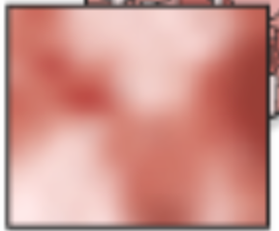


Spatial Variability Aware Neural Networks (SVANN)
Each NN parameter is a map i.e., a function of location
  Similar to Geographically Weighted Regression
Evaluation:
  Urban Garden Detection across Hennepin County, MN and Fulton County, GA.
  SVANN outperformed OSFA by 14.34% on F1-scores.
0.3
0.3
0.5
0.8
0.5
0.6
A Neural Network (NN)
SVANN
Details:Towards Spatial Variability Aware Deep Neural Networks (SVANN), ACM Trans. on Intelligent Systems and Tech, 12(6):1-21, 2021. (A Summary in ACM SIGKDD DeepSpaial, 2020. (Best Paper Award)

Slide 41
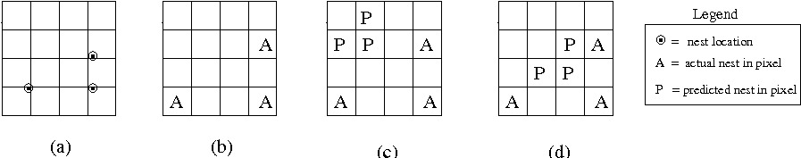
Research Needs in Spatial Prediction
Spatial Auto-Regression
  Estimate W
  Scaling issue
Spatial interest measure
  e.g., distance(actual, predicted)
Actual Sites
Pixels with
actual sites
Prediction 1
Prediction 2.
Spatially more interesting
than Prediction 1

Slide 42
Outline
Motivation
Spatial Data Types
Spatial Statistical Foundations
Spatial Data Mining
  Location Prediction
  Hotspots
  Spatial Outliers
  Colocations
Conclusions

Slide 43
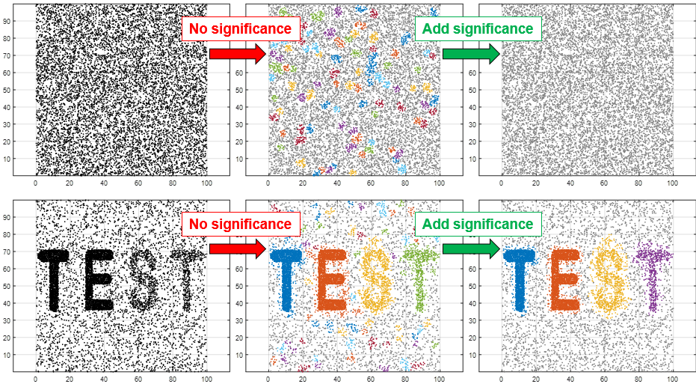
Limitations of Classical Clustering Methods
  Easily fooled by noise
Data
DBSCAN
Desired

Slide 44
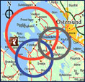
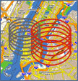

Spatial Scan Statistics
  Goal: Omit chance clusters
  Ideas: Likelihood Ratio, Statistical Significance
  Steps
    Enumerate candidate zones & choose zone X with highest likelihood ratio (LR)
      LR(X) = p(H1|data) / p(H0|data)
      H0: points in zone X show complete spatial randomness (CSR)
      H1: points in zone X are clustered
    If LR(Z) >> 1 then test statistical significance
      Check how often is LR( CSR ) > LR(Z)
        using 1000 Monte Carlo simulations

Slide 45
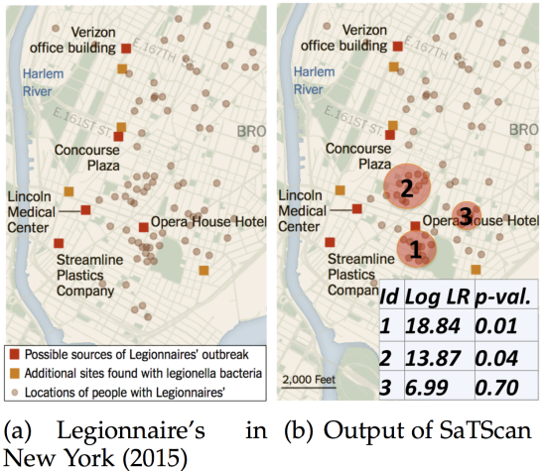
SaTScan Examples
1854 London Cholera, p-value = 0.001
Source: Ring-Shaped Hotspot Detection, IEEE Trans. Know. & Data Eng., 28(12), 2016.
(A Summary in Proc. IEEE ICDM 2014) (w/ E. Eftelioglu et al.)

Slide 46
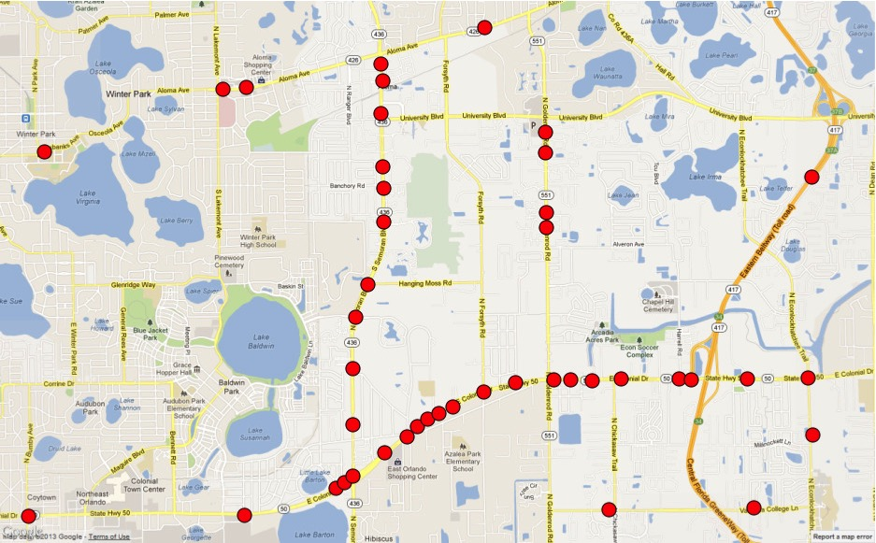
Non-circular Hotspots
  Geographic features, e.g., rivers, streams, roads, …
    Hot-spots => Hot Geographic-features, e.g., Linear Hotspots
  Spatial Theories, e.g,, environmental criminology
    Circles ➔ Doughnut holes
Pedestrian fatalities Orlando, FL
Circular hotspots
by SatScan
Linear hotspots
Details: Significant Linear Hotspot Discovery, IEEE Transactions on Big Data, 3(2):140-153, 2017.
(Summary in Proc. Geographic Info. Sc., Springer LNCS 8728, pp. 284-300, 2014.

Slide 47
Hotspots with Flexible Shapes
Data
DBSCAN
Significant DBSCAN
Complete Spatial Random
(noise)
Hotspots with Noise
Details: Significant DBSCAN towards Statistically Robust Clustering, ACM Trans. on Intelligent Systems and Tech, 12(5):1-26, Oct. 2021. (A summary in 16th Intl. Symp. on Spatial and Temporal Databases, 2019. (Best Paper Award)

Slide 48
Outline
Motivation
Spatial Data Types
Spatial Statistical Foundations
Spatial Data Mining
  Location Prediction
  Hotspots
  Spatial Outliers
  Colocations
Conclusions

Slide 49
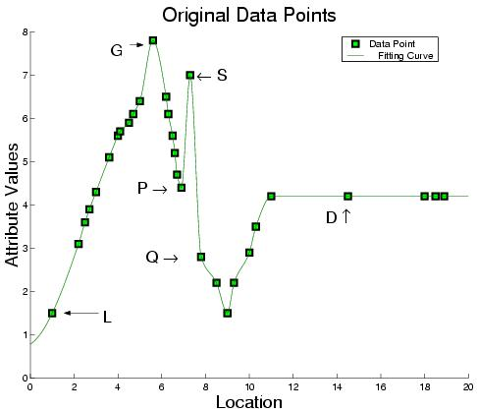
Outliers: Global (G) vs. Spatial (S)

Slide 50
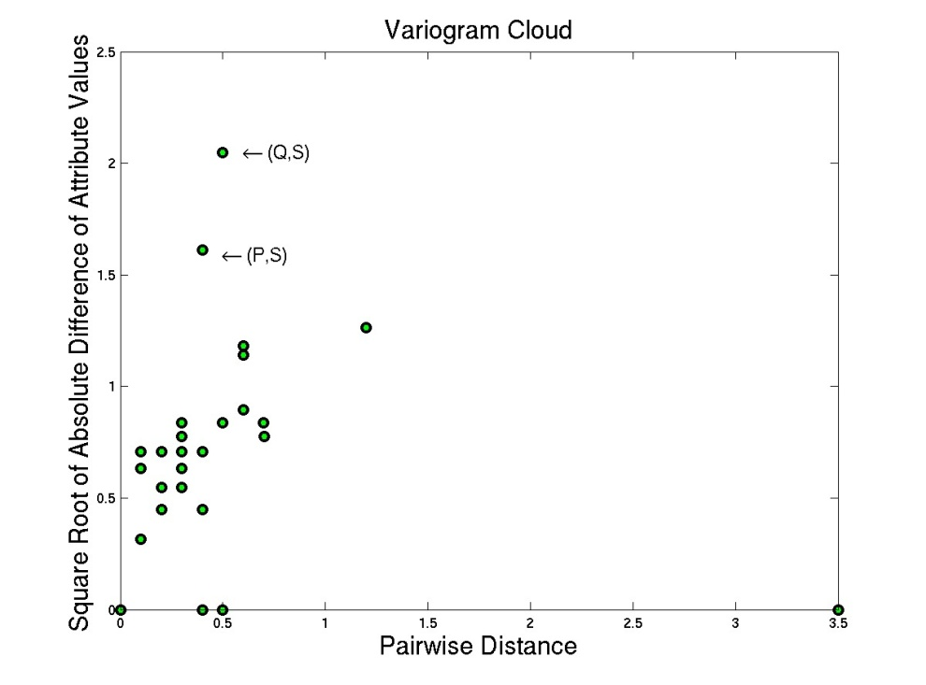
Outlier Detection Tests: Variogram Cloud
  Graphical Test: Variogram Cloud

Slide 51
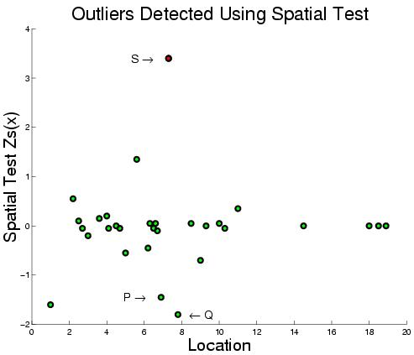
Outlier Detection Tests: Spatial Z-test
  Quantitative Tests: Spatial Z-test
    Algorithmic Structure: Spatial Join on neighbor relation

Slide 52





Flow Anomalies
Example Forensics: When and where do contaminants enter a Creek?
Dissolved
Oxygen
6/4/08 13:06 - 6/5/08 19:34
After heavy rain (June 4 & 5)
www.sfgate.com/cgi-bin/news/oilspill/busan
Rainfall
(HydroLab sensor)
(Shingle Creek, MN Study Site)
Details: Discovering Flow Anomalies: A SWEET Approach, IEEE Intl. Conf. on Data Mining, 2008 (w/J. Kang et al.).

Slide 53
Spatial Outlier Detection: Computation
  Separate two phases
    Model Building
    Testing: test a node (or a set of nodes)
  Computation Structure of Model Building
    Key insights:
      Spatial self join using N(x) relationship
      Algebraic aggregate function computed in one scan of spatial join

Slide 54
Trends in Spatial Outlier Detection
  Multiple spatial outlier detection
    Eliminating the influence of neighboring outliers
  Multi-attribute spatial outlier detection
    Use multiple attributes as features
  Spatio-temporal anomalies
    Anomalous trajectories, patterns of life
  Scale up for large data

Slide 55
Outline
Motivation
Spatial Data Types
Spatial Statistical Foundations
Spatial Data Mining
  Location Prediction
  Hotspots
  Spatial Outliers
  Colocations
Conclusions

Slide 56

Background: Association Rules
  Association rule e.g. (Diaper in T => Beer in T)
    Support: probability (Diaper and Beer in T) = 2/5
    Confidence: probability (Beer in T | Diaper in T) = 2/2
  Apriori Algorithm
    Support based pruning using monotonicity
    Computationally efficient, scales to larger dataset than correlation coefficient

Slide 57

Limitations of Association Rules
Spatial Partitioning | P1 | P2 | P3
Transactions | T11, T12, T13, T14 | T21, T22, T23, T24 | T31, T32, T33, T44
Associations with support >= 0.5 | ( ) | ( ) | ( )

Slide 58
Spatial Colocation
Feature set: ( , , , , )
Feature Subsets:
Participation ratio (pr):
pr(A , (A,B) ) = fraction of A instances neighboring feature { B} = 2/3
pr(B. , (A,B). ) = ½
Participation index (A,B. ) = pi(A,B. )
= min{ pr(A. , (A,B). ), pr(B. , (A,B). ) }
= min (2/3, ½ ) = ½
Participation Index Properties:
(1) Computational: Non-monotonically decreasing like support measure
(2) Statistical: Upper bound on Ripley’s Cross-K function

Slide 59
Participation Index >= Cross-K Function
B.1
A.1
B.1
A.1
B.1
A.1
A.3
A.3
A.3
B.2
A.2
B.2
A.2
B.2
A.2
Cross-K (A,B) | 2/6 = 0.33 | 3/6 = 0.5 | 6/6 = 1
PI (A,B) | 2/3 = 0.66 | 1 | 1

Slide 60

Co-occurrence Patterns to Refine a Physical Model
Details: R. Ali, V. Gunturi, A. Kotz, E. Eftelioglu, S. Shekhar, and W. Northrop “Discovering Non-compliant Window Co-Occurrence Patterns.” GeoInformatica, 21(4), 829-866 (2017).
Notes:
Updated Slide 18
Updated Slide 18
Ask Reem for nice picture: Helps to improve NOx prediction
Ask Yan: Get the picture from the proposal
Remove table from the bottom

Slide 61
Spatial Colocation: Trends
  Algorithms
    Join-based algorithms
      One spatial join per candidate colocation
    Join-less algorithms
  Statistical Significance
    ?Chance-patterns
  Spatio-temporal
    Which events co-occur in space and time?
      (bar-closing, minor offenses, drunk-driving citations)
    Which types of objects move together?

Slide 62


Cascading spatio-temporal pattern (CSTP)
TimeT1
TimeT2
TimeT3
Aggregate(T1,T2,T3)
Bar Closing(B)
Assault(A)
Drunk Driving (C)
Input: Urban Activity Reports
Output: CSTP
  Partially ordered subsets of ST event types.
  Located together in space + Occur in stages over time.
Applications: Public Health, Public Safety, …
CSTP: P1
C
B
A
Details: Cascading Spatio-Temporal Pattern Discovery, IEEE Trans. on Know. & Data Eng, 24(11), 2012.
Notes:
1. Public Safety/ Crime analysis is the primary motivation, where Bars in large cities serve as crime generators , and events such as Drunk driving and assaults are observed after bar closing. This illustrative example shows 3 time spans from 1 am, within an interval of 20 min to 1 hr. Patterns observed are partially ordered, where events are located together in space and occur in stages over time, we call such patterns cascading spatio-temporal patterns, they are also observed in climate change (e.g. El-nino), epidemiology and evacuation planning)

Slide 63
Outline
Motivation
  Use cases
  Pattern families
Spatial Data Types
Spatial Statistical Foundations
Spatial Data Mining
Conclusions

Slide 64

Summary
  What’s Special About Mining Spatial Data ?
Frequent Patterns of Change
Change Detection

Slide 65
References :Surveys, Overviews
Spatial Computing, The MIT Press Essential Knowledge series, Feb. 2020.
Spatial Computing ( html , short video , tweet ), Communications of the ACM, 59(1):72-81, Jan. 2016.
AM-97 - An Introduction to Spatial Data Mining , The Geographic Information Science & Technology Body of Knowledge, 2020, J. Wilson (Ed.). DOI:10.22224/gistbok/2020.4.5. (Also UMN CS technical report 18-013, 2018).
Transdisciplinary Foundations of Geospatial Data Science ( html , pdf ), ISPRS Intl. Jr. of Geo-Informatics, 6(12):395-429, 2017. ( doi:10.3390/ijgi6120395 )
Spatiotemporal Data Mining: A Computational Perspective , ISPRS Intl. Jr. on Geo-Information, 4(4):2306-2338, 2015 (DOI: 10.3390/ijgi4042306).
Identifying patterns in spatial information: a survey of methods ( pdf ), Wiley Interdisciplinary Reviews: Data Mining and Knowledge Discovery, 1(3):193-214, May/June 2011. (DOI: 10.1002/widm.25).
Theory-Guided Data Science: A New Paradigm for Scientific Discovery from Data, IEEE Transactions on Knowledge and Dat Mining, 29(10):2318-2331, June 2017. ( DOI: 10.1109/TKDE.2017.2720168 ).
Parallel Processing over Spatial-Temporal Datasets from Geo, Bio, Climate and Social Science Communities: A Research Roadmap. IEEE BigData Congress 2017: 232-250.
Spatial Databases: Accomplishments and Research Needs, IEEE Transactions on Knowledge and Data Engineering, 11(1):45-55, 1999.

Slide 66
References: Details
Colocations | Discovering colocation patterns from spatial data sets: a general approach, IEEE Trans. on Know. and Data Eng., 16(12), 2004 (w/ Y. Huang et al.). A join-less approach for mining spatial colocation patterns, IEEE Trans. on Know. and Data Eng.,18 (10), 2006. (w/ J. Yoo). Cascading Spatio-Temporal Pattern Discovery. IEEE Trans. Knowl. Data Eng. 24(11): 1977-1992, 2012 (w/ P. Mohan et al.).
Spatial Outliers | Detecting graph-based spatial outliers: algorithms and applications (a summary of results), Proc.: ACM Intl. Conf. on Knowledge Discovery & Data Mining, 2001 (with Q. Lu et al.) A unified approach to detecting spatial outliers, Springer GeoInformatica, 7 (2), 2003. (w/ C. Lu, et al.) Discovering Flow Anomalies: A SWEET Approach, IEEE Intl. Conf. on Data Mining, 2008 (w/ J. Kang).
Hot Spots | Discovering personally meaningful places: An interactive clustering approach, ACM Trans. on Info. Systems (TOIS) 25 (3), 2007. (with C. Zhou et al.) A K-Main Routes Approach to Spatial Network Activity Summarization, IEEE Trans on Know. & Data Eng., 26(6), 2014. (with D. Oliver et al.) Significant Linear Hotspot Discovery, IEEE Trans. Big Data 3(2): 140-153, 2017, (w/ X.Tang et al.) Statistically-Robust Clustering Techniques for Mapping Spatial Hotspots: A Survey, ACM Computing Surveys, 55(2):1-38, March 2023, https://doi.org/10.1145/3487893
Location Prediction | Spatial contextual classification and prediction models for mining geospatial data, IEEE Transactions on Multimedia, 4 (2), 2002. (with P. Schrater et al.) Focal-Test-Based Spatial Decision Tree Learning. IEEE Trans. Knowl. Data Eng. 27(6): 1547-1559, 2015 (summary in Proc. IEEE Intl. Conf. on Data Mining, 2013) (w/ Z. Jiang et al.).
Change Detection | Spatiotemporal change footprint pattern discovery: an inter-disciplinary survey. Wiley Interdisc. Rew.: Data Mining and Know. Discovery 4(1), 2014. (with X. Zhou et al.) https://doi.org/10.1002/widm.1113

Slide 67
(Past and Future) Patterns of Pandemic
N. Nazia et al., Methods Used in the Spatial and Spatiotemporal Analysis of COVID-19 Epidemiology: A Systematic Review. Int J Environ Res Public Health. 2022 Jul 6;19(14):8267. doi: 10.3390/ijerph19148267.
Describe past spatial patterns and predict future spatial patterns
Infectious disease outbreak, outbreak source, spread (OD matrix) and peak prediction, SEIR model (e.g., estimate R0 by place), outbreak places and correlates, quarantine management (which transportation links to break?) , …
Pattern Family | Pandemic Concept, Use Cases, … | Examples, Picture,
Hot Spots | Outbreaks, Areas of Concentrations | NYC in phase 1 (L. Andersen e al., Analyzing the spatial determinants of local Covid-19 transmission in the United States. Sci Total Environ. 2021 Feb 1;754:142396.)
Spatial Outliers | Exceptions: (which places or groups have lower level of adverse outcomes?) | Bar in London Cholera map,
Spatial Prediction | Locate origin of an outbreak/pandemic Predict spread of an infectious disease When will it peak in a geographic area | (a) NYC Legionnaire Disease (RHD), Wuhan COVID-19 (b) Estimate R0 in SEIR model via DNN
Colocations | Spatially correlates of adverse outcomes (e.g., #cases, #deaths), e.g., medical facilities, access, insurance, #vaccinations, public health, …) | (COVID transmission rate, population density), (COVID cases/death, diabetes, obesity), (vaccination rate, insurance)
Change Detection | How are spatial patterns changing? ? ABM/SEIR | maps across COVID phases (Zhu, D., Ye, X. & Manson, S. Revealing the spatial shifting pattern of COVID-19 pandemic in the United States. Sci Rep 11, 8396 (2021). https://doi.org/10.1038/s41598-021-87902-8), …

