Slide 1
Spatial Data Science: Interdisciplinary Experiences
Shashi Shekhar
McKnight Distinguished University Professor
Dept. of Computer Sc.& Eng., University of Minnesota
www.cs.umn.edu/~shekhar
April 10th, 2017
Nebraska Data Analytics Workshop
University of Nebraska, Lincoln, NE
Notes:
1
1

Slide 2
Outline
Interdisciplinary Research
Motivation: Intellectual & Societal
A definition
Academic Example with Two disciplines
Multi-sector Example
Conclusions

Slide 3
Societal Motivation
Q? Identify disciplines of societal challenges?
Cyber-security, e.g., Fake news, Reduce cancer deaths, Climate change
Poverty, Hunger, Health & Well-being, Inequality, …
Interactions: Feed growing population while protecting water
Q? Identify disciplines of non-academic organizations?
Government, e.g., USDOD, USDA, USDOT, NIH, …
Businesses, e.g., Google, Amazon, GE, Berkshire Hathaway, …

Slide 4
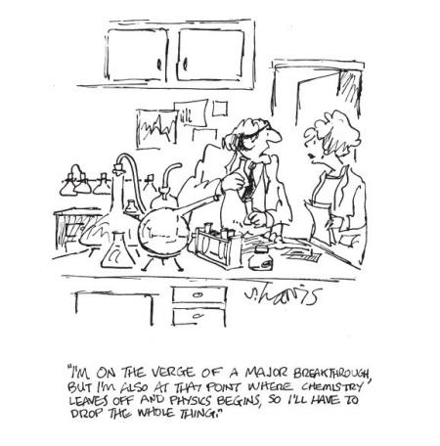
Intellectual Motivation
Q? Identify disciplines of scholars?
Aristotle, Gelileo, Da Vinci, al Bruni, …
Polymaths, Unquenchable curiosity
History of Disciplines
Only a few hundred years old
A way to organize universities
Budget, hiring, degrees, courses,…
+ intra-discipline communication
- inter-disciplinary comm., questions, hiring, education, …
Analogies
Holistic (Systems view) vs. Reductionist
Nationalism vs. Globalism

Slide 5
Interdisciplinary Research
5
integrates information, data, techniques, tools, perspectives, concepts, and/or theories from two or more disciplines or bodies of specialized knowledge
to advance fundamental understanding or to solve problems whose solutions are beyond the scope of a single discipline or area of research practice.

Slide 6
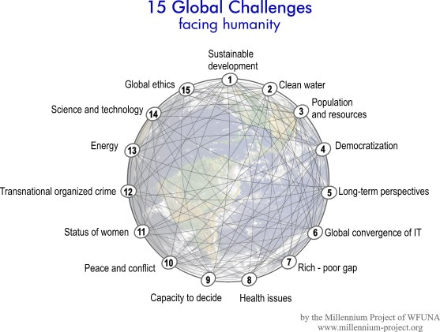
Outline
Why Interdisciplinary ?
Example with Two disciplines
Challenges
A Case Study
Roles of Computer Science in collaboration
Understanding Computer Science
Multi-sector Example
Community Building
Conclusions
Societal
Needs
Data-Driven
Discipline
Data Sc.
Discipline

Slide 7
What is Interdisciplinary Research?
7
Is it multiple Disciplines working on a single project?
Is it one discipline helping another?
My Thoughts:
Ideal: Perform research that enhances all disciplines involved.
Not just a subset!
Very Hard To Do!!!
A lot of asking questions back and forth

Slide 8
Challenges: Communication, Trust, Finding Win-Win
8
Each Discipline has its own language!
We need to learn (foreign) language of other discipline
Homonym (Civil Eng., C. S.): infrastructure, network, bridge, …
Synonyms (Civil Eng., C.S.): networks vs. graphs
Disciplines have different values, cultures and goals
Different norms for ordering of authors in a joint paper
Different emphasis on grants, citations, service, …
Misunderstanding of what each discipline really is
e.g., “I thought Civil Eng. was all about building bridges!”
e.g., “I thought Computer Sc. was all about programming!”
Break down barriers
Build mutual trust and respect via social activities, sharing core competencies, …
Keep talking to each other to find a win-win
Have an open mind when discussing each others’ interests
Is P = NP ?

Slide 9
Disciplines
9
Civil (Env.) Engineering
Professors
William Arnold
Ray Holzalski
Miki Hondzo
Paige Novak
Students
Mike Henjum
Christine Wennen
Computer Science
Professors
Shashi Shekhar
Students
Jim Kang
Hydrology
Professors
David Maidment
Ack: NSF IGERT: Non-equilibrium Dynamics Across Space and Time: A Common Approach for Engineers, Earth Scientists and Ecologists (2008-2012).

Slide 10
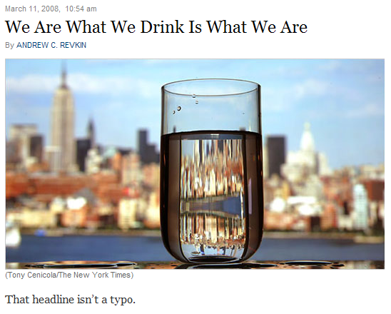
Societal Challenge: Clean Water
10
Source: New York Times (March 11, 2008) (http://dotearth.blogs.nytimes.com/2008/03/11/we-are-what-we-drink-is-what-we-are/?hp)
By 2025,1.8 billion people could be living in water scarce areas
Today, 750 million people live below the water-stress threshold of 1.7 K cubic meters per person
Souce: WFUNA, 15 Global Challenges
Notes:
10

Slide 11
Brainstorming: In the Beginning…
11
Civil Engineering Questions
How is Computer Science involved in this work?
CS: I don’t know!
Need to understand domain questions and dataset first
Computer Science Questions
How many sensors will there be? Like 1000 or 10,000 or more?
CE Ans: No Way! A sensor cost $30,000
CS: Large data or computations ?
CE: Time-series length is in 50,000
CS: time-series similarity query?
CE: What is similarity?
CS: time-series correlation
CE: Not yet!
CRISP-DM Methodology
Notes:
11

Slide 12
Brainstorming: A little later…
12
Civil Eng. Questions
Can you help publish field-sensor data on national website (HIS) ? dealing with wireless communication, data format conversion, XML, etc.?
Can you remove errors from the dataset?
CS Ans:
Yes, we will help with these.
But these do not advance CS
Techniques already exist
Computer Science Questions
Do you want to know how fast the river is flowing?
CE Ans:
Not really,
We can already determine that by the discharge, water depth, and physical characteristics of the river
Notes:
12

Slide 13
Brainstorming: Light at the end of the tunnel
13
Civil Engineering
Can you help with Env. Forensics?
Find when and where a contaminant enters a river?
CS: Is there signature in sensor data?
CE Ans.
Signature across a pair of sensors.
Upstream sensor sees clean water.
Downstream sensor sees contamination.
CS.:
How hard is it manually? computationally?
CE Ans.
Its too hard to find this manually
e.g., hours to sift through the data
50,000 data points per measured variable
Quadratic effort, e.g., 2,500,000,000 pairs
Computer Science
Let me see. Spatial outlier detection won’t not catch it!
A new pattern family: Flow Anomaly: time periods of flow mismatch between up/downstream sensors?
It may advance Computer Sc.
Which Flow Anomalies (F.A.) ?
Transient
Persistent
Dominant Persistent
CE Ans:
Yes!
Dominant Persistent F.A.s please.
Notes:
13

Slide 14
Problem Formulation: Flow Anomaly
Apply Threshold
Nitrate
Nitrate
Nitrate
Time
Time
Time
S₁
S₂
S₃
Flow Anomaly between these two sensors.
Water Treatment Plant
Direction of Water Flow
Two Use Cases:
At the water treatment plant, when should it turn off the water supply from the river?
Where is the source of the contaminant?

Slide 15
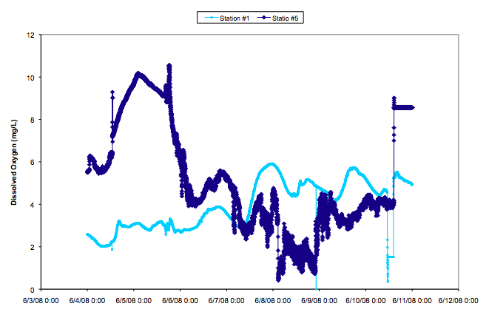
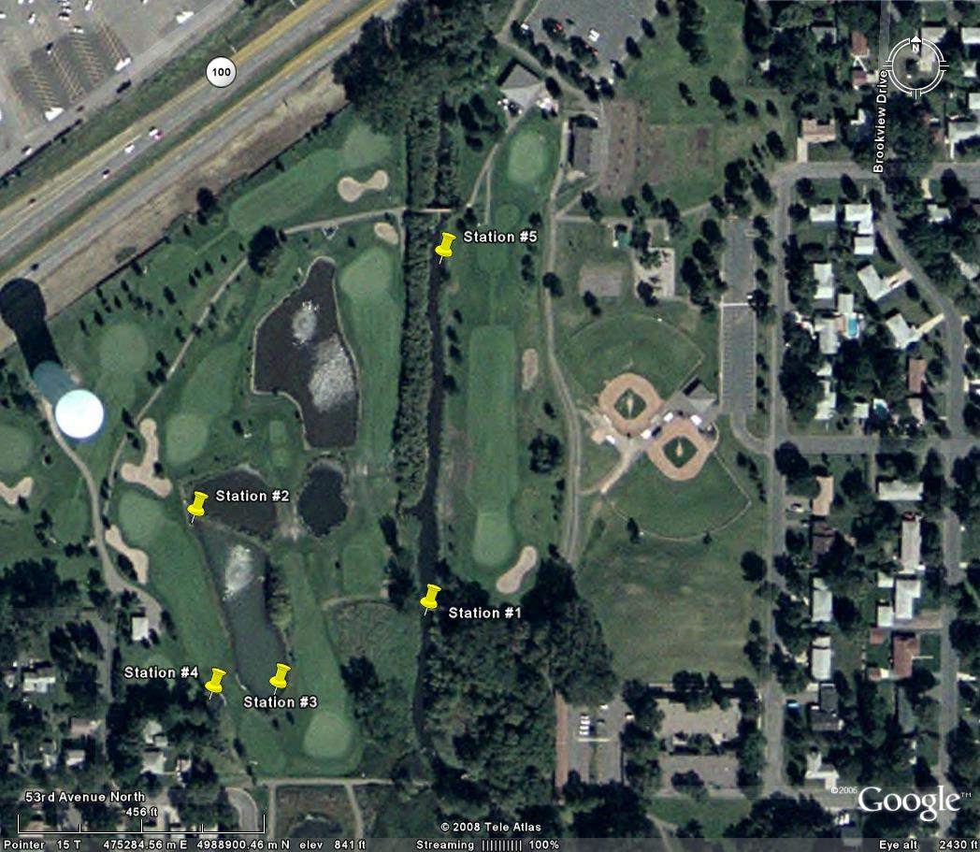
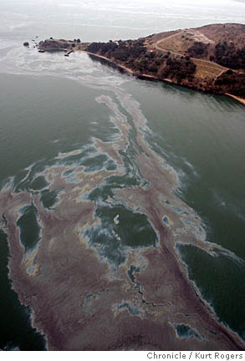
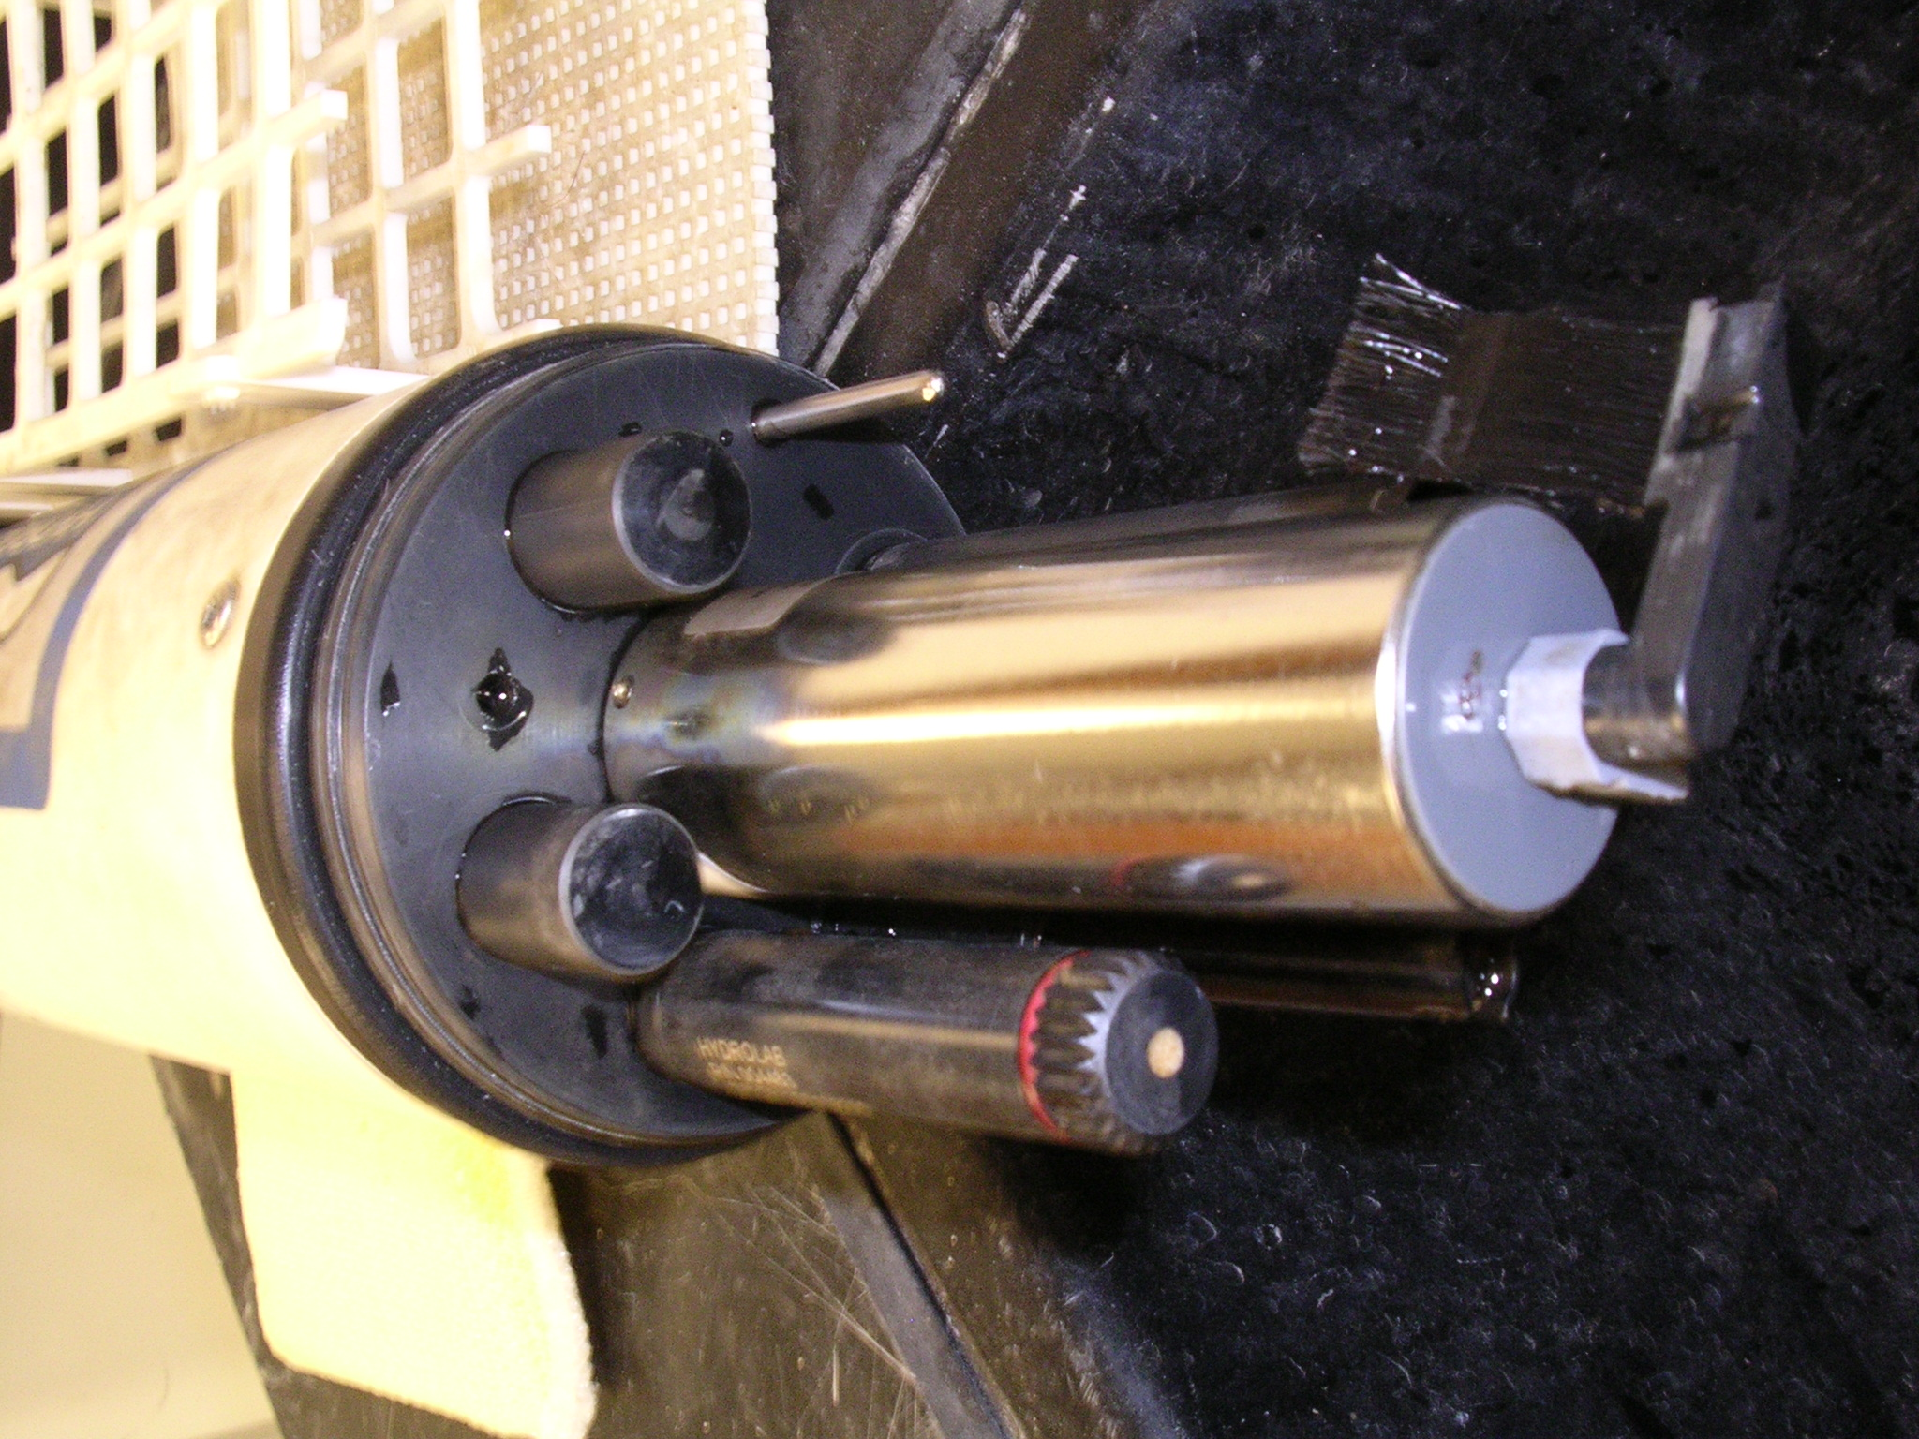
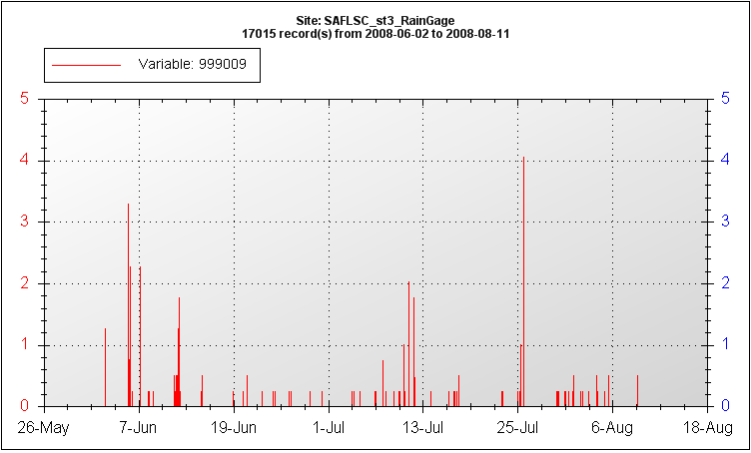
Env. Sc.:Forensics: When and where do contaminants enter Shingle Creek?
Computer Sc.: Scalable detection of flow-anomalies & co-occurrences
Dissolved
Oxygen
Ex. Oil Spill
Flow anomaly
After consecutive heavy rain events
(HydroLab sensor)
Rainfall
J. M. Kang, S. Shekhar, C. Wennen, and P. Novak,
Discovering Flow Anomalies: A SWEET Approach, IEEE Intl. Conf. on Data Mining, 2008.
Ack: NSF IGERT, CISE/IIS/III, USDOD.

Slide 16
Key Insights to Reduce Computational Cost From Quadratic to Linear Time Complexity
1
1-1
1-2
2-2
Lemma 1: If a singleton is not a tFA, then periods starting or ending with this instant is not a dpFA.
2
1-3
2-3
3-3
Lemma 2: If a period is a pFA, then its descendents cannot be a dpFA
1-4
2-4
3-4
4-4
1-5
2-5
3-5
4-5
5-5
Using the Starting and Ending time instants (6-10), determine number of tFAs as: 5 – 3 + 1 = 3
Lemma 3: Number of tFAs in a period is an algebraic function.
3
1-6
2-6
3-6
4-6
5-6
6-6
1-7
2-7
3-7
4-7
5-7
6-7
7-7
1-8
2-8
3-8
4-8
5-8
6-8
7-8
8-8
4
1-9
2-9
3-9
4-9
5-9
6-9
7-9
8-9
9-9
5
1-10
2-10
3-10
4-10
5-10
6-10
7-10
8-10
9-10
10-10

Slide 17
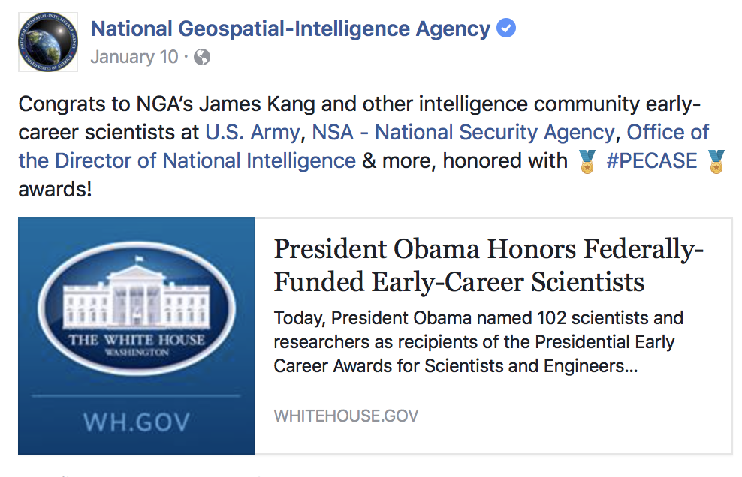
Contributions & Impact
Civil (Env.) Sc. Contribution:
State of the Art: Fate, e.g., Where do various contaminants go?
Contribution: Forensics, e.g., Where did the contamination come from?
Computer Sc. Contribution:
Fast algorithms for a problem where Dynamic Programming doesn’t help.
Broader Impact:
IGERT Fellow James Kang joined USDOD-NGA Research in 2010
IGERT helped in adapting to and innovating there
Received 2016 Presidential Early Career Award for Scientists and Engineers (PECASE).
Notes:
Dispersion – soil breaking apart
Volitalization – dissolved sample is vaporized
“simplify these processes so we can apply it to our proposed techniqes”

Slide 18
Outline
Why Interdisciplinary ?
Academic Example with Two disciplines
Multi-sector Example
Role of Science in Policy/Decision Making
A Case Study
Community Building
Conclusions
Societal
Needs
Data-Driven
Discipline
Other Sectors,
e. g., Policy-Makers,
First Responders
Data Sc.
Discipline

Slide 19
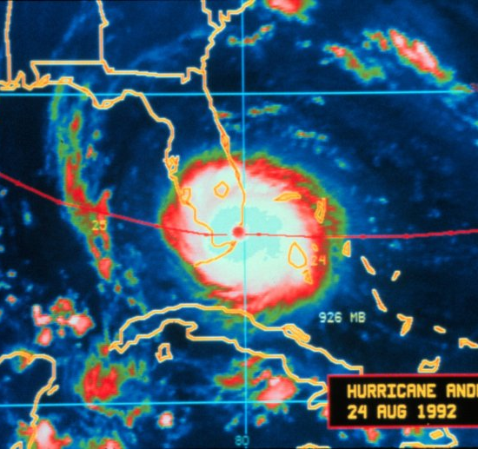
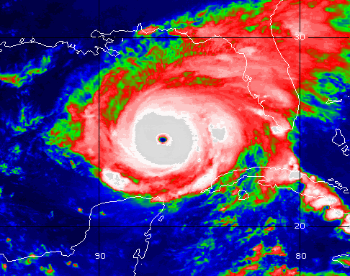
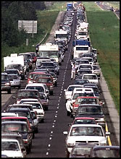
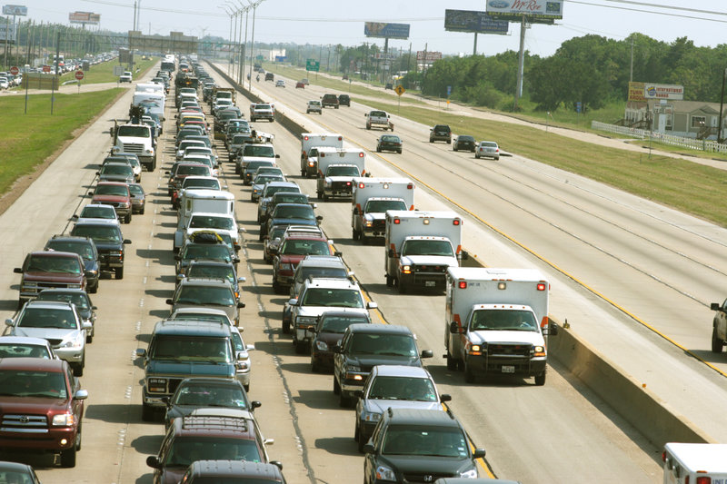
Societal Challenge: Large Scale Evacuation
Florida, Lousiana (Andrew, 1992)
Houston
(Rita, 2005)
Hurricane: Andrews, Rita
Traffic congestions on all highways
e.g. 100-mile congestion (TX)
Great confusions and chaos
( National Weather Services)
( National Weather Services)
"We packed up Morgan City residents to evacuate in the a.m. on the day that Andrew hit coastal Louisiana, but in early afternoon the majority came back home. The traffic was so bad that they couldn't get through Lafayette."
Mayor Tim Mott, Morgan City, Louisiana ( http://i49south.com/hurricane.htm )
( www.washingtonpost.com)
I-45 out of Houston
( FEMA.gov)

Slide 20
Problem Dimensions
Policy Decisions
When to evacuate? Which routes? Modes? Shelters? Phased evacuation?
Computer Science: How to scale up to large roadmaps and populations?
(Spatio-temporal) Data Availability
Estimate evacuee population, available transport capacity
Pedestrian data: walkway maps, link capacities based on width
Traffic Eng.
Link capacity depends on traffic density
Modeling traffic control signals, ramp meters, contra-flow, …
Evacuee Behavior (Social Science)
Unit of evacuation: Individual or Household
Heterogeneity: by physical ability, age, vehicle ownership, language, …
How to gain public’s trust in plans? Will they comply?
Science: How does one evaluate an evacuation planning system ?

Slide 21
Metropolitan Wide Evacuation Planning - 2
Advisory Board
MEMA/Hennepin Co. - Tim Turnbull, Judith Rue
Dakota Co. (MEMA) - David Gisch
Minneapolis Emergency Mgt. - Rocco Forte, Kristi Rollwagen
St. Paul Emergency Mgt. - Tim Butler
Minneapolis Fire - Ulie Seal
DPS HSEM - Kim Ketterhagen, Terri Smith
DPS Special Operations - Kent O’Grady
DPS State Patrol - Mark Peterson
Workshops
Over 100 participants from various local, state and federal govt.

Slide 22
Multi-Sectoral Task-structure
Metro Evacuation Plan
Evacuation Route Modeling
Evacuation Routes and Traffic Mgt. Strategies
Identify Stakeholders
Establish Steering Committee
Perform Inventory of Similar Efforts and Look at Federal Requirements
Finalize Project Objectives
Regional Coordination and Information Sharing
Agency Roles
Preparedness Process
Stakeholder Interviews and Workshops
Issues and Needs
Final Plan

Slide 23
Computational Problem: Evacuation Route Planning
Given
Number of evacuees and their initial locations
Evacuation destinations
A transportation network, a directed graph G = ( Nodes, Edges ) with
Travel time for each edge
Capacity constraint for each edge and node
Output
Evacuation plan = a set of origin-destination routes & schedule
Objective
Minimize evacuation time
Constraints
(Spatio-temporal) Data Feasibility
Computational Scalability to large population and geographies
(Societal) Application Domain Interpretability and value
Transportation Network Capacity << Number of evacuees

Slide 24
Computational Feasibility
Computational Scalability to large population and geographies
Is it computable in reasonable time with current hardware, software ?
Does it require computer science advances?
A. Related Work in Transportation Sc.: Dynamic Traffic Assignment
- Game Theory: Wardrop Equilibrium, e.g. DYNASMART (FHWA), DYNAMIT(MIT)
Limitation: Nice Game Theory,but Extremely high computation time
- Does not scale to medium size networks and populations!
B. Related Work Operations Research: Time-Expanded Graph + Linear Prog.
- Optimal solution, e.g. EVACNET (U. FL), Hoppe and Tardos (Cornell U).
Limitation: - High computational complexity => Does not scale to large problems
- Users need to guess an upper bound on evacuation time
Inaccurate guess => either no solution or increased computation cost!
Number of Nodes
50
500
5,000
50,000
EVACNET Running Time
0.1 min
2.5 min
108 min
> 5 days
C. Computer Science: Capacity Constrained Route Planner
- Extends shortest-path algorithms to honor capacity constraints
- Scales up to to Millions of evacuees over hundreds of square miles

Slide 25
Win-Win
25
Contributions:
Computer Science: New algorithm to scale up to metropolitan scenarios
Transportation Science: Walking first mile speeds up evacuation by factor of 3
Policy: Increase public trust in evacuation plans
Societal Impact highlighted in Fox TV (KMSP) evening news
A 5-miute video-clip is at http://www.cs.umn.edu/~shekhar/talk/video/fox9_aired_mpg.avi
It highlighted the evacuation route planning work along with its social impact including those on evacuation plan for Minneapolis-St. Paul Twincities.
Details: Experiences with evacuation route planning algorithms, International Journal of Geographical Information Science, 26(12): 2253-2265, Taylor and Francis, December 2012.
Notes:
25

Slide 26
Outline
Why Interdisciplinary ?
Academic Case with Two disciplines
Multi-sector Case
Community Building
Conclusions

Slide 27
Lessons Learned
27
Interdisciplinary Research is rewarding but HARD
Reward: Solve complex societal problems
Which may not be amenable to a single discipline
Hardest part is trying to understand the other domain
Quote: “If you think Mathematics is hard, try learning Chinese.” - Peter Bol
Analogy: “If you think learning Chinese is hard, try
Learning language, culture and strengths of another discipline
Developing trust across disciplines to find win-win
Introspecting to understand when one needs help from another discipline
Crucial that both sides understand each other before research can begin
A lot of trial and error between both sides
Once an “Ah-ha” moment occurs
The number of opportunities can be unlimited!

