Slide 1



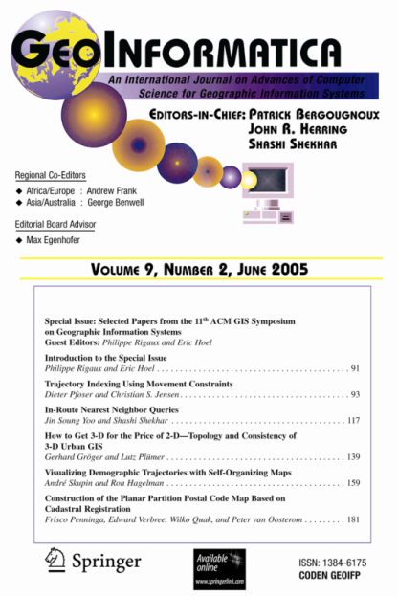


Spatial Data Science: Interdisciplinary Experiences
Shashi Shekhar
McKnight Distinguished University Professor
Dept. of Computer Sc.& Eng., University of Minnesota
www.cs.umn.edu/~shekhar
April 10th, 2017
Nebraska Data Analytics Workshop
University of Nebraska, Lincoln, NE
Notes:
1
1

Slide 2
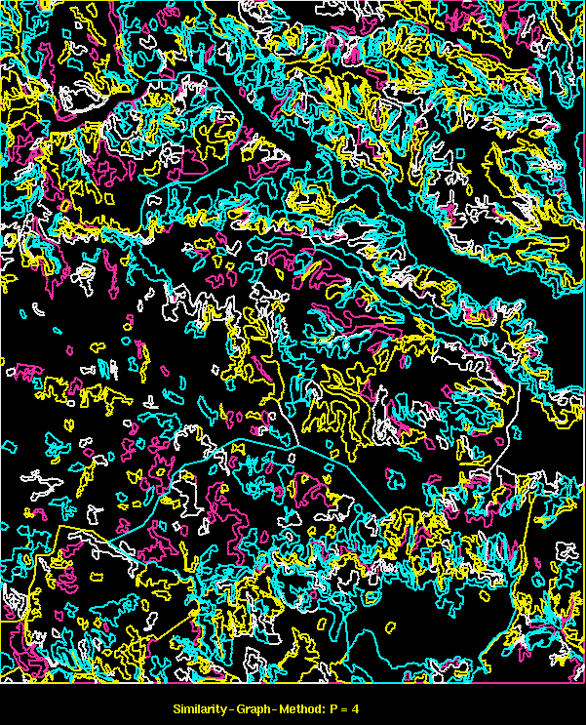
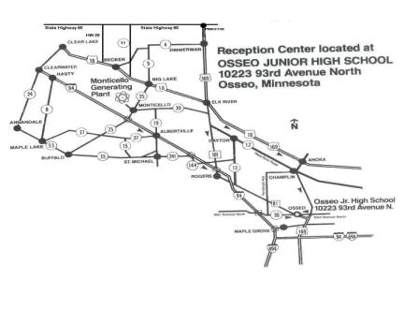
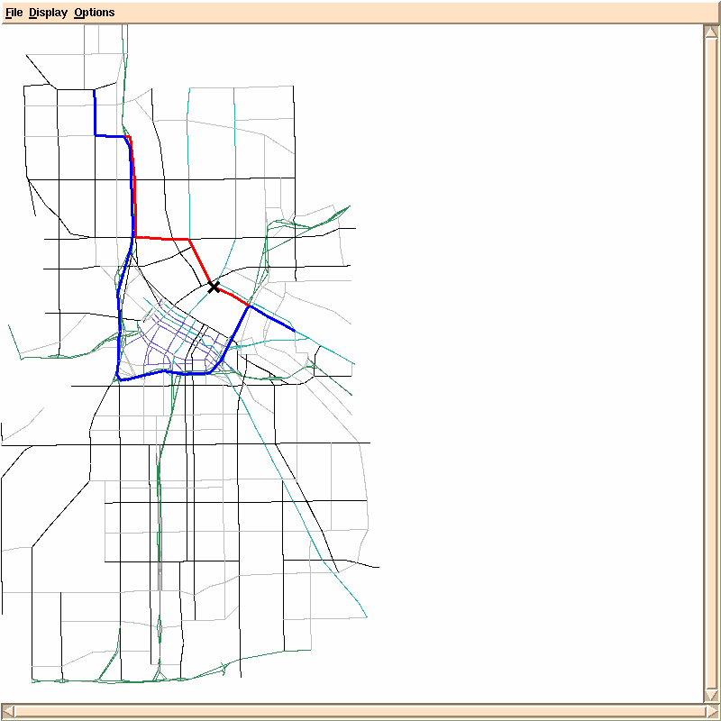
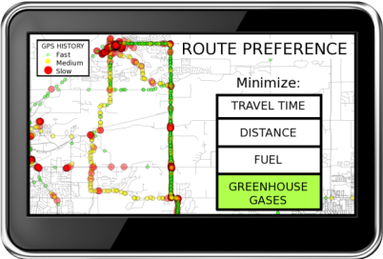
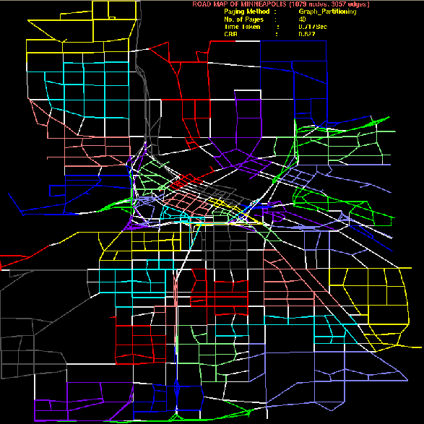

Research Theme 1: Spatial Databases
Evacutation Route Planning
Parallelize
Range Queries
only in old plan
Only in new plan
In both plans
Shortest Paths
Storing graphs in disk blocks

Slide 3
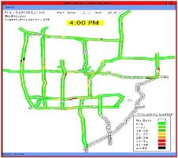
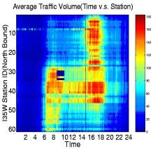
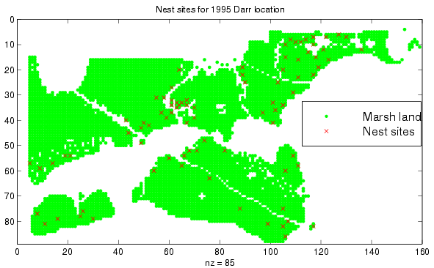
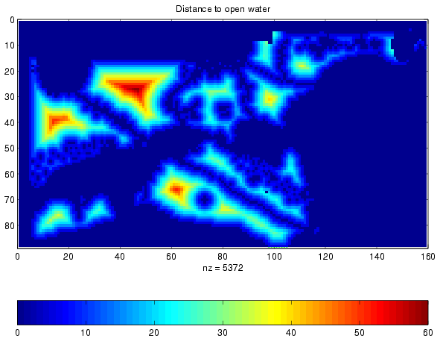
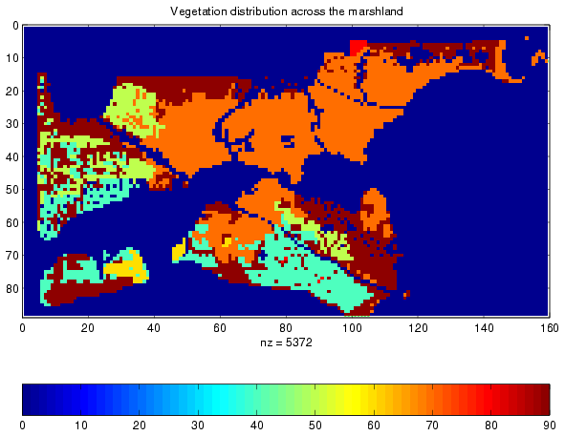
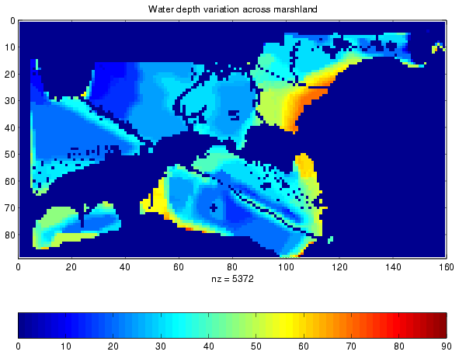
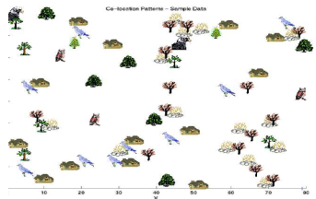
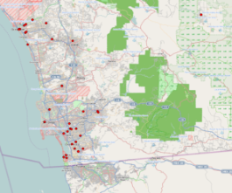
Theme 2 : Spatial Data Mining
Location Prediction: nesting sites
Spatial outliers: sensor (#9) on I-35
Nest locations
Distance to open water
Vegetation durability
Water depth
Co-location Patterns
Spatial Concept Aware Summarization
LR_{R} = 23.02
p-value = 0.04
LR_{R} = 10.61
p-value = 0.18
Output: SaTScan
LR_{R} = 27.74
p-value = 0.01
0
20
miles

Slide 4

Outline
Interdisciplinary Research
  Motivation: Intellectual & Societal
  A definition
Academic Example with Two disciplines
Multi-sector Example
Conclusions

Slide 5


Societal Motivation
Q? Identify disciplines of societal challenges?
  Cyber-security, e.g., Fake news, Reduce cancer deaths, Climate change
  Poverty, Hunger, Health & Well-being, Inequality, …
  Interactions: Feed growing population while protecting water
Q? Identify disciplines of non-academic organizations?
  Government, e.g., USDOD, USDA, USDOT, NIH, …
  Businesses, e.g., Google, Amazon, GE, Berkshire Hathaway, …

Slide 6
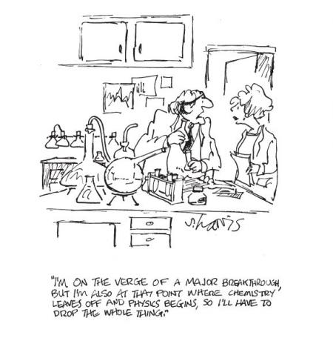
Intellectual Motivation
Q? Identify disciplines of scholars?
  Aristotle, Gelileo, Da Vinci, al Bruni, …
  Polymaths, Unquenchable curiosity
History of Disciplines
  Only a few hundred years old
  A way to organize universities
    Budget, hiring, degrees, courses,…
  + intra-discipline communication
  - inter-disciplinary comm., questions, hiring, education, …
Analogies
  Holistic (Systems view) vs. Reductionist
  Nationalism vs. Globalism

Slide 7

Interdisciplinary Research
7
integrates information, data, techniques, tools, perspectives, concepts, and/or theories from two or more disciplines or bodies of specialized knowledge
to advance fundamental understanding or to solve problems whose solutions are beyond the scope of a single discipline or area of research practice.

Slide 8
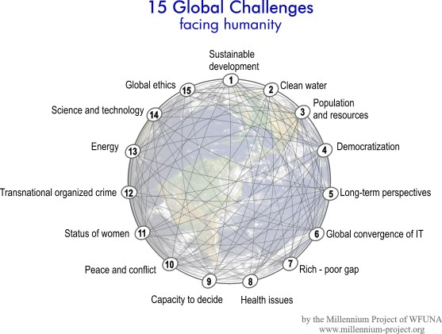
Outline
Why Interdisciplinary ?
Example with Two disciplines
  Challenges
  A Case Study
  Roles of Computer Science in collaboration
  Understanding Computer Science
Multi-sector Example
Community Building
Conclusions
Societal
Needs
Data-Driven
Discipline
Data Sc.
Discipline

Slide 9
What is Interdisciplinary Research?
9
Is it multiple Disciplines working on a single project?
Is it one discipline helping another?
My Thoughts:
  Ideal: Perform research that enhances all disciplines involved.
    Not just a subset!
  Very Hard To Do!!!
  A lot of asking questions back and forth

Slide 10

Challenges: Communication, Trust, Finding Win-Win
10
Each Discipline has its own language!
  We need to learn (foreign) language of other discipline
  Homonym (Civil Eng., C. S.): infrastructure, network, bridge, …
  Synonyms (Civil Eng., C.S.): networks vs. graphs
Disciplines have different values, cultures and goals
  Different norms for ordering of authors in a joint paper
  Different emphasis on grants, citations, service, …
Misunderstanding of what each discipline really is
  e.g., “I thought Civil Eng. was all about building bridges!”
  e.g., “I thought Computer Sc. was all about programming!”
Break down barriers
  Build mutual trust and respect via social activities, sharing core competencies, …
  Keep talking to each other to find a win-win
  Have an open mind when discussing each others’ interests
Is P = NP ?

Slide 11
Disciplines
11
Civil (Env.) Engineering
Professors
  William Arnold
  Ray Holzalski
  Miki Hondzo
  Paige Novak
Students
  Mike Henjum
  Christine Wennen
Computer Science
Professors
  Shashi Shekhar
Students
  Jim Kang
Hydrology
Professors
  David Maidment
Ack: NSF IGERT: Non-equilibrium Dynamics Across Space and Time: A Common Approach for Engineers, Earth Scientists and Ecologists (2008-2012).

Slide 12
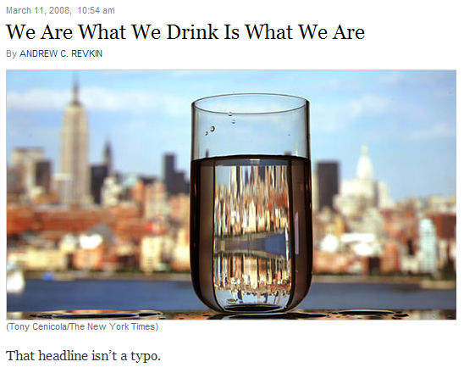
Societal Challenge: Clean Water
12
Source: New York Times (March 11, 2008)
(http://dotearth.blogs.nytimes.com/2008/03/11/we-are-what-we-drink-is-what-we-are/?hp)
By 2025,1.8 billion people could be living in water scarce areas
Today, 750 million people live below the water-stress threshold of 1.7 K cubic meters per person
Souce: WFUNA, 15 Global Challenges
Notes:
12

Slide 13
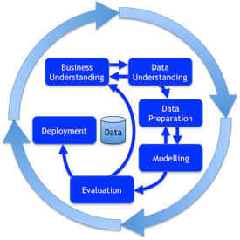
Brainstorming: In the Beginning…
13
Civil Engineering Questions
How is Computer Science involved in this work?
CS: I don’t know!
Need to understand domain questions and dataset first
Computer Science Questions
How many sensors will there be? Like 1000 or 10,000 or more?
CE Ans: No Way! A sensor cost $30,000
CS: Large data or computations ?
CE: Time-series length is in 50,000
CS: time-series similarity query?
CE: What is similarity?
CS: time-series correlation
CE: Not yet!
CRISP-DM Methodology
Notes:
13

Slide 14
Brainstorming: A little later…
14
Civil Eng. Questions
Can you help publish field-sensor data on national website (HIS) ? dealing with wireless communication, data format conversion, XML, etc.?
Can you remove errors from the dataset?
CS Ans:
  Yes, we will help with these.
  But these do not advance CS
  Techniques already exist
Computer Science Questions
Do you want to know how fast the river is flowing?
CE Ans:
  Not really,
  We can already determine that by the discharge, water depth, and physical characteristics of the river
Notes:
14

Slide 15
Brainstorming: Light at the end of the tunnel
15
Civil Engineering
Can you help with Env. Forensics?
Find when and where a contaminant enters a river?
CS: Is there signature in sensor data?
CE Ans.
  Signature across a pair of sensors.
  Upstream sensor sees clean water.
  Downstream sensor sees contamination.
CS.:
  How hard is it manually? computationally?
CE Ans.
  Its too hard to find this manually
  e.g., hours to sift through the data
  50,000 data points per measured variable
  Quadratic effort, e.g., 2,500,000,000 pairs
Computer Science
  Let me see. Spatial outlier detection won’t not catch it!
  A new pattern family: Flow Anomaly: time periods of flow mismatch between up/downstream sensors?
  It may advance Computer Sc.
  Which Flow Anomalies (F.A.) ?
    Transient
    Persistent
    Dominant Persistent
CE Ans:
  Yes!
  Dominant Persistent F.A.s please.
Notes:
15

Slide 16
Problem Formulation: Flow Anomaly
Apply Threshold
Nitrate
Nitrate
Nitrate
Time
Time
Time
S₁
S₂
S₃
Flow Anomaly between these two sensors.
Water Treatment Plant
Direction of Water Flow
Two Use Cases:
At the water treatment plant, when should it turn off the water supply from the river?
Where is the source of the contaminant?

Slide 17
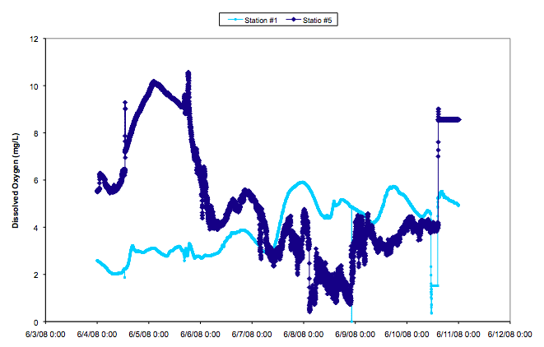
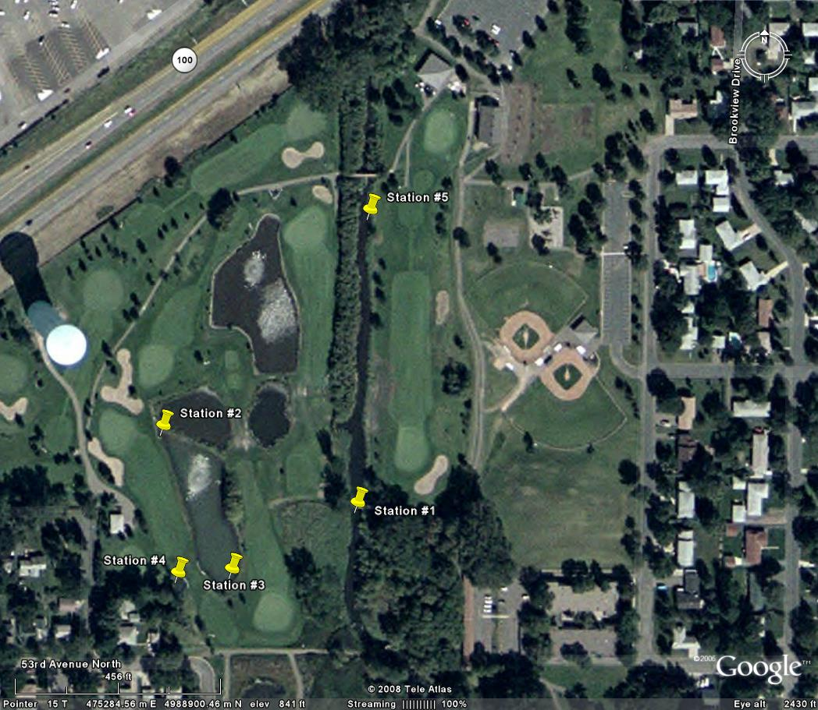
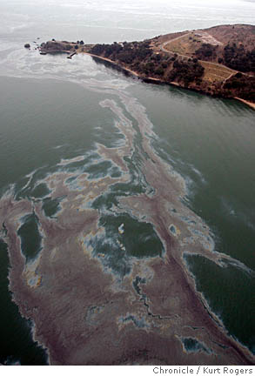
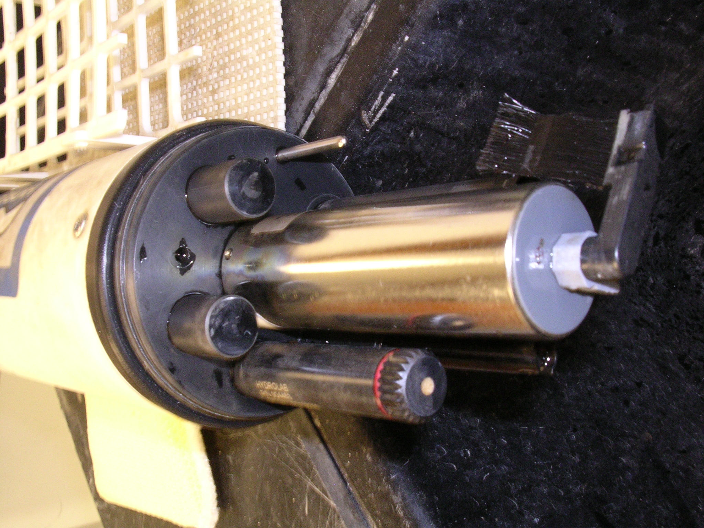
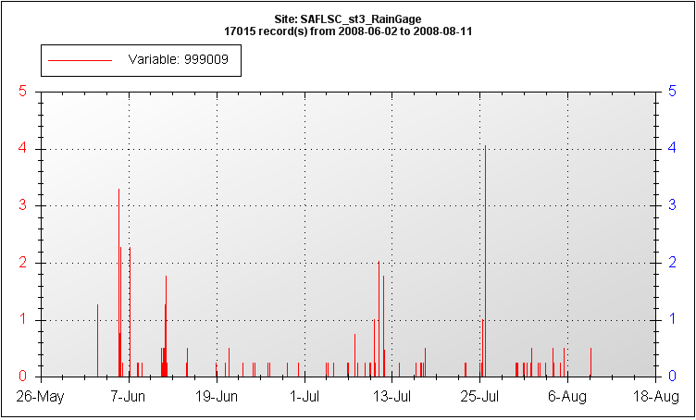
Env. Sc.:Forensics: When and where do contaminants enter Shingle Creek?
Computer Sc.: Scalable detection of flow-anomalies & co-occurrences
Dissolved
Oxygen
Ex. Oil Spill
Flow anomaly
After consecutive heavy rain events
(HydroLab sensor)
Rainfall
J. M. Kang, S. Shekhar, C. Wennen, and P. Novak,
Discovering Flow Anomalies: A SWEET Approach, IEEE Intl. Conf. on Data Mining, 2008.
Ack: NSF IGERT, CISE/IIS/III, USDOD.

Slide 18
Key Insights to Reduce Computational Cost From Quadratic to Linear Time Complexity
1
1-1
1-2
2-2
Lemma 1: If a singleton is not a tFA, then periods starting or ending with this instant is not a dpFA.
2
1-3
2-3
3-3
Lemma 2: If a period is a pFA, then its descendents cannot be a dpFA
1-4
2-4
3-4
4-4
1-5
2-5
3-5
4-5
5-5
Using the Starting and Ending time instants (6-10), determine number of tFAs as: 5 – 3 + 1 = 3
Lemma 3: Number of tFAs in a period is an algebraic function.
3
1-6
2-6
3-6
4-6
5-6
6-6
1-7
2-7
3-7
4-7
5-7
6-7
7-7
1-8
2-8
3-8
4-8
5-8
6-8
7-8
8-8
4
1-9
2-9
3-9
4-9
5-9
6-9
7-9
8-9
9-9
5
1-10
2-10
3-10
4-10
5-10
6-10
7-10
8-10
9-10
10-10

Slide 19

Contributions & Impact
Civil (Env.) Sc. Contribution:
    State of the Art: Fate, e.g., Where do various contaminants go?
    Contribution: Forensics, e.g., Where did the contamination come from?
Computer Sc. Contribution:
    Fast algorithms for a problem where Dynamic Programming doesn’t help.
Broader Impact:
  IGERT Fellow James Kang joined USDOD-NGA Research in 2010
  IGERT helped in adapting to and innovating there
  Received 2016 Presidential Early Career Award for Scientists and Engineers (PECASE).
Notes:
Dispersion – soil breaking apart
Volitalization – dissolved sample is vaporized
“simplify these processes so we can apply it to our proposed techniqes”

Slide 20
Outline
Why Interdisciplinary ?
Example with Two disciplines
  Challenges
  A Case Study
  Roles of Computer Science in collaboration
  How to engage Computer Scientists?
Multi-sector Example
Conclusions
Societal
Needs
Data-Driven
Discipline
Data Sc.
Discipline

Slide 21
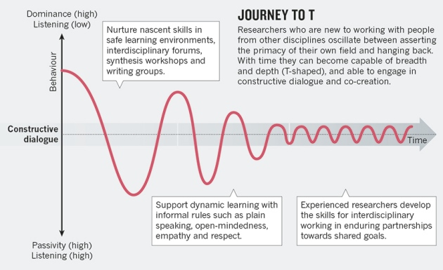
Nurturing Constructive Interdisciplinary Dialog
Oscillation between listening and asserting primacy of their own field
Notes:
Dispersion – soil breaking apart
Volitalization – dissolved sample is vaporized
“simplify these processes so we can apply it to our proposed techniqes”

Slide 22
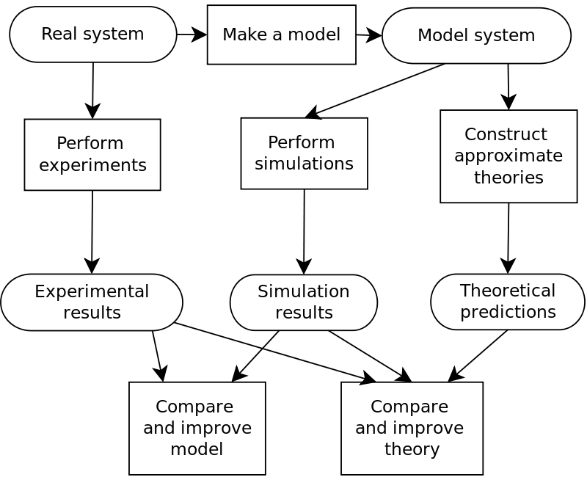

Computer Simulation: 3rd Leg of Science
Complements theory and experiments
Main option if phenomenon is
  Too complex to model theoretically
  Too expensive or dangerous for experiments
Examples
  Global Climate Models
  Weather Prediction
  Boeing 777 design
  …
Source: wikipedia

Slide 23
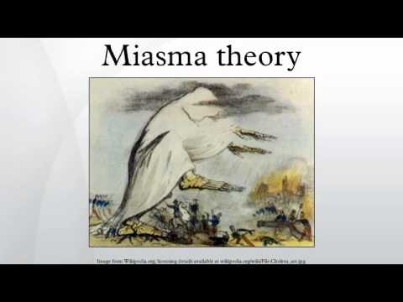
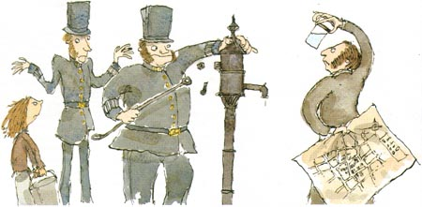
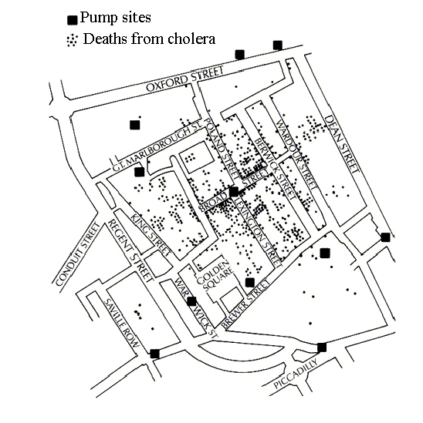

Data-Driven Hypothesis Generation
What causes Cholera?
Data
Data Driven Hypothesis Generation
?water pump
Test Hypothesis
(Controlled Experiments)
Develop Theory
Remove handle of water pump
Germ
Theory

Slide 24


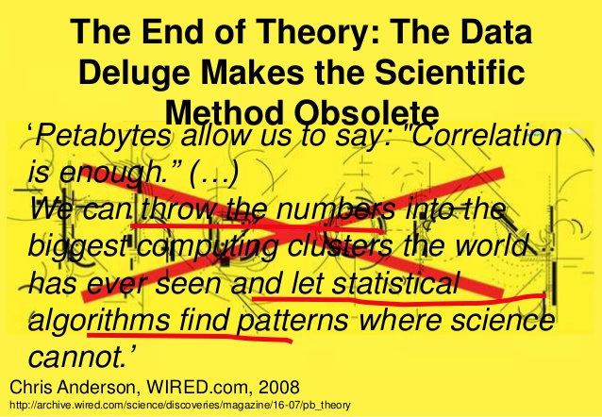
Data-Intensive Scientific Discovery: 4th Paradigm
Ex.: find cure, Forensics, Functional Genomics, Astronomy, Social Sc., Geo Sc., …
Library of molecules
Which molecules may cure disease D?
Does molecule M cure disease D?
Why/how does M cure disease D?
Big Data
Hypothesis Generation:
- Data Driven
Test Hypothesis
(Controlled Experiments)
Develop Theory
What are side-effects of M?
What not to do?

Slide 25

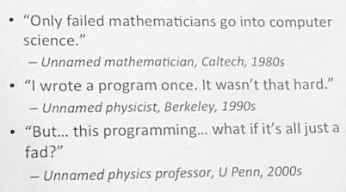

Computer Science : Conversation Starters
A Few Trends
Big Data, Machine Learning, Robotics, Cyber-Physical Systems, …
Cloud Computing, social media, cell-phones, sensor networks, Exa-scale…
A Few Societal Challenges
Cyber-security (e.g., fake news, spam, privacy, …), Cyber-equity, …
A Few Questions
Which problems are computable? Can computers mimic human intelligence?
What is computational complexity of a problem?
  How may we scale up to 1000x current capabilities? Is Moore’s law obsolete?
What not to do?
Notes:
Dispersion – soil breaking apart
Volitalization – dissolved sample is vaporized
“simplify these processes so we can apply it to our proposed techniqes”

Slide 26
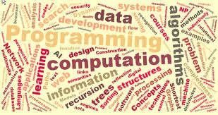
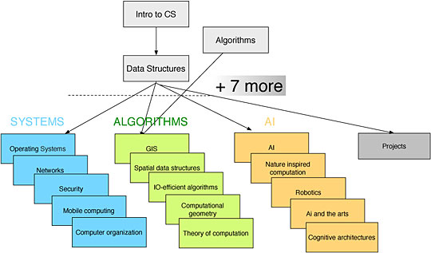
Computer Science
Sample Basic Ideas
Program = Algorithms + Data-Structure + Architecture
Algorithms: hash or binary search, shortest path, …
Data-structures: stack, queue, table, tree, graph …
Architectures: web-services, object oriented, relational, …
Sample Grand Challenges
Data Integration
Ubiquitous computing
Autonomous vehicles
Quantum computers
Source:
Bowdin College
Notes:
Dispersion – soil breaking apart
Volitalization – dissolved sample is vaporized
“simplify these processes so we can apply it to our proposed techniqes”

Slide 27
Outline
Why Interdisciplinary ?
Academic Example with Two disciplines
Multi-sector Example
  Role of Science in Policy/Decision Making
  A Case Study
Community Building
Conclusions
Societal
Needs
Data-Driven
Discipline
Other Sectors,
e. g., Policy-Makers,
First Responders
Data Sc.
Discipline

Slide 28

Role of Science in Policymaking
Policy: affects how the world should be
Science: understand natural world
    Subjective → Objective
    Transparent, reproducible
    New data may revise hypothesis and theories
Science under Policy Constraints
  Science is an input among others for policy decisions
  Policy may move forward whether or not science is ready!
Notes:
28
More applications:
Social networks: social behavior of chimpanzees
Sensor networks?

Slide 29
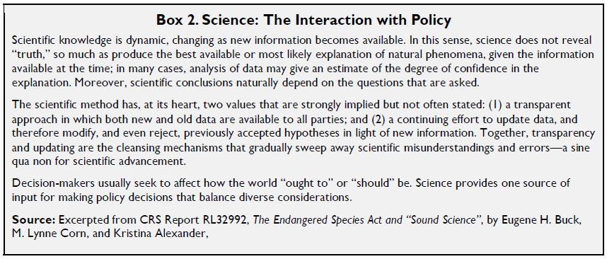
Role of Science in Policy
Notes:
29
More applications:
Social networks: social behavior of chimpanzees
Sensor networks?

Slide 30

Deconstructing Precision Agriculture

Slide 31
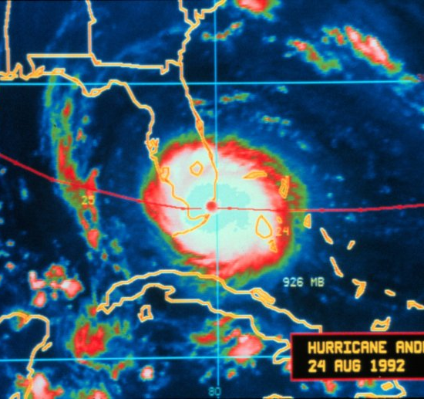
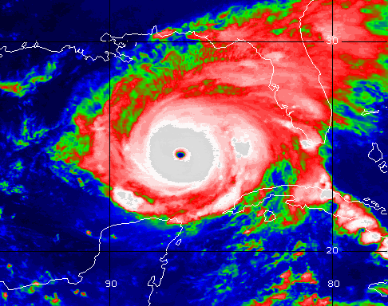
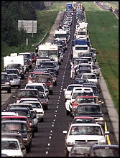
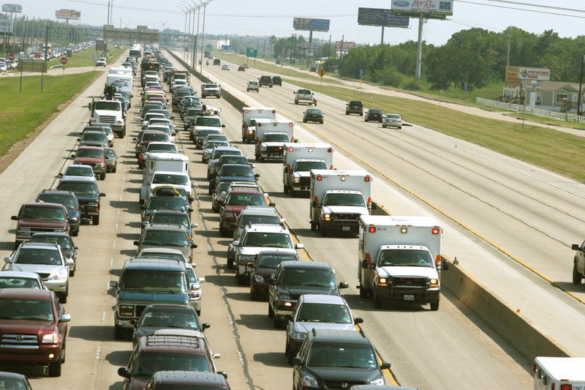
Societal Challenge: Large Scale Evacuation
Florida, Lousiana (Andrew, 1992)
Houston
(Rita, 2005)
Hurricane: Andrews, Rita
Traffic congestions on all highways
  e.g. 100-mile congestion (TX)
Great confusions and chaos
( National Weather Services)
( National Weather Services)
"We packed up Morgan City residents to evacuate in the a.m. on the day that Andrew hit coastal Louisiana, but in early afternoon the majority came back home. The traffic was so bad that they couldn't get through Lafayette."
Mayor Tim Mott, Morgan City, Louisiana ( http://i49south.com/hurricane.htm )
( www.washingtonpost.com)
I-45 out of Houston
( FEMA.gov)

Slide 32
Problem Dimensions
Policy Decisions
  When to evacuate? Which routes? Modes? Shelters? Phased evacuation?
Computer Science: How to scale up to large roadmaps and populations?
(Spatio-temporal) Data Availability
  Estimate evacuee population, available transport capacity
  Pedestrian data: walkway maps, link capacities based on width
Traffic Eng.
  Link capacity depends on traffic density
  Modeling traffic control signals, ramp meters, contra-flow, …
Evacuee Behavior (Social Science)
  Unit of evacuation: Individual or Household
  Heterogeneity: by physical ability, age, vehicle ownership, language, …
  How to gain public’s trust in plans? Will they comply?
Science: How does one evaluate an evacuation planning system ?

Slide 33
Metropolitan Wide Evacuation Planning - 2
Advisory Board
  MEMA/Hennepin Co. - Tim Turnbull, Judith Rue
  Dakota Co. (MEMA) - David Gisch
  Minneapolis Emergency Mgt. - Rocco Forte, Kristi Rollwagen
  St. Paul Emergency Mgt. - Tim Butler
  Minneapolis Fire - Ulie Seal
  DPS HSEM - Kim Ketterhagen, Terri Smith
  DPS Special Operations - Kent O’Grady
  DPS State Patrol - Mark Peterson
Workshops
Over 100 participants from various local, state and federal govt.

Slide 34
Workshop Participants
Federal, State, County, City
Gerald Liibbe, Federal Highway Administration (FHWA)
Katie Belmore, Representing Wisconsin Department of Transportation
Airports
George Condon, Metropolitan Airports Commission
Businesses
Chris Terzich, Minnesota Information Sharing and Analysis Center
Barry Gorelick, Minnesota Security Board
Communications and Public Information
Kevin Gutknecht, Mn/DOT
Lucy Kender, Mn/DOT
Andrew Terry, Mn/DOT
Dispatch
Keith Jacobson, Mn/DOT
Education
Bob Fischer, Minnesota Department of Education
Dick Guevremont, Minnesota Department of Education
Emergency Management
Bruce Wojack, Anoka County Emergency Management
Tim Walsh, Carver County Emergency Management
Jim Halstrom, Chisago County Emergency Management
David Gisch, Dakota County Emergency Preparedness
Tim O'Laughlin, Scott County Sheriff – Emergency Management
Tim Turnbull, Hennepin County Emergency Preparedness
Judith Rue, Hennepin County Emergency Preparedness
Rocco Forte, Minneapolis Fire Department – Emergency Preparedness
Kristi Rollwagen, Minneapolis Fire Department –Emergency Preparedness
William Hughes, Ramsey County Emergency Management and Homeland
Security
Tim Butler, St. Paul Fire and Safety Services
Deb Paige, Washington County Emergency Management
Kim Ketterhagen, Department of Public Safety (DPS) HSEM
Sonia Pitt, Mn/DOT HSEM
Bob Vasek, Mn/DOT HSEM
Fire
Gary Sigfrinius, Forest Lake Fire Department
Health
Debran Ehret, Minnesota Department of Health
Hospitals
Dan O'Laughlin, Metropolitan Hospital Compact
Human Services
Glenn Olson, Minnesota Department of Human Services
Law Enforcement
Brian Johnson, Hennepin County Sheriff
Jack Nelson, Metro Transit Police Department
David Indrehus, Metro Transit Police Department
Otto Wagenpfeil, Minneapolis Police Department
Kent O'Grady, Minnesota State Patrol
Mark Peterson, Minnesota State Patrol
Chuck Walerius, Minnesota State Patrol
Douglas Biehn, Ramsey County Sheriff's Office
Mike Morehead, St. Paul Police
Maintenance and Operations
Beverly Farraher, Mn/DOT
Gary Workman, Mn/DOT
Robert Wryk, Mn/DOT
Military
Daniel Berg, Marine Safety Office St.
Louis Planning Division
Eric Waage, Minnesota National Guard
Planning
Connie Kozlak, MetCouncil
Public Works
Bill Cordell, Wright County
Jim Gates, City of Bloomington
Jim Grube, Hennepin County
Bob Winter, Mn/DOT
Klara Fabry, City of Minneapolis
Mark Kennedy, City of Minneapolis
Gary Erickson, Hennepin County
Dan Schacht, Ramsey County
Safety
Thomas Cherney, Minnesota Department of Public Safety
Doug Thies, Mn/DOT
Security
Terri Smith, Minnesota Homeland Security Emergency
Management
Paul Pettit, Transportation Security Administration
Transit
Dana Rude, Metro Mobility
Steve McLaird, MetroTransit
Christy Bailly, MetroTransit
David Simoneau, SouthWest Metro Transit
Traffic
Thomas Bowlin, City of Bloomington
Jon Wertjes, City of Minneapolis
Bernie Arseneau, Mn/DOT
Amr Jabr, Mn/DOT
Eil Kwon, Mn/DOT
Paul St. Martin, City of St. Paul
Trucking
John Hausladen, Minnesota Trucking Association
University
Dan JohnsonPowers,
University of Minnesota Emergency Management
Volunteer Organizations
Gene Borochoff, MinnesotaVolunteer
Organization active in Disaster

Slide 35
Multi-Sectoral Task-structure
Metro Evacuation Plan
Evacuation Route Modeling
Evacuation Routes and Traffic Mgt. Strategies
Identify Stakeholders
Establish Steering Committee
Perform Inventory of Similar Efforts and Look at Federal Requirements
Finalize Project Objectives
Regional Coordination and Information Sharing
Agency Roles
Preparedness Process
Stakeholder Interviews and Workshops
Issues and Needs
Final Plan

Slide 36
Computational Problem: Evacuation Route Planning
Given
Number of evacuees and their initial locations
Evacuation destinations
A transportation network, a directed graph G = ( Nodes, Edges ) with
  Travel time for each edge
  Capacity constraint for each edge and node
Output
Evacuation plan = a set of origin-destination routes & schedule
Objective
Minimize evacuation time
Constraints
(Spatio-temporal) Data Feasibility
Computational Scalability to large population and geographies
(Societal) Application Domain Interpretability and value
  Transportation Network Capacity << Number of evacuees

Slide 37
Spatio-temporal Data Feasibility
(Spatio-temporal) Data Feasibility
  Is it doable with available geographic dataset ?
  Does it require new geo-datasets, surveys, mapping efforts?
Digital Road Maps
  Are Navteq, OpenStreetMap digital roadmaps adequate?
  Capacity constraints: TP+ (Tranplan) has major roads
Evacuee Population
  Is Census Data adequate? Timely?
  Day-time population – employment, school, tourist, events, …
  Location-aware Smart-phones ?estimate real-time population

Slide 38
Computational Feasibility
Computational Scalability to large population and geographies
  Is it computable in reasonable time with current hardware, software ?
  Does it require computer science advances?
A. Related Work in Transportation Sc.: Dynamic Traffic Assignment
- Game Theory: Wardrop Equilibrium, e.g. DYNASMART (FHWA), DYNAMIT(MIT)
Limitation: Nice Game Theory,but Extremely high computation time
- Does not scale to medium size networks and populations!
B. Related Work Operations Research: Time-Expanded Graph + Linear Prog.
- Optimal solution, e.g. EVACNET (U. FL), Hoppe and Tardos (Cornell U).
Limitation: - High computational complexity => Does not scale to large problems
- Users need to guess an upper bound on evacuation time
Inaccurate guess => either no solution or increased computation cost!
Number of Nodes
50
500
5,000
50,000
EVACNET Running Time
0.1 min
2.5 min
108 min
> 5 days
C. Computer Science: Capacity Constrained Route Planner
- Extends shortest-path algorithms to honor capacity constraints
- Scales up to to Millions of evacuees over hundreds of square miles

Slide 39

Win-Win
39
Contributions:
Computer Science: New algorithm to scale up to metropolitan scenarios
Transportation Science: Walking first mile speeds up evacuation by factor of 3
Policy: Increase public trust in evacuation plans
Societal Impact highlighted in Fox TV (KMSP) evening news
A 5-miute video-clip is at http://www.cs.umn.edu/~shekhar/talk/video/fox9_aired_mpg.avi
It highlighted the evacuation route planning work along with its social impact including those on evacuation plan for Minneapolis-St. Paul Twincities.
Details: Experiences with evacuation route planning algorithms, International Journal of Geographical Information Science, 26(12): 2253-2265, Taylor and Francis, December 2012.
Notes:
39

Slide 40
Outline
Why Interdisciplinary ?
Academic Case with Two disciplines
Multi-sector Case
Community Building
Conclusions

Slide 41
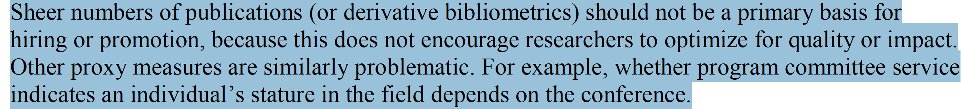
Evaluating Research: Beyond Quantitative Measures
Institutions
  Qualitative metrics, e.g., impact on practice, beyond traditional metrics
Researchers
  Prioritize depth, and embrace breadth via relationships with people outside your field

Slide 42

Promoting Inter-Disciplinarity (ID)
Funders
  Panels include ID researchers
  ask for ID teams balanced across disciplines
Institutions
  Identify institutional strengths with ID potential
  ID seed grants, workshops, panels, debates
  Qualitative metrics, e.g., impact on practice, beyond traditional metrics
Publishers
  ID journals & conferences
  Special issues in mono-disciplinary journals
  Review criteria: innovation across disciplines
Researchers
  Build stamina, patience, self-awareness
  Open to views from other disciplines or practice
  Prioritize depth, and embrace breadth via relationships with people outside your field

Slide 43
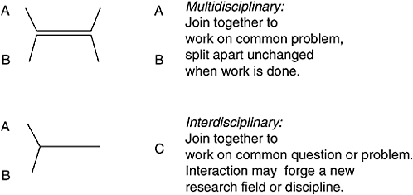
Supporting Interdisciplinary Research
43
Challenges
  Publication Forums, journals, conferences
  Professional Organizations
  Pedagogy, e.g., textbooks, curriculum
  Research Funding
  Academic Hiring, tenure, promotion

Slide 44
Forging a New Research Area
Need conferences, journals, professional organizations, pedagogy, visibility
1980s: NSF National Center for Geographic Information & Analysis, Symposium on Spatial Databases
1990s: University Consortium for GIS, ACM Workshop on GIS, Geographic Information Science Conference, Geo-Informatica Journal
2000s: ACM SIG-Spatial , Texts, Encyclopedia of GIS, UCGIS Model Curriculum
2012: CCC Visioning Workshop on Spatial Computing 2020
2016: Communications of the ACM – cover article
Notes:
44
44

Slide 45
Research Theme 1: Spatial Databases
Evacutation Route Planning
Parallelize
Range Queries
only in old plan
Only in new plan
In both plans
Shortest Paths
Storing graphs in disk blocks

Slide 46

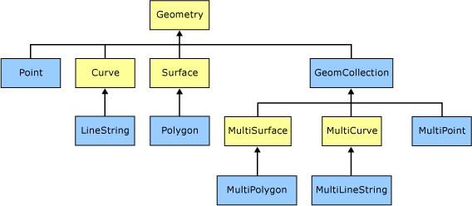
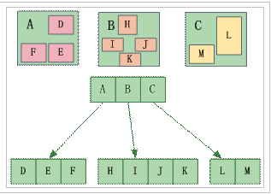
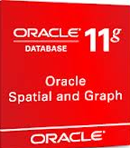



Spatial Databases
Spatial Querying
  Geo-fence, Geo-tag. Checkin, …
  Set based querying beyond GIS
Spatial Querying Software
  OGC: 6 Data Types (Closed Algebra)
  Operations.: inside, overlap, distance, area, …
    Topological 9-intersection model
  Data-structures: B-tree => R-tree
  Algorithms: Sorting => Geometric
  Big Data: SpatialHadoop, GIS Tools for Hadoop

Slide 47

Spatial Interactions
T1
V1
T1
V1
V1
T
T1
A1
A1
T2
A1
A2
T2
V2
T2
V
V2
T3
A2
V2
T3
A2
T3
A
(a) a map of 3 features
(b) Spatial Partitions
(c) Neighbor graph
 | Pearson’s Correlation | Ripley’s cross-K | Participation Index
T-A | -0.90 | 0.33 | 0.5
V-A | 1 | 0.5 | 1

Slide 48
Spatio-temporal (ST) Data Mining
What is ST Data Mining?
  Identifying interesting, useful, non-trivial patterns
  in large spatial or spatio-temporal datasets
    satellite imagery, gps-tracks, census, …
  Challenges: Costly false positives, auto-correlation
Pattern Families
  Hotspots, e.g., John Snow’s map of London
  ST discontinuities
  Co-locations, Tele-connections
  Predicting location, trajectories, …
  Details: (a) Spatiotemporal Data Mining: A Computational Perspective, ISPRS Intl. Journal on Geo-Information, 4(4):2306-2338, 2015.
  (b) Identifying patterns in spatial information: a survey of methods, Wiley Interdisciplinary Reviews: Data Mining and Knowledge Discovery , 193-214, 1(3), May/June 2011.
Notes:
More applications:
Social networks: social behavior of chimpanzees
Sensor networks?

Slide 49
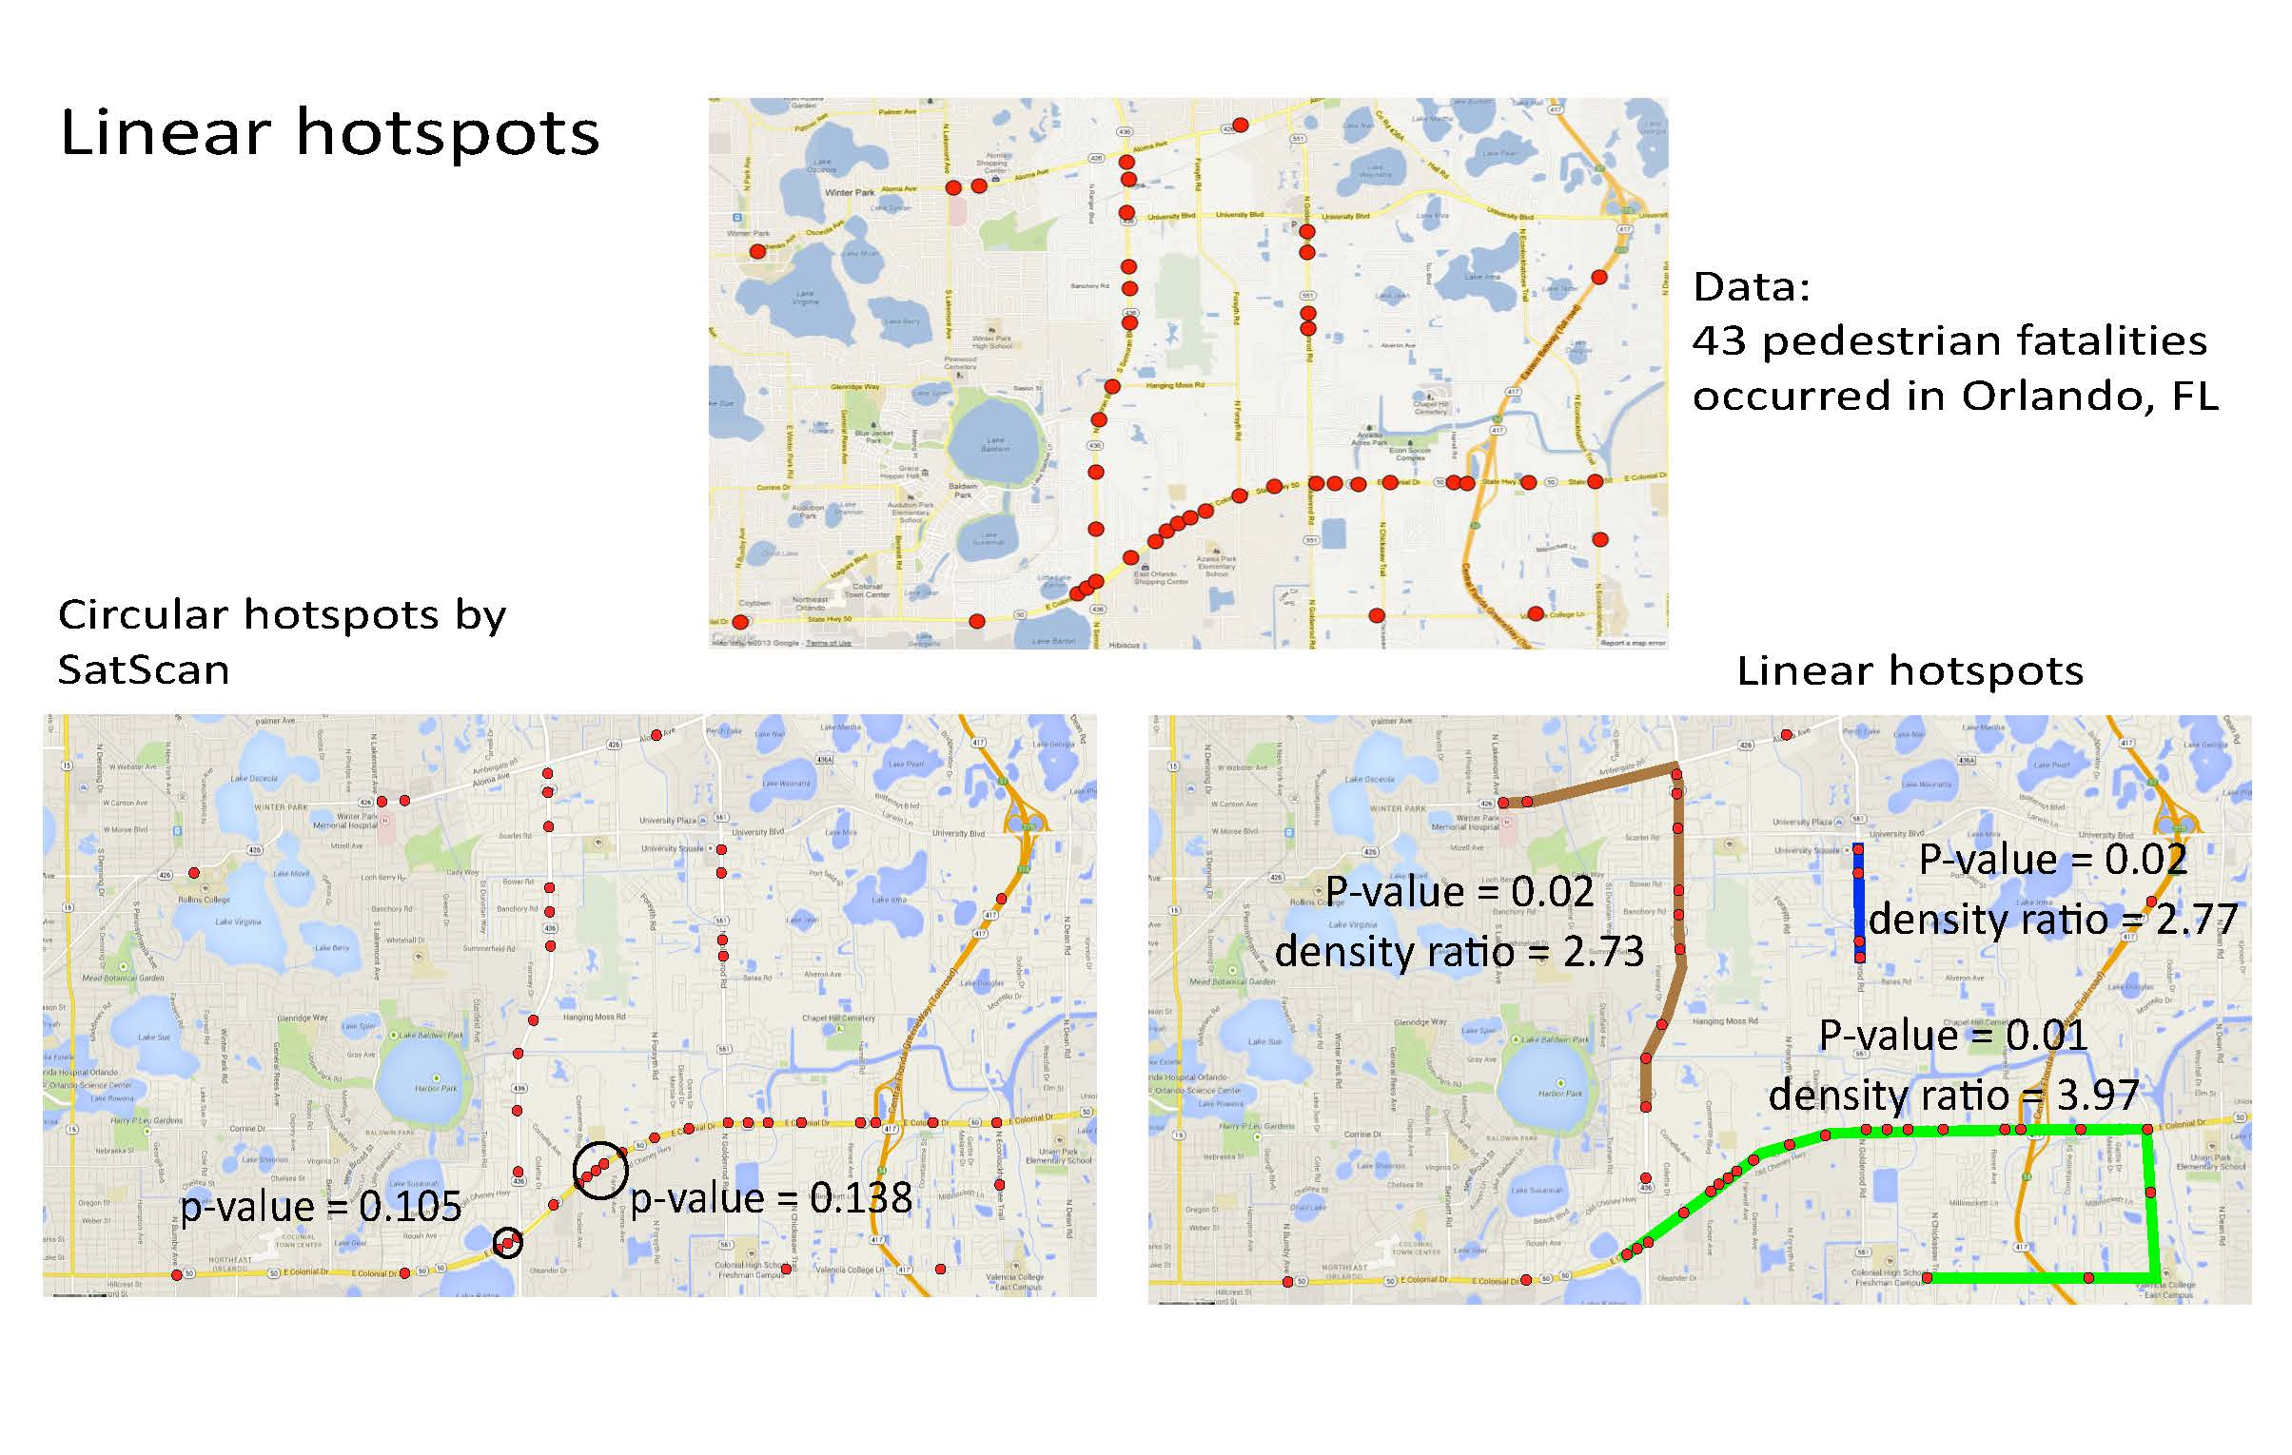
Details: Significant Linear Hotspot Discovery, IEEE Transactions on Big Data (accepted) (A summary in Proc. Intl. Conf. on Geographic Info. Sc., Springer LNCS 8728, pp. 284-300, 2014.

Slide 50
Spatial Auto-Regression
Maximum Likelihood Estimation
Computing determinant of large matrix is a hard (open) problem!
  size(W) is quadratic in number of locations/pixels.
  Typical raster image has Millions of pixels
  W is sparse but not banded.
A parallel formulation of the spatial auto-regression model for mining large geo-spatial datasets, SIAM Intl. Workshop on High Perf. and Distr. Data Mining, 2004. (w/ B. Kazar)
Notes:
y: n-by-1 vector of dependent variable
x: n-by-k matrix of the explanatory variables
Beta: k-by-1 vector of regressions
Epsilon: n-by-1 vector of unobservable error term N(0,sigma^2 I )
Example: Linear Regression Model
Given a vector of y of n observations and a matrix x of explanatory variables
Encapsulates their interrelationship using the linear equation y=xbeta+epsilon
Does not work well for spatial datasets
Low prediction accuracy
Spatial Data Dependencies (Auto-correlation)
Residual error may vary systematic over space
The occurrence of one feature is influenced by the distribution of similar features in the adjacent area
May yield biased and inconsistent estimation
May lead to poor fit of the model

Slide 51
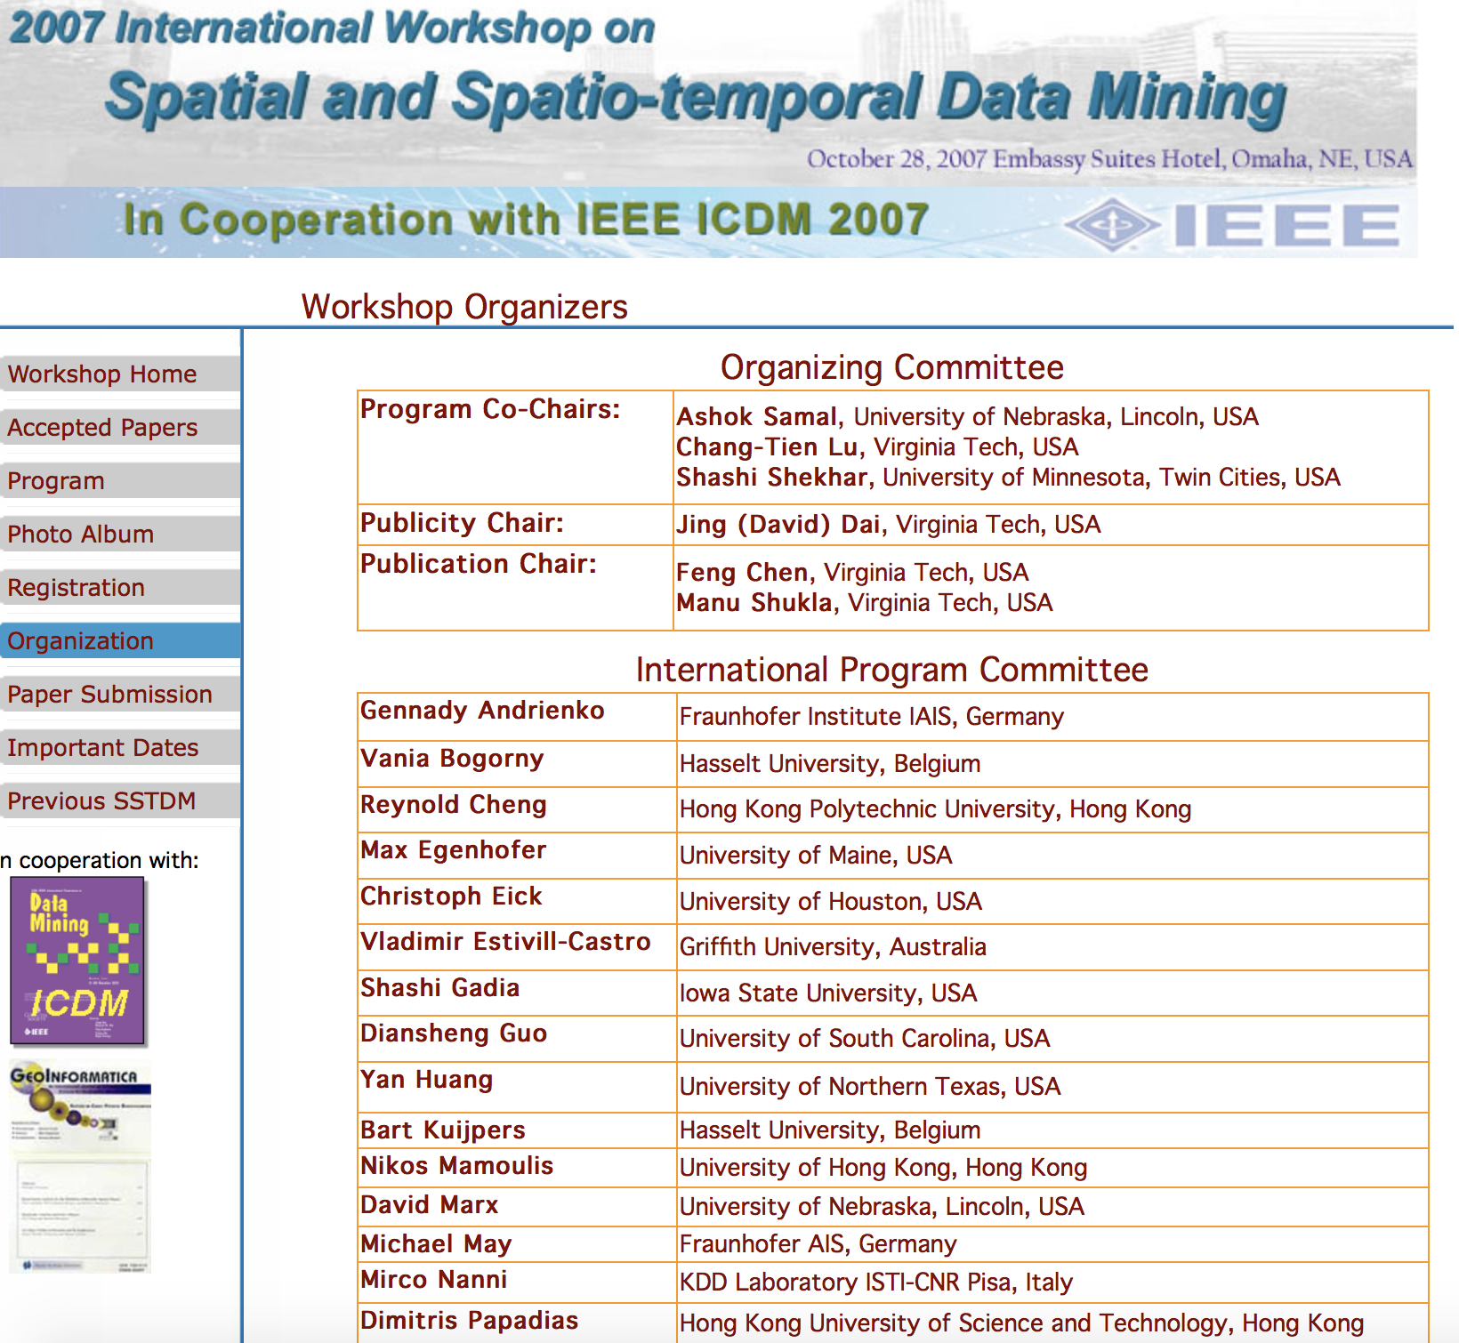

Spatial Data Mining
Location Prediction: nesting sites
Spatial outliers: sensor (#9) on I-35
Nest locations
Distance to open water
Vegetation durability
Water depth
Co-location Patterns
Spatial Concept Aware Summarization
LR_{R} = 23.02
p-value = 0.04
LR_{R} = 10.61
p-value = 0.18
Output: SaTScan
LR_{R} = 27.74
p-value = 0.01
0
20
miles

Slide 52











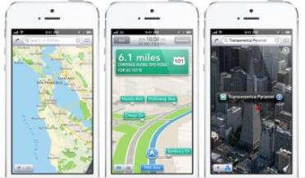
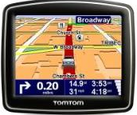


Spatial Computing
Transformed our lives though understanding spaces and places
  Ex.: localization, navigation, site selection, precision agriculture, …
  Examples: spatial context, situation assessment (distribution, patterns), …
Smarter
Planet

Slide 53
The Changing World of Spatial Computing
 | Last Century | Last Decade
Map User | Well-trained few | Billions
Mappers | Well-trained few | Billions
Software, Hardware | Few layers, e.g., Applications: Arc/GIS, Databases: SQL3/OGIS | Almost all layers
User Expectations & Risks | Modest | Many use-case & Geo-privacy concerns

Slide 54
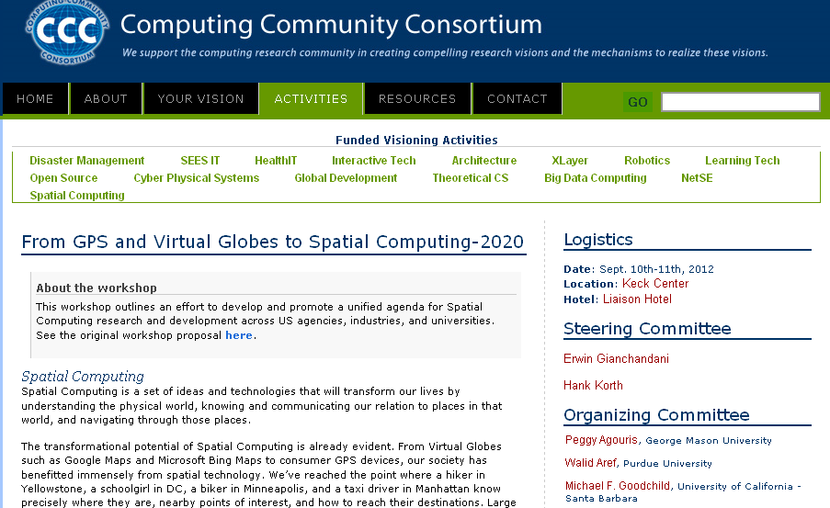
CCC Visioning Workshop: Making a Case for Spatial Computing 2020
http://cra.org/ccc/spatial_computing.php
54
54

Slide 55
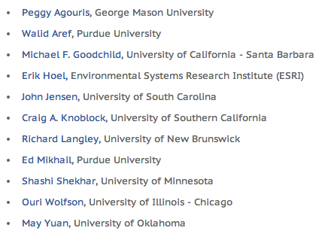





Workshop Highlights
Agenda
Identify fundamental research questions for individual computing disciplines
Identify cross-cutting research questions requiring novel, multi-disciplinary solutions
Organizing Committee

Slide 56

Primary Sources
  Spatial Computing, Communications of the ACM, 59(1), Jan. 2016.
  From GPS and Virtual Globes to Spatial Computing 2020, Computing Community Consortium Report, 2013.
  www.cra.org/ccc/visioning/visioning-activities/spatial-computing
Notes:
56
56

Slide 57
Outline
Why Interdisciplinary ?
Academic Case with Two disciplines
Multi-sector Case
Community Building
Conclusions

Slide 58
Lessons Learned
58
Interdisciplinary Research is rewarding but HARD
Reward: Solve complex societal problems
  Which may not be amenable to a single discipline
Hardest part is trying to understand the other domain
  Quote: “If you think Mathematics is hard, try learning Chinese.” - Peter Bol
  Analogy: “If you think learning Chinese is hard, try
    Learning language, culture and strengths of another discipline
    Developing trust across disciplines to find win-win
    Introspecting to understand when one needs help from another discipline
Crucial that both sides understand each other before research can begin
A lot of trial and error between both sides
Once an “Ah-ha” moment occurs
  The number of opportunities can be unlimited!

